Slide 1
Ethics of Information
Lisa Hoover
ERC 1110
X3760
Lhoover@Clarkson.edu
Calendly.com/lisahoover

Slide 2
What Is Information Ethics?
“Information ethics is concerned with ethical, legal and societal aspects of using information and information and communication technologies.” – UNESCO
Responsible creation of use and information
Freedom of expression, access to information, access to education, right to privacy, right to participate in cultural life (UNESCO)

Slide 3
Intellectual Property
Copyright, patents, trademarks, trade secrets
“To encourage the creation of valuable ideas, and protect them from being stolen, the U.S. legal system adopted the concept of intellectual property.” – MIT guide

Slide 4
Intellectual Property
Patents
A grant issued by the federal government giving an inventor the right to exclude others from making, having made, using, leasing, offering to sell, selling, or importing an invention in the United States. A patent, however, does not necessarily guarantee inventors the right to make, use or sell their inventions; in some cases, utilizing a patented invention depends on another person's prior, unexplored patent. Violating patent rights is known as infringement and can be litigated. Patent infringement occurs when one violates each element of at least one claim in a patent. – MIT guide
Copyrights
A right that protects original works of authorship fixed in a tangible medium of expression. Copyrights can include published and unpublished works—literary, dramatic, musical and dance compositions, films, photographs, audiovisual works, paintings, sculpture, and other visual works of art, as well as computer programs—from being copied. Copyright protects the expression of ideas, not the ideas themselves, and gives their authors exclusive rights to reproduce the copyrighted material. – MIT guide
Trademarks
A non-functional word, logo, slogan, symbol, design—or any combination of these—that distinguishes a product or service. Essentially brand names, trademarks promote competition by giving products corporate identity and marketing leverage. Trademarks do not need to be registered, but federal registration can help to protect the mark legally. – MIT guide
Trade Secrets
A formula, pattern, manufacturing process, method of doing business, or technical know-how that gives its holder a competitive advantage. Trade secrets cover a wide spectrum of information, including chemical compounds, machine patterns, customer lists and software. No federal law protecting trade secrets exists; legal definitions vary from state to state so inventors should make careful note of the requirements depending on the location. – MIT guide

Slide 5
BioPiracy, Traditional Knowledge & Natural Resources
Who owns genetic resources?
Who owns knowledge regarding use of plants or resources?
What is patentable?
Natural substances?
Genes?

Slide 6
BioPiracy, Traditional Knowledge & Natural Resources
Stevia
Cultivated by the Guarani people
“Coca-Cola, PepsiCo, and other companies have used the sugar alternative—which came from Guaraní lands, where it’s been used as a ceremonial medicine and sweetening agent for centuries—to build an estimated $492 million a year industry.” – Atlas Obscura
Now endangered in the wild
By FRANK HECKER from Atlas Obscura

Slide 7
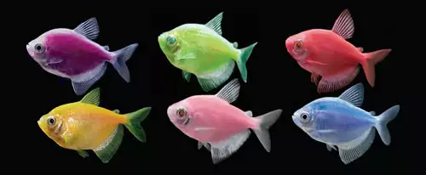
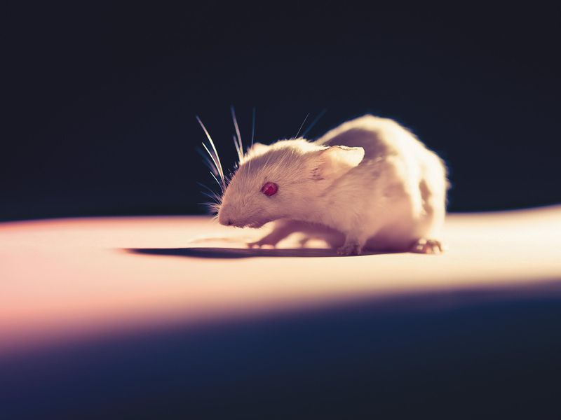
Economic
Times
Should we be able to patent/profit from living things, or parts of living things?
Smithsonian

Slide 8
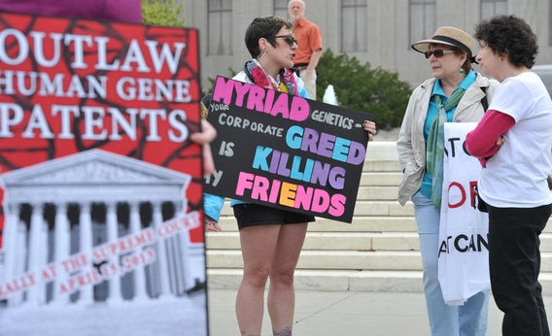
BioPiracy, Traditional Knowledge & Natural Resources
What about our genes?
Molecular Pathology v. Myriad Genetics, Inc (2013) - The US Supreme Court say human genes cannot be patented in the US because DNA is a product of nature. (NIH)
However, DNA manipulated in a lab can be patented because DNA sequences altered by humans are not found in nature (NIH)
John Moore - Moore’s spleen was removed by Dr. David Golde to slow progress of hairy-cell leukemia. Moore signed a consent form authorizing surgery. The doctors created a cell line from the cells extracted from Moore’s spleen. Moore was not informed. The cell line was patented in 1984. The California Supreme Court rejected Moore’s ownership claim as he was not one of the inventors, and there is no interested in discharged body tissues. However, the court did say a doctor has a “fiduciary duty” to inform a patient of any economic or personal interest in studying the patient’s tissues. (WIPO)
The Hagahai people of Papua New Guinea sought help for a disease. Researchers discovered they had a gene that predisposes humans to leukemia, which led to a potential vaccine for certain types of leukemia. The NIH sought a patent on a cell line developed from a Hagahai donor. The patent was later abandoned, but was controversial with regard to whether the donor had consented or should have consented to the creation of the cell line. (WIPO)
From Slate.com

Slide 9
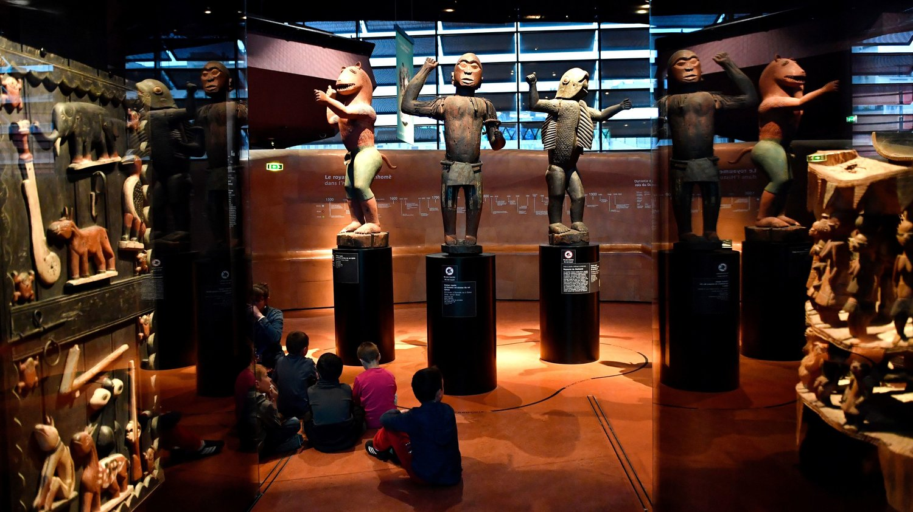
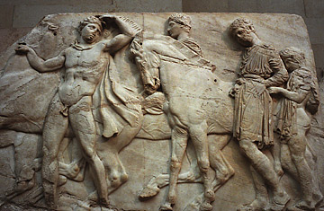
Dahomey art, now located in Paris. NPR
Who owns ancient art? The country (or modern equivalent) that created it? The country where it is found? The archaeologist who digs it up?
Elgin marbles - Time

Slide 10
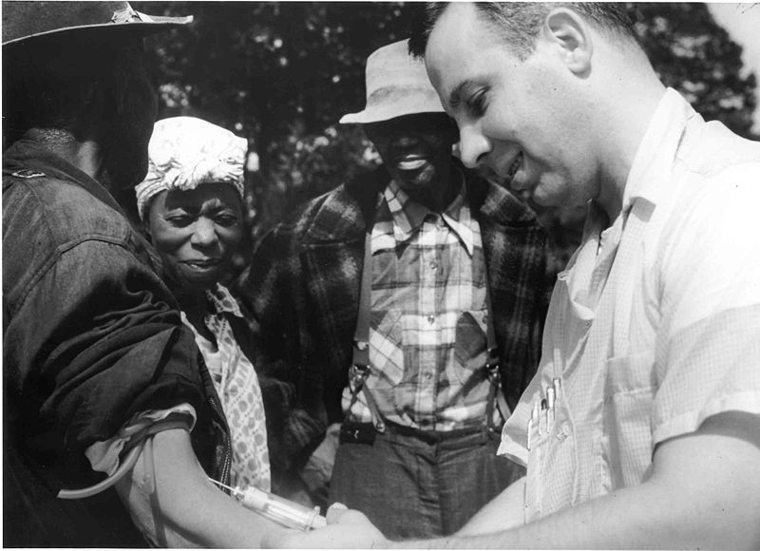
Ethics in Research
Nathan Schnurman Navy testing
Protective clothing
Sulfur mustard and Lewisite
No medical treatment, ordered not to talk about
1993 National Academy of Sciences exposed tests from 1944 to 1975 on at least 4,000 GIs
Also radiation testing
Tuskegee
US Public Health Service & Tuskegee Institute
“Untreated syphilis in the negro male”
600 men, 399 with syphilis
Started in 1932, penicillin not offered even after 1947 when it became standard of treatment
Study continued for 40 years
- Physicians Committee for Responsibly Medicine
From National Archives, via Wikimedia Commons

Slide 11
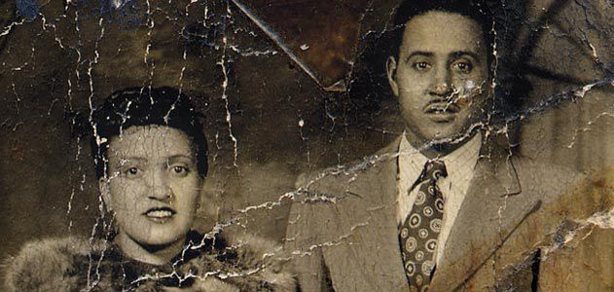
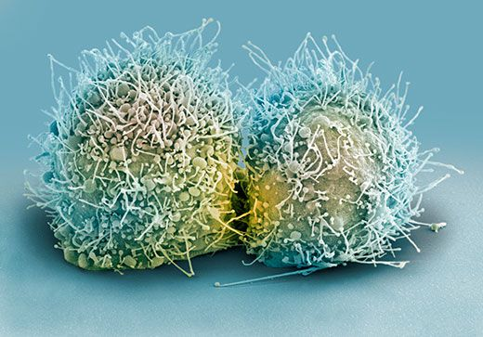
Henrietta Lacks (left) and her cells (bottom). From Smithsonian
In 1951 Henrietta Lacks (an African American woman) visited Johns Hopkins for treatment of a tumor on her cervix. Her doctors had been trying to cultivate certical cancer cells in the lab, but other patients’ cells had all died. Henrietta’s cells, nicknamed HeLa, thrived. They are still used to study toxins, drugs, hormones, viruses, etc. (Johns Hopkins) This later led to confusion and controversy on the part of Lacks’ family, along with anger at the medical community, especially given that her family was poor and often could not include medical insurance. (Smithsonian)

Slide 12
Ethics in Research
Confidentiality
Confidentiality refers to the obligation of organizations that collect information to ensure that no person or organization is likely to be identified from any data released. - Australian Bureau of Statistics
Consent
Voluntary
Informed
Human Subjects Testing
Belmont Report
Institutional Review Boards
Clarkson’s IRB

Slide 13
Ethics in Research
Belmont Report
1968 – ethical concerns raised
1973 Congress holds hearings, class-action lawsuit filed
National Research Act of 1974 is passed – creates the National Commission for the Protection of Human Subjects of Biomedical and Behavioral Research – the Commission writes The Belmont Report
Report sets ethical principles and guidelines for protections of human subjects research
$10 million out of court settlement, plus medical benefits and burial services for all living participants
2001 – President’s Council on Bioethics formed

Slide 14
Filter Bubbles
“A squirrel dying in your front yard may be more relevant to your interests right now than people dying in Africa.” – Mark Zuckerberg
“And the thing is, we've actually been here before as a society. In 1915, it's not like newspapers were sweating a lot about their civic responsibilities. Then people noticed that they were doing something really important. That, in fact, you couldn't have a functioning democracy if citizens didn't get a good flow of information.”
Today, “we need the new gatekeepers to encode that kind of responsibility into the code that they're writing.”
- Beware Online “Filter Bubbles” Ted Talk

Slide 15
Algorithms
“To give you the most useful information, Search algorithms look at many factors, including the words of your query, relevance and usability of pages, expertise of sources, and your location and settings. The weight applied to each factor varies depending on the nature of your query—for example, the freshness of the content plays a bigger role in answering queries about current news topics than it does about dictionary definitions.” – From Google
Factors considered by Google:
Meaning of your query
Relevance of webpages
Quality of the content
Usability of webpages
Context and settings
Relevance of Webpages
Matches keywords
Uses “aggregated and anonymized data to assess whether search results are relevant”
The algorithms “are not designed to analyze subjective concepts such as the viewpoint or political leaning of a page’s content”
Tries to weed out “manipulative” behavior

Slide 16
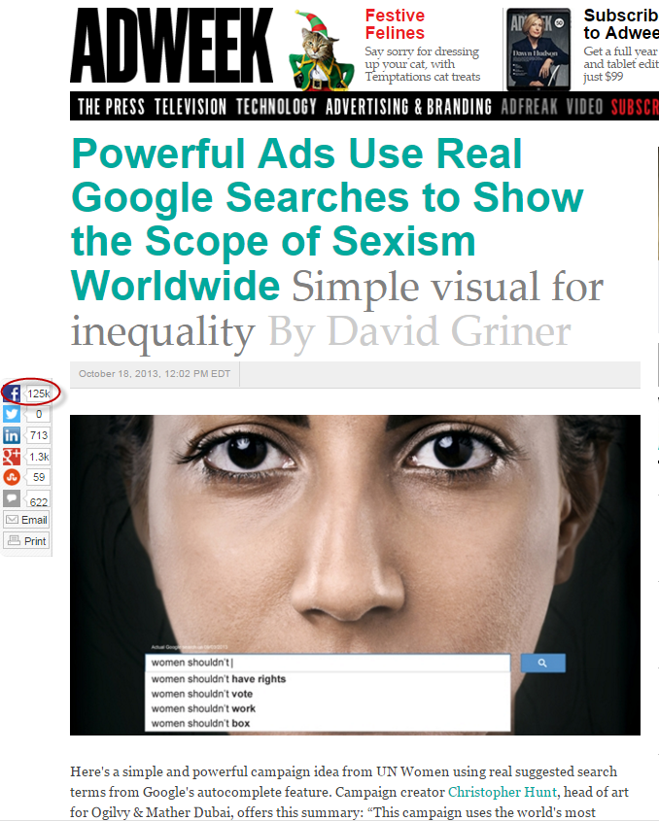
Algorithms
“Algorithms are rules, they're binary.… truth is never binary. Truth is a value. Truth is emotional it is fluid and above all it’s human.” - Markham Nolan
From Medium

Slide 17
Manipulation – Google Bombs
From The Atlantic & Wikipedia
A Google search for “murder” redirected to the Wikipedia page about abortion
A search for “miserable failure” returned George W. Bush’s official White House bio (similar campaigns directed at President Obama and Donald Trump)
Searching “more evil than Satan himself” returned the Microsoft homepage
Effort to push the anti-Semitic website Jew Watch down the results list by bumping the Wikipedia entry for Jews up the rankings
Waffles re-directed to Senator John Kerry
Steven Lerner created a webpage which asked users who searched French military victories if they meant French military defeats
Searching bad writers or Dumb & Dumber returned results on David Benioff & DB Weiss during season 8 of Game of Thrones
Has also been used commercially, known as “spamdexing”

Slide 18
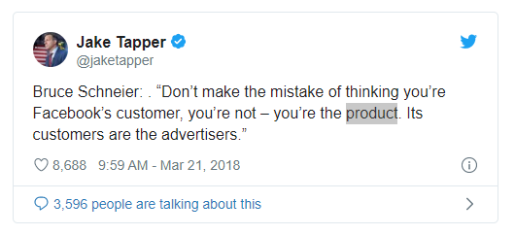
Privacy – What Does Google Know?
Name
Gender
Birthdate
Phone numbers
Recent Google searches
Websites I have visited
Where I have been
What I like
Where I work
Where I live
YouTube videos I have watched
What I have said to my Google assistant
NOTE: You can control what Search activity is used to improve your Search experience, including adjusting what data is saved to your Google account, at myaccount.google.com. To disable Search personalization based on activity in your account, turn off Web & App Activity.
NOTE: Visit Manage Ad Settings while logged in to Google, then toggle off Ads Personalization to stop ad customization
- How to find out what Google knows about you and limit the data it collects, CNBC

Slide 19
“In this groundbreaking work, Seth Stephens-Davidowitz, a Harvard-trained economist, former Google data scientist, and New York Times writer, argues that much of what we thought about people has been dead wrong. The reason? People lie, to friends, lovers, doctors, surveys—and themselves. However, we no longer need to rely on what people tell us. New data from the internet—the traces of information that billions of people leave on Google, social media, dating, and even pornography sites—finally reveals the truth.
Everybody Lies combines the informed analysis of Nate Silver’s The Signal and the Noise, the storytelling of Malcolm Gladwell’s Outliers, and the wit and fun of Stephen Dubner and Steven Levitt’s Freakonomics in a book that will change the way you view the world. There is almost no limit to what can be learned about human nature from Big Data—provided, that is, you ask the right questions.” – From Amazon
Main Campus Library Book Collection - 006.3 S8354e

Slide 20
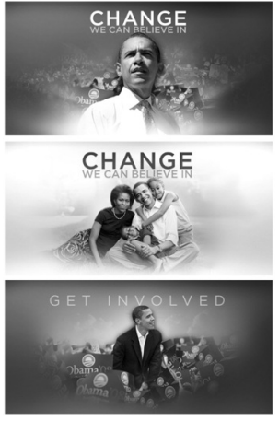
Which combination got the most clicks? Why?
Activity borrowed from Everybody Lies, Seth Stephens-Davidowitz

Slide 21
The winner? The Obama family + the “Learn More” button, by an estimated 40% more sign ups, roughly $60 million in funding.
- Everybody Lies, Seth Stephens-Davidowitz

Slide 22
Headline A | Headline B
Can the SnotBot drone save the whales? | Can this drone help save the whales?
Of course “deflated balls” is a top search term in Massachusetts | This top Mass. Google search term is pretty embarrassing
Hookup contest at heart of St. Paul rape trial | No charges in prep school sex scandal
Woman makes bank off rare baseball card | Woman makes $179,000 off rare baseball card
MBTA projects annual operating deficit will double by 2020 | Get ready: the MBTA’s deficit is about to double
How Massachusetts helped win you the right to birth control access | How Boston University helped end “crimes against chastity”
When the first subway opened in Boston | Cartoons from when the first subway opened in Boston
Victim and family in prep-school rape trial blame toxic culture | Victim and family in prep-school rape trial release statement
Guy in “Free Brady” hat is only one able to foil Miley Cyrus prank | Pats fan gets an eyeful for recognizing an undercover Miley Cyrus
Headlines tested by the Boston Globe
Which do you think got the most clicks? Why?
What does this tell us about human nature?
Does it bother you to think that news organizations are testing ways to get you to click?
Borrowed from Everybody Lies, Seth Stephens-Davidowitz

Slide 23
Headline A | Headline B
Can the SnotBot drone save the whales? | Can this drone help save the whales? | 53% more clicks
Of course “deflated balls” is a top search term in Massachusetts | This top Mass. Google search term is pretty embarrassing | 986% more clicks
Hookup contest at heart of St. Paul rape trial | No charges in prep school sex scandal | 108% more clicks
Woman makes bank off rare baseball card | Woman makes $179,000 off rare baseball card | 38% more clicks
MBTA projects annual operating deficit will double by 2020 | Get ready: the MBTA’s deficit is about to double | 62% more clicks
How Massachusetts helped win you the right to birth control access | How Boston University helped end “crimes against chastity” | 188% more clicks
When the first subway opened in Boston | Cartoons from when the first subway opened in Boston | 33% more clicks
Victim and family in prep-school rape trial blame toxic culture | Victim and family in prep-school rape trial release statement | 76% more clicks
Guy in “Free Brady” hat is only one able to foil Miley Cyrus prank | Pats fan gets an eyeful for recognizing an undercover Miley Cyrus | 67% more clicks

Slide 24
Other Issues
Reliability of Information
Access to information & open access/open data
Cost of information
Representation & inclusion in information
Sustainability
Participatory Culture

Slide 25
Resources
Clarkson Libraries Copyright, Patent & Trademark Guide
Belmont Report: https://www.hhs.gov/ohrp/regulations-and-policy/belmont-report/index.html
Clarkson Libraries Evaluating Sources Guide
Clarkson Libraries Issues in Scholarly Communications
Clarkson Libraries Expanding Our Worldview Guide
Clarkson’s IRB
World Intellectual Property Organization (WIPO)
Books
Everybody Lies: Big Data, New Data & What the Internet Reveals About Who We Really Are
Loot: The Battle Over Stolen Treasures of the Ancient World
The Genome Defense: Inside the Epic Legal Battle to Determine Who Owns Your DNA
The Immortal Life of Henrietta Lacks
Algorithms of Oppression: How Search Engines Reinforce Racism

