Slide 1
LW 466 NexisUni
Lisa Hoover
X3760
lhoover@Clarkson.edu
ERC 1110
Calendly.com/lisahoover

Slide 2
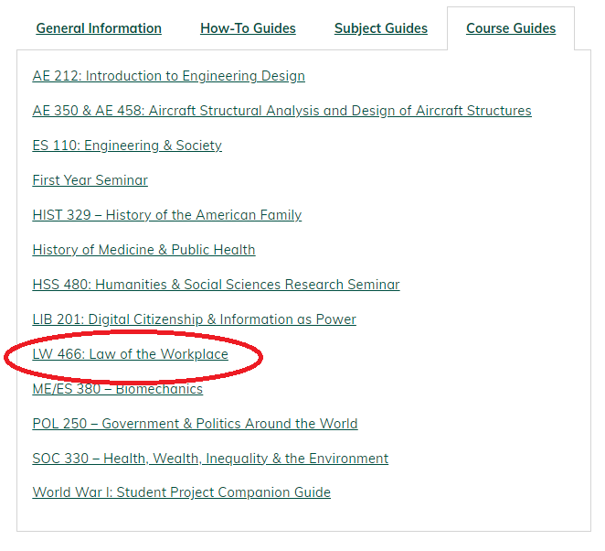
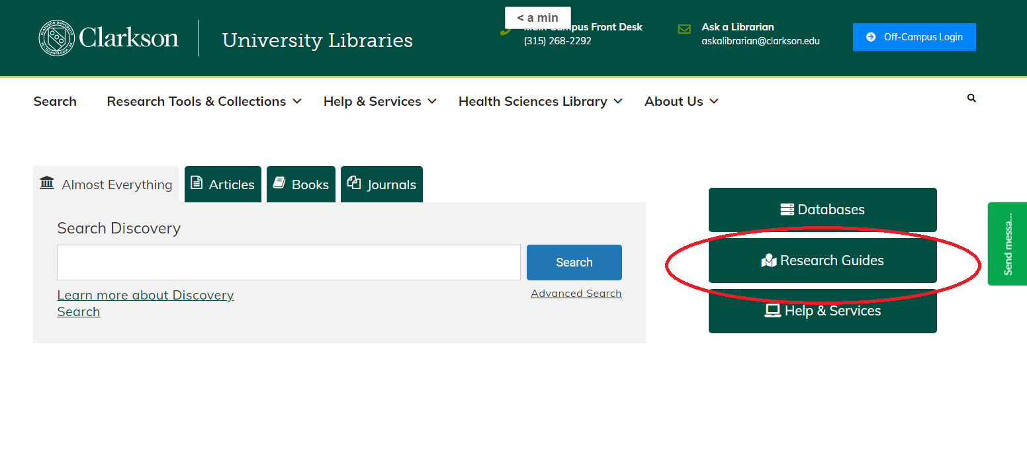
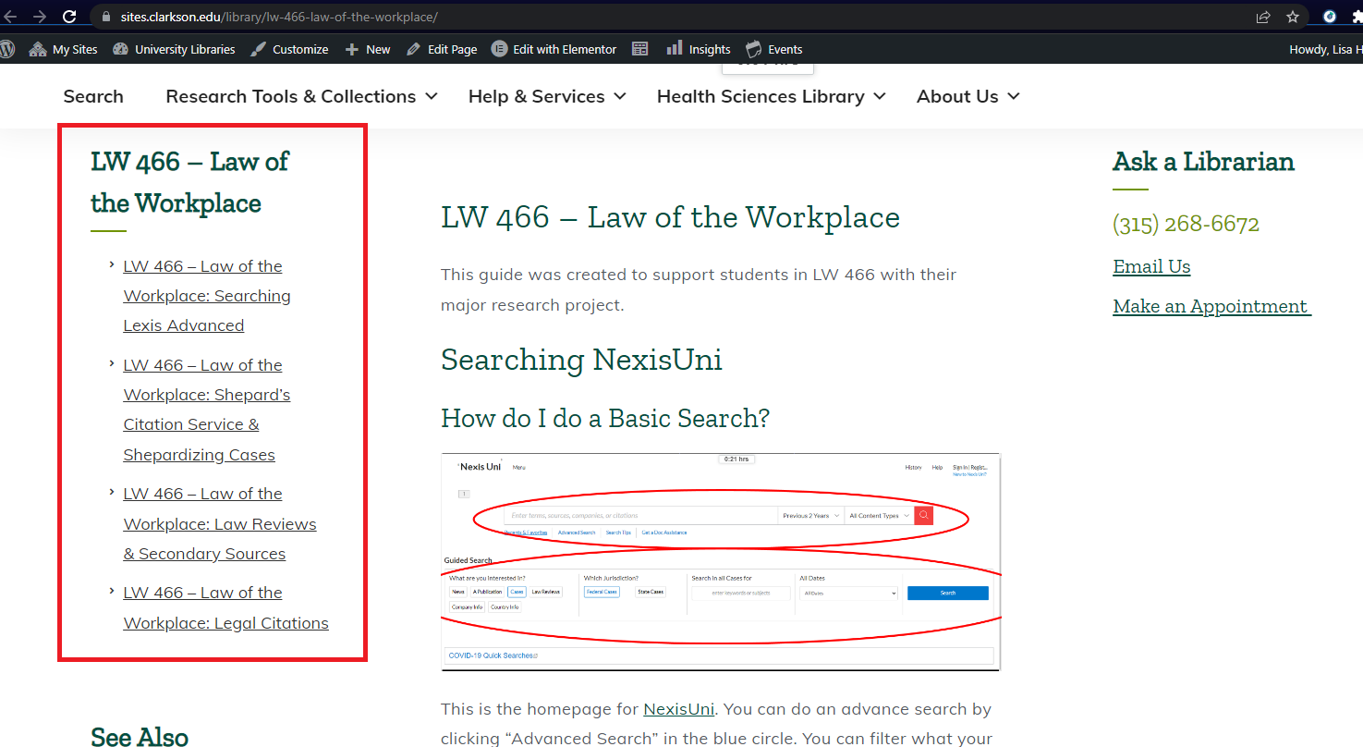

Slide 3
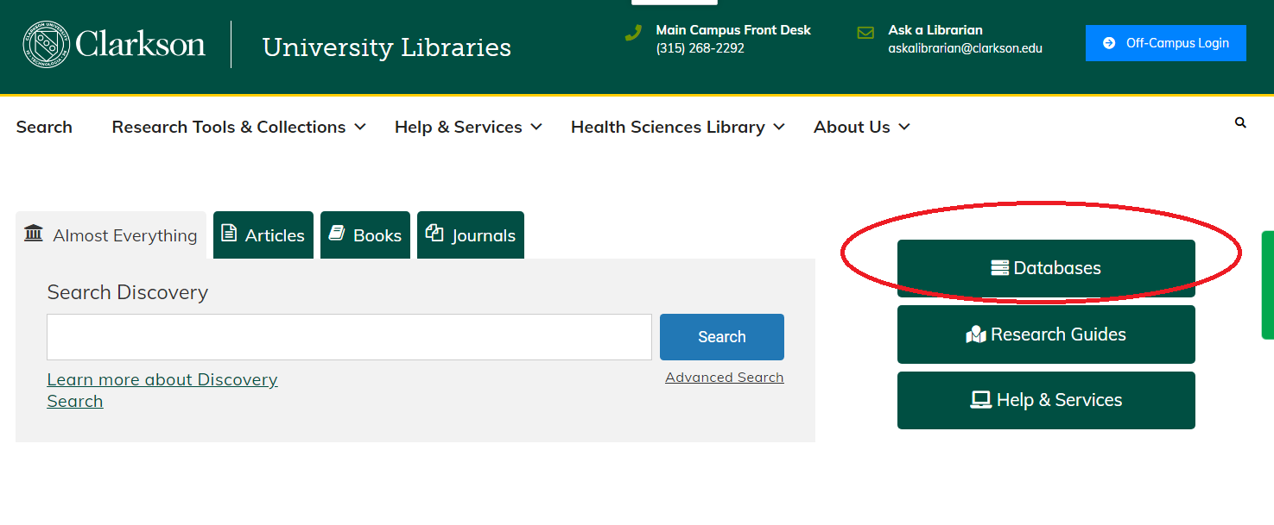
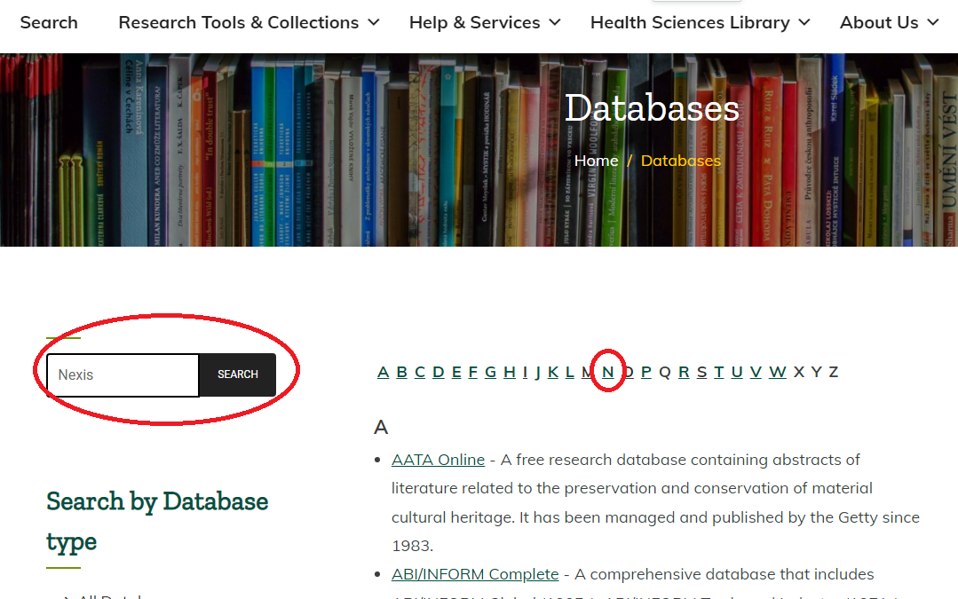

Slide 4
Basics

Slide 5
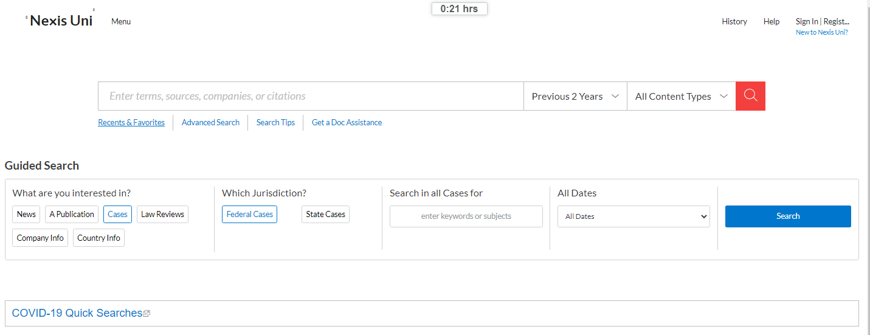

Slide 6
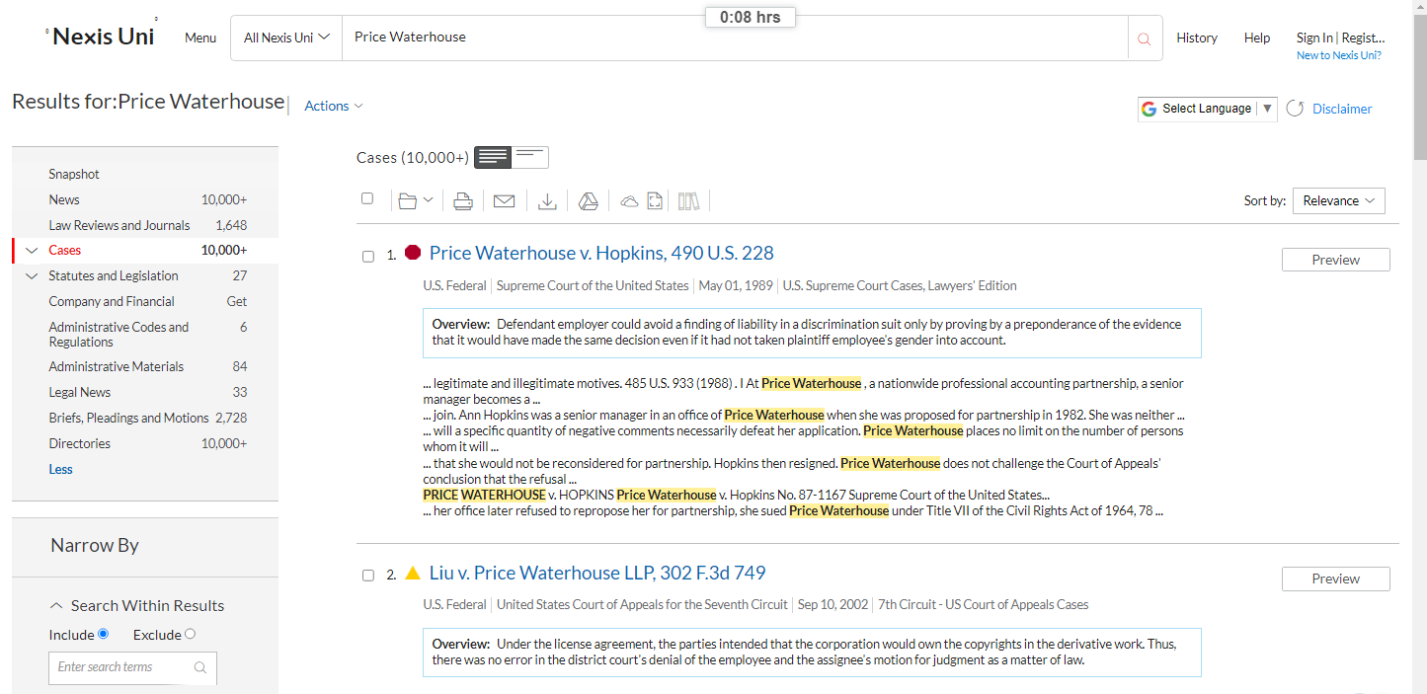
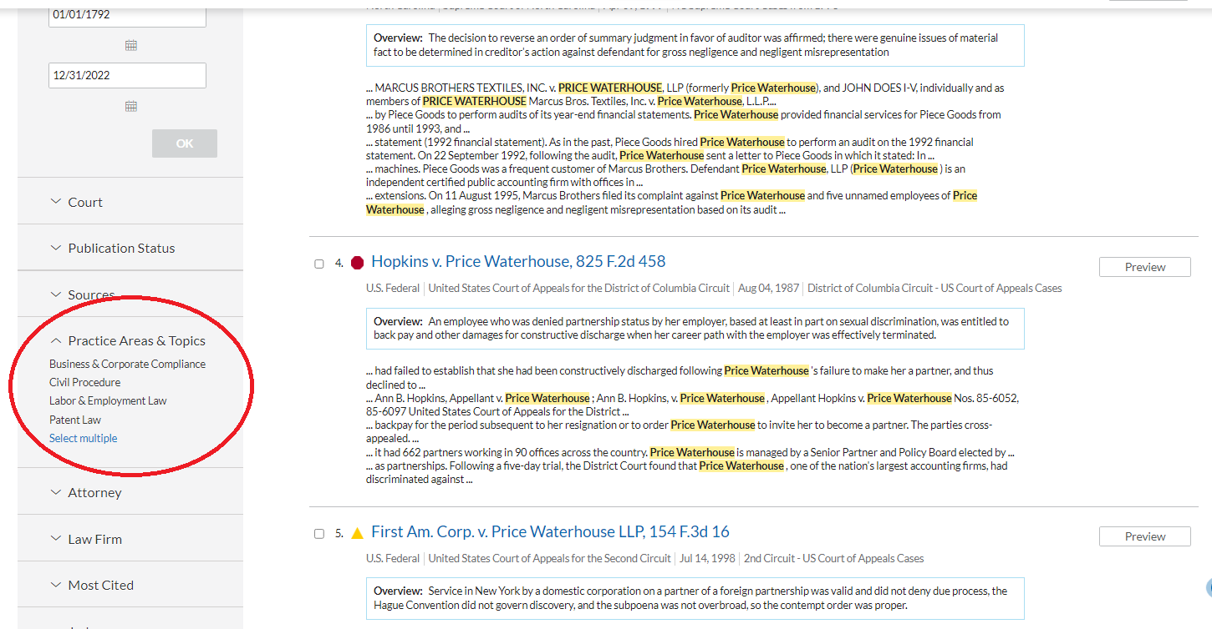

Slide 7
READING A CASE CITATION
Miranda v. Arizona, 384 US 436 (1966)
Party name
Party name
Reporter
Year of the decision
Volume of the reporter the case is found in
Starting page
of the case

Slide 8
READING A CASE CITATION
State v. Miranda, 98 Ariz. 11 (1965)
Party name
Reporter
Year of the decision
Party name
Volume of the reporter the case is found in
Starting page
of the case

Slide 9
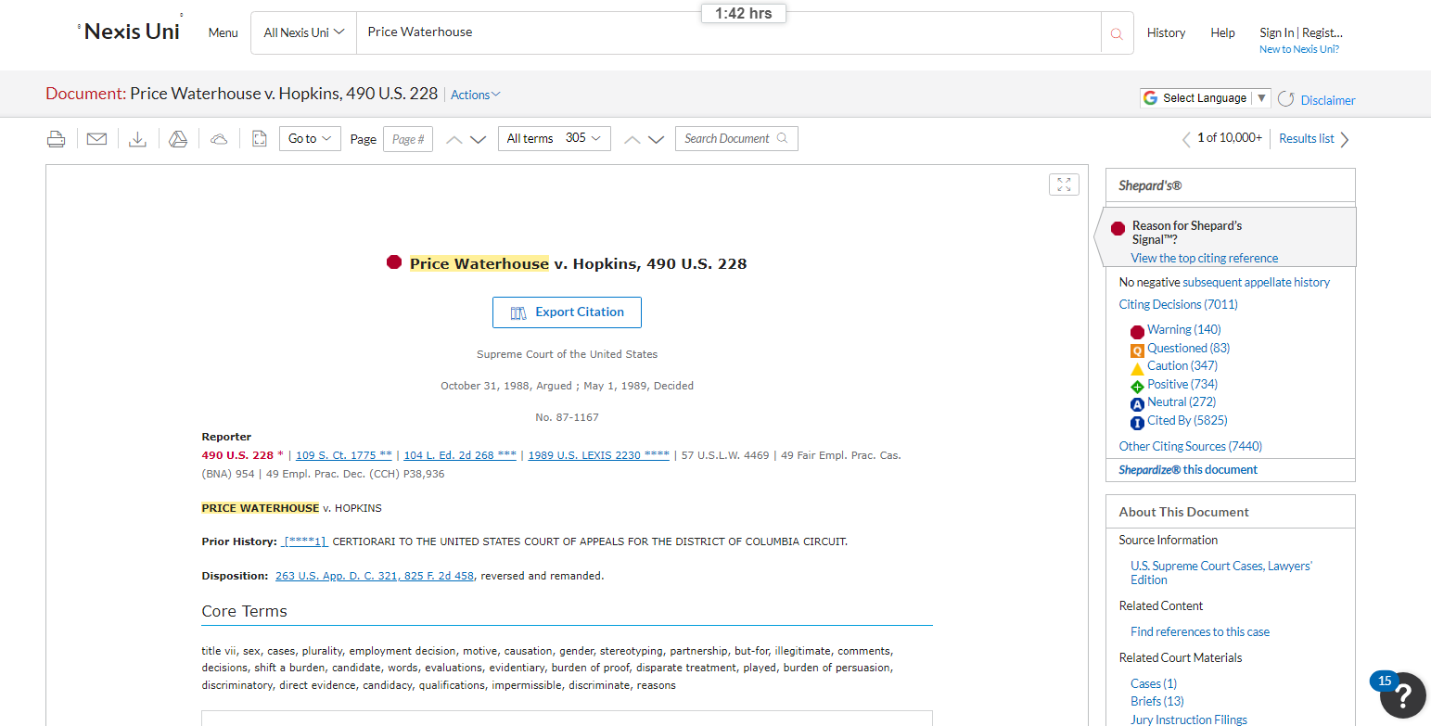

Slide 10
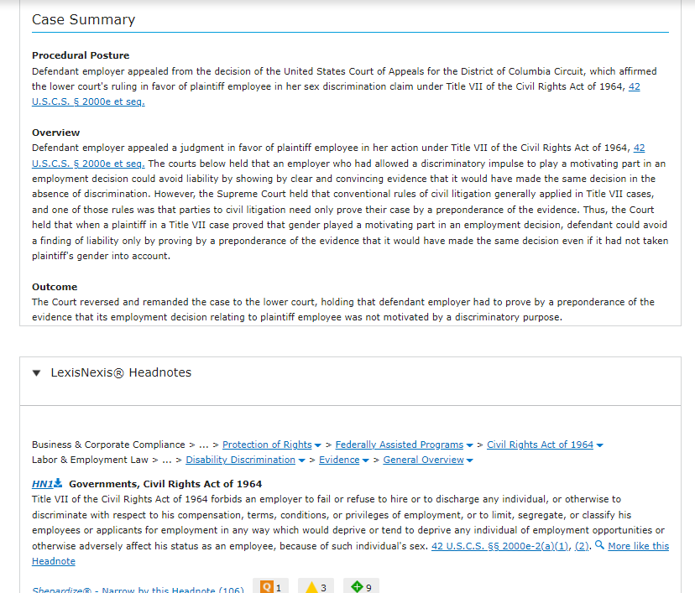

Slide 11
Shepardizing
Shepardizing a case refers to using sheaprd’s citations (also known as a citator) to identify other cases or authorities that have discussed the case you are looking at. You can use the process of shepardizing to determine your case’s current value as precedent. In other words, it can help you determine whether a case is still “good law.”

Slide 12
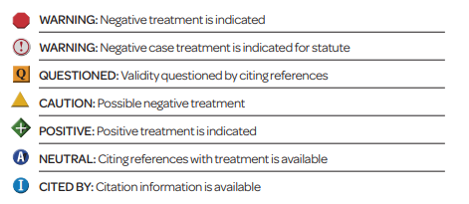

Slide 13
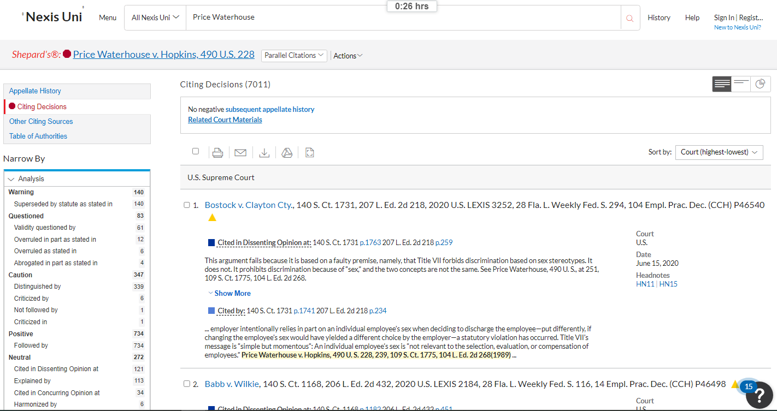

Slide 14
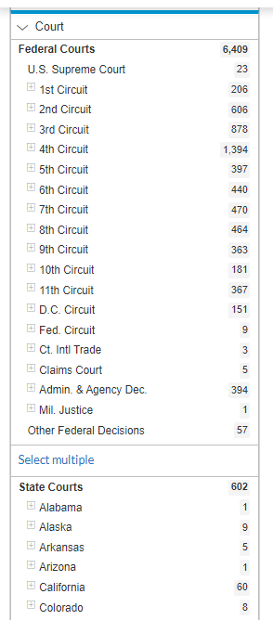
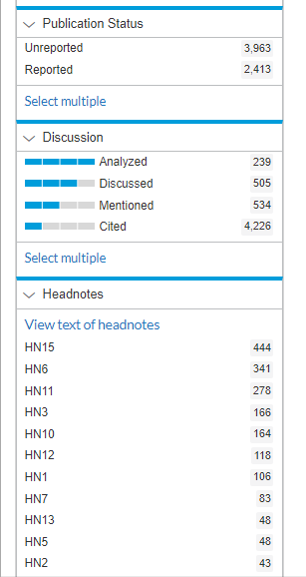

Slide 15
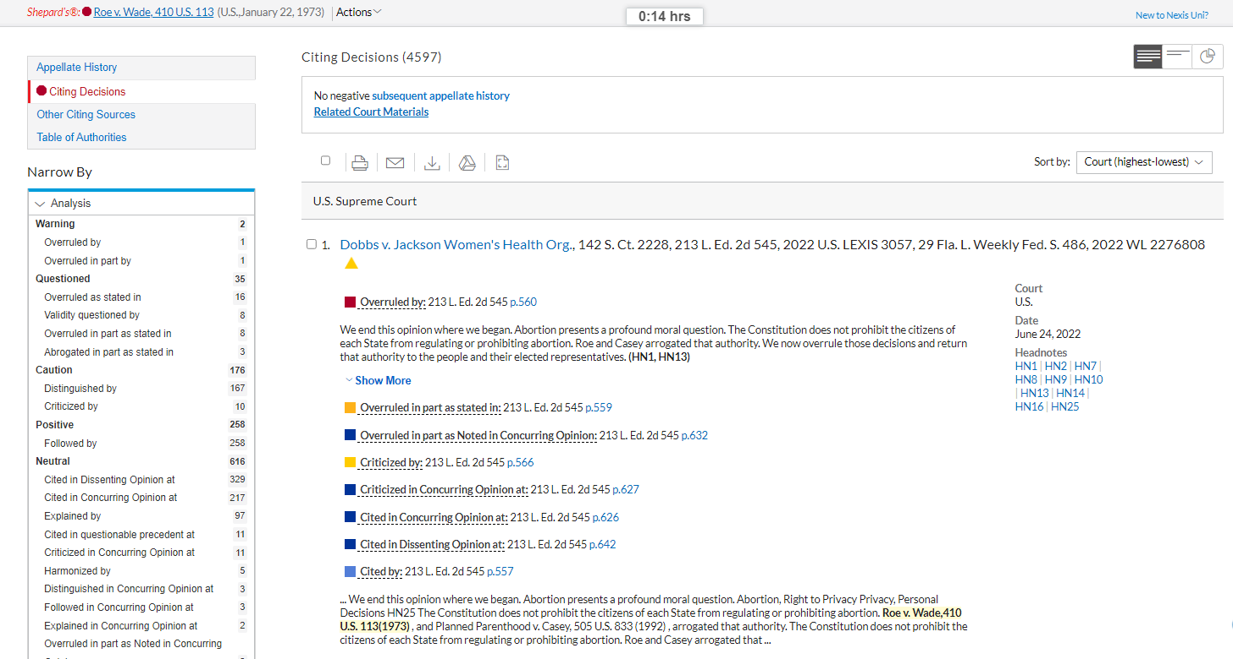

Slide 16
Secondary Sources
Secondary Sources
What is a law review?
A law review is a scholarly journal, usually from a group of students at a law school, focusing on legal issues. Articles are generally written by experts in the field, including law professors, judge and other legal professionals. Law students may write “notes” or “comments” included in the law review. Law reviews are the primary means by which legal professionals engaged in scholarship and discussion of legal issues.
What is a treatise?
A treatise focuses on a single area of law and is written by experts in that area. Treatises range from broad, multi-volume sets to narrowly focused one-volume titles. Practitioners rely heavily on treatises for the detailed coverage and practical tips they contain. The content varies tremendously, but you can usually find thorough explanations of the law at issue along with citations to relevant cases, statutes, regulations, and other secondary sources. Some treatises also contain the full text of these materials in appendices. (Georgetown Law) What is a restatement?
Restatements of the law, aka restatements, are a series of treatises that articulate the principles or rules for a specific area of law. They are secondary sources of law written and published by the American Law Institute (ALI) to clarify the law. Restatements currently exist for twenty areas of law such as contracts, law governing lawyers, and torts.
The ali created restatements to help courts understand and interpret the current common law. Thus, restatements synthesize and restate existing case law and statutes from various jurisdictions. As secondary sources, restatements are only a source of persuasive authority and do not replace precedents and controlling statutes. However, courts may choose to adopt or cite approvingly to restatement. (Cornell Law)

Slide 17
