Slide 1
Becoming a Research Guru:
Research Project Tips & Tricks
Sites with pay walls/ subscribed content
Sites with no links (or broken links) to them
New Websites
Sites with Technical Issues
Lisa Hoover
lhoover@clarkson.edu
Calendly.com/lisahoover
Sites web developers don’t want indexed
The Deep Web

Slide 2
Source: https://technology.ie/an-internet-minute/

Slide 3
So Where Do I Start?
Types of Sources:
Encyclopedias & Reference Materials
Books
Journal Articles
Also…
Primary Sources
Secondary Sources
Also…
Peer Reviewed & Scholarly Sources
Popular Materials
What’s the difference between a journal and a journal article?
What does “scholarly” mean?

Slide 4
What’s My Topic?
Start with a broad topic and consult reference materials like encyclopedias to get a general understanding of the issue
Consider the specific question you want to answer
Think about your search terms
Synonyms
Related concepts

Slide 5
Thesis & Final Paper
Specific
Question
Broad Topic

Slide 6
And, if we’re being honest…. Distractions!
Thesis & Final Paper
Third Search Search
Second Search
Specific
Question
First
Search
Broad Topic

Slide 7
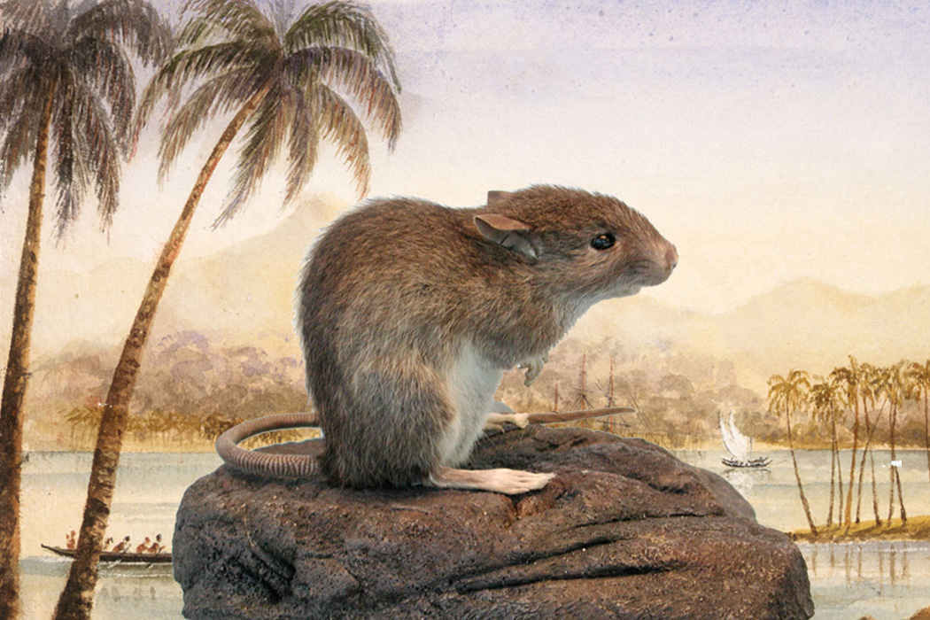
Down the Research Rat Hole
By
Christina Thompson
“And, although I went into this project knowing something about Pacific history, I am by no means an expert in many of these fields, which is why I have spent the last seven or eight years down one research rat hole after another.
A rat hole, according to Urban Dictionary, is a digression, often an unprofitable or distracting one. “Ratholes,” we are told, “usually open up when related but tangential topics are discussed which are explored in much more detail than is required.” Of course, as every researcher knows, it is difficult to determine at the outset which will be the tangential topics and which the essential. Which of many fascinating digressions will prove ultimately to have been a distraction and which will turn out to be the key to some fundamental understanding, the perfect illustration of an essential idea, a critical bridge from one part of the story to another? How to know which unlikely byway will lead to some valuable tidbit and which will dump you out unceremoniously in a dark and profitless dead end?”
The Polynesian rat (Rattus exulans)
via Wikimedia Commons/Flickr/ITHAKA

Slide 8
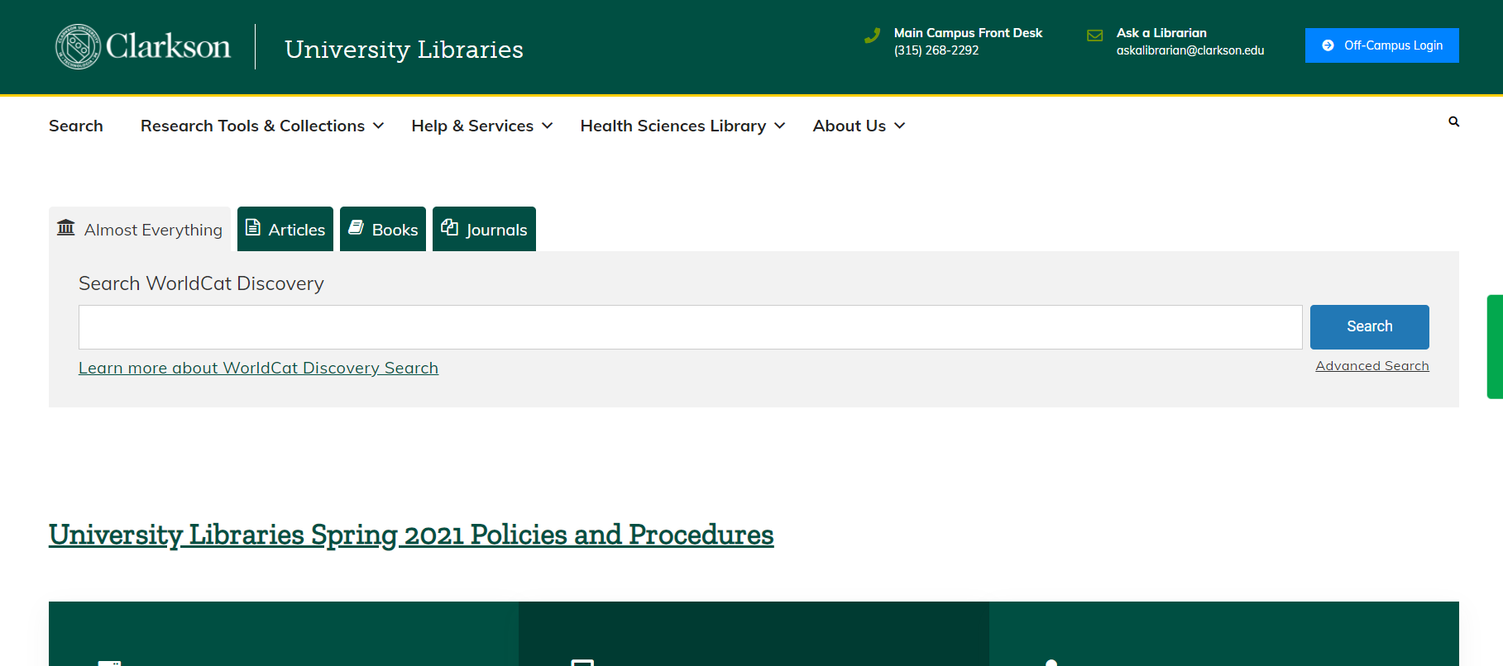

Slide 9
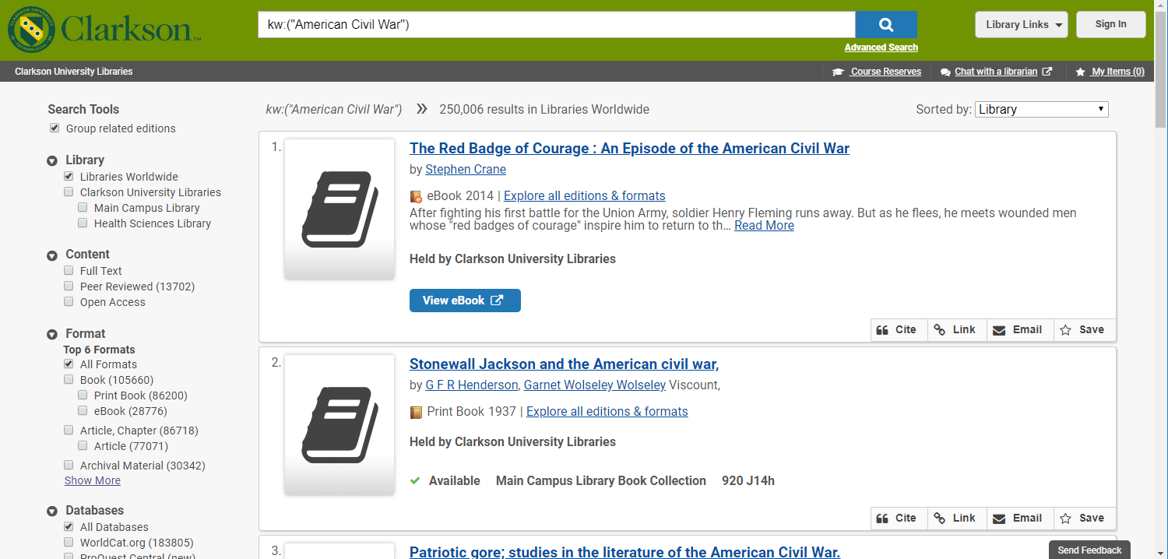
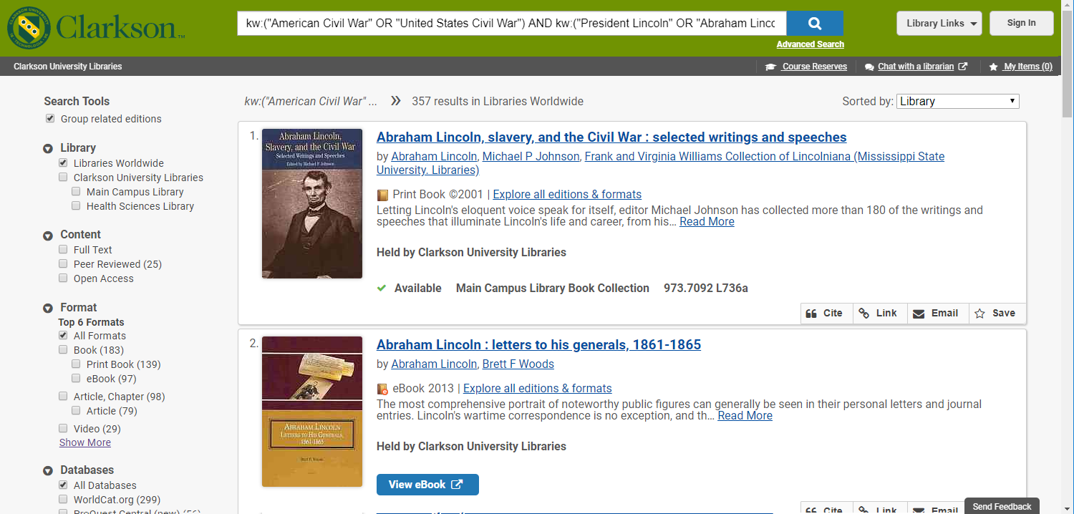
How did President Lincoln’s leadership contribute to the resolution of the Civil War?

Slide 10
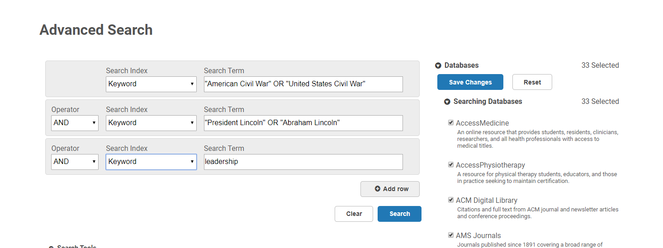

Slide 11
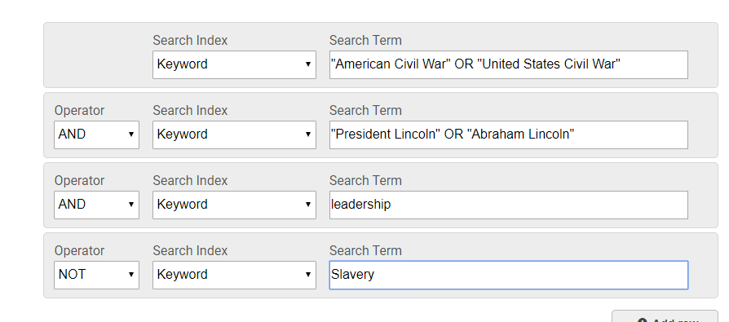
“American Civil War” OR “United States Civil War”

Slide 12
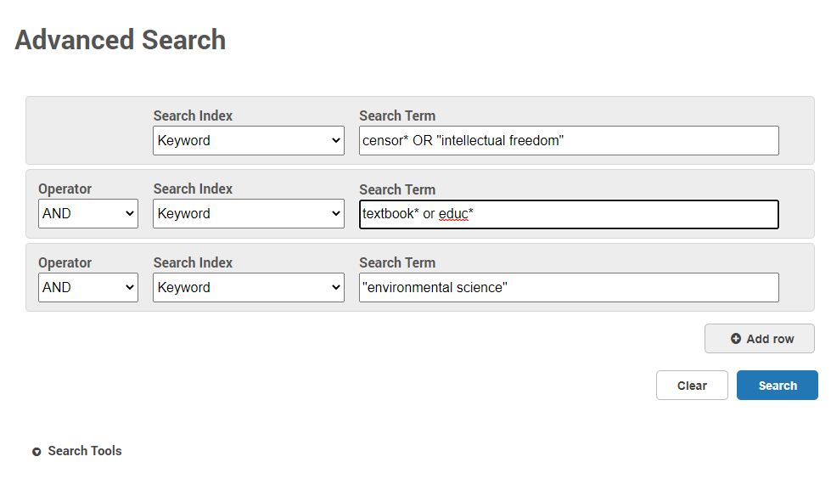
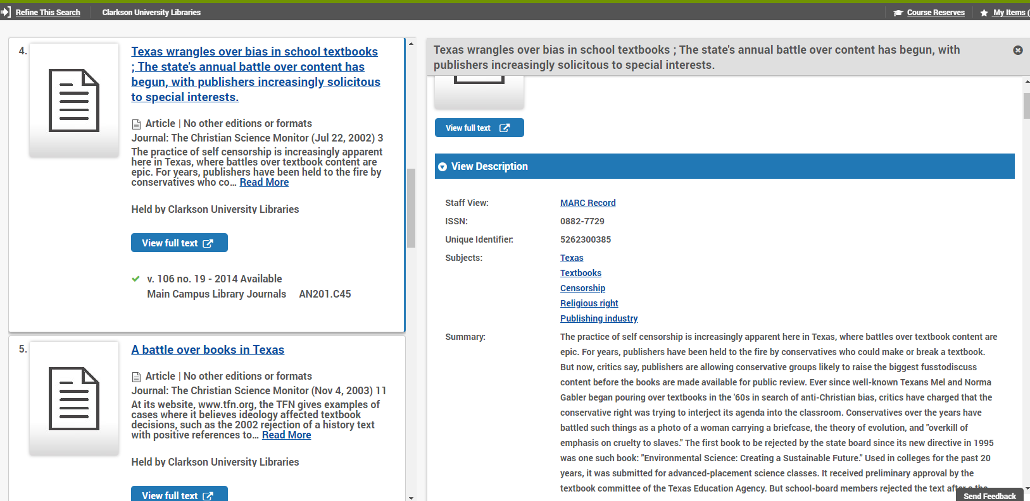

Slide 14
ZOTERO
Zotero is a free tool to help you collect, organize, cite and share your research.
It helps you save your citation information and track your sources
It allows you to organize your sources
It allows you to create in-text and reference list citations
Zotero Workshop
Tues, Mar 2 – 5pm
Zoom

Slide 15
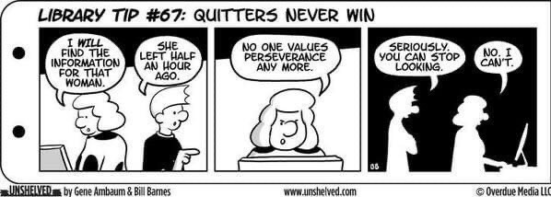

Slide 16
Your
Librarian

Slide 17
Lisa Hoover
lhoover@clarkson.edu
Calendly.com/lisahoover

