Slide 1
Graduate Workshop: Staying Up to Date in Business
Amber Dashnaw
Spring 2020

Slide 2
Staying Up to Date Can Be:
Time-Consuming
Information Overload

Slide 3
Why is it Important?
Build Credibility
Identify Opportunities for Growth
Don’t look Out-of-Date

Slide 4
Finding Journals
Journal Citation Reports
Journal of International Business Studies
The Economist
Consumer Reports
Forbes
Inc. Magazine
MIT Technology Review
Wired

Slide 5
Journal Alerts
Get an email when a new issue of a journal is released!

Slide 6
Table of Content Alerts
JournalTOCs
Publisher Websites
Databases

Slide 7
Mergent
Business and financial information for over 23,000 U.S. and international companies.
Search Alerts

Slide 8
Web of Science
Scholarly articles from 10,000+ social science and scientific journals. Includes cited reference tracking and impact factors.
Citation Alerts
Search Alerts
Journal Alerts

Slide 9
ABI/Inform Complete (ProQuest)
Mostly full text journal articles, dissertations, working papers, market & industry reports, business oriented news, downloadable data. Business, economics, management theory, marketing, accounting, finance topics.
Search Alerts

Slide 10
Other Business Databases
ProQuest Databases
Business Market Research Collection
Hoover’s Company Profile
GALE Databases
Business Insights: Essentials
Small Business Collection
Ebsco Databases
Business Abstracts
Applied Science & Business Periodicals Retrospective: 1913-1983
Small Business Reference Center

Slide 11
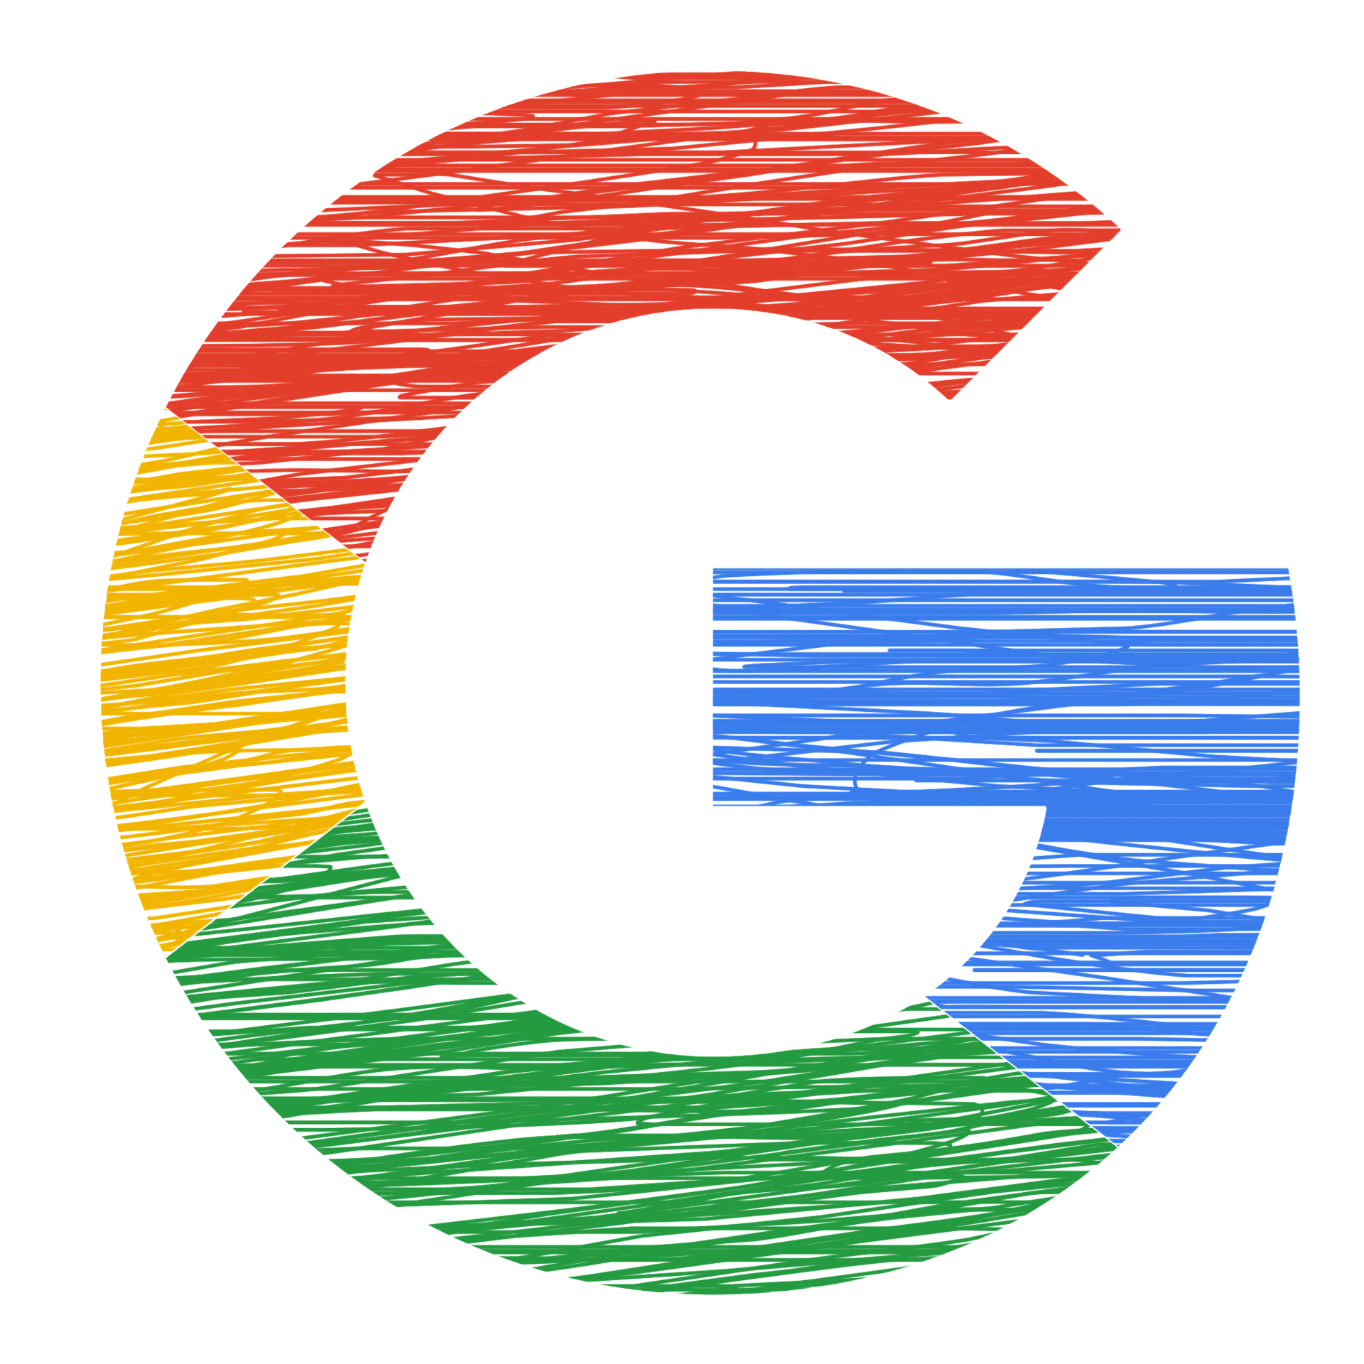
Google Alerts
Create a Google account if you do not already have one.
Go to https://www.google.com/alerts
Fill in the search terms for the topic you wish to monitor, and other details in the Create Alert box.
Enter your email address.
Create your alert.*
*You can run a number of alerts concurrently, and revisit your Google Alerts account to modify/add/remove alerts.

Slide 12
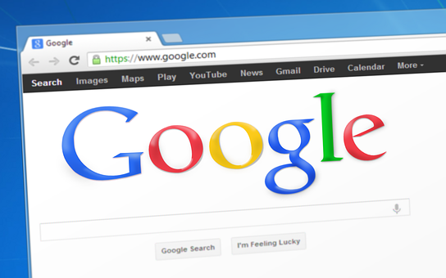
Google Citation Alerts
Follow Authors
Follow Citations
Follow Recommended Articles

Slide 13
RSS Feeds
Keep current on websites which frequently update their content
Readers:
Feedly
The Old Reader
NewsBlur
NetVibes
CommaFeed
News and Social Media Dashboard Apps (with options to import RSS Feeds):
FlipBoard
Google Play Newsstand
Other options include:
Emailing yourself a feed.
Integrating RSS into your email using Outlook, Gmail, or Thunderbird.
Downloading the app version of your RSS feed reader to your smartphone or tablet.

Slide 14
Conferences
Conference Alerts
Conference Series
Professional Organizations

Slide 15
Call for Papers
Call for Papers Wiki
Thecfplist
ResearchBib Call for Papers
Call4paper
Elsevier Call for Papers

Slide 16
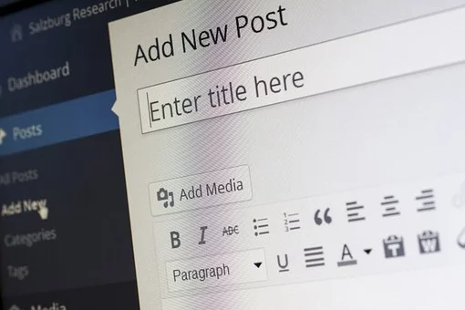
Social Media
Blogs
Blog Directories
https://alltop.com/
http://technorati.com/

Slide 17
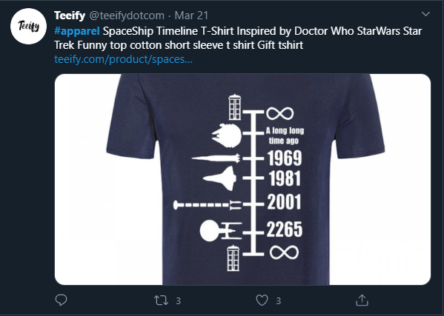
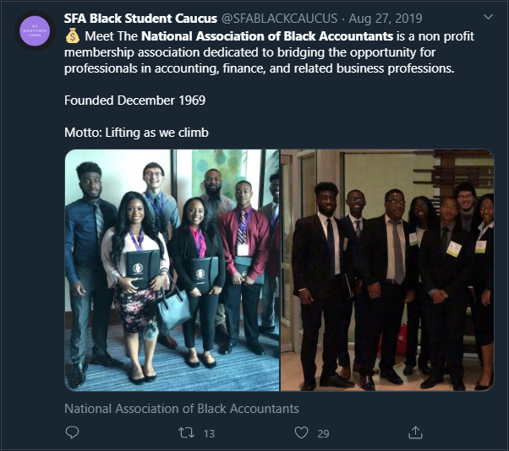
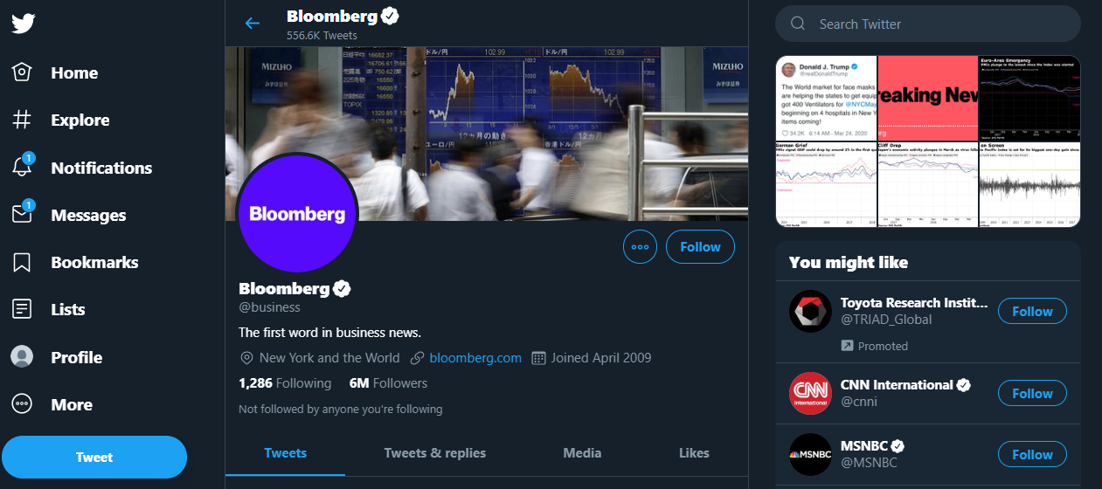
Social Media
Twitter
News sources
Organizations
Professional Associations
Track hashtags
Professional conferences

Slide 18
Social Media
LinkedIn
Organizations
Group Pages
Company Pages

Slide 19
Social Media
Academic Networks
Howcanishareit?
Mendeley
Academia.edu
ResearchGate

Slide 20
Citation Management Tools

Slide 21
Summary
Set up citation alerts for your own works
Set up article alerts for academics in your field
Set up article alerts for key topics in your field
Check Google Scholar’s “recommended” once a month
Subscribe to Table of Contents alerts
Periodically Review Core Journals in your field

Slide 22
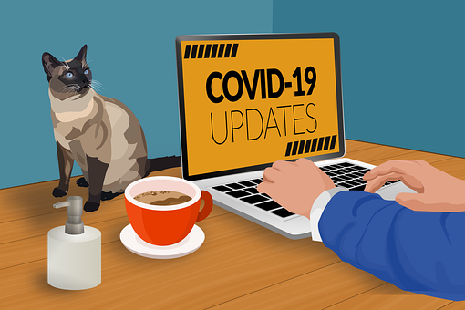
Contact Me
Amber Dashnaw
aldashnaw@clarkson.edu
(315) 268-4454

