Slide 1
Citation Management Tools
collect collaborate create

Slide 2
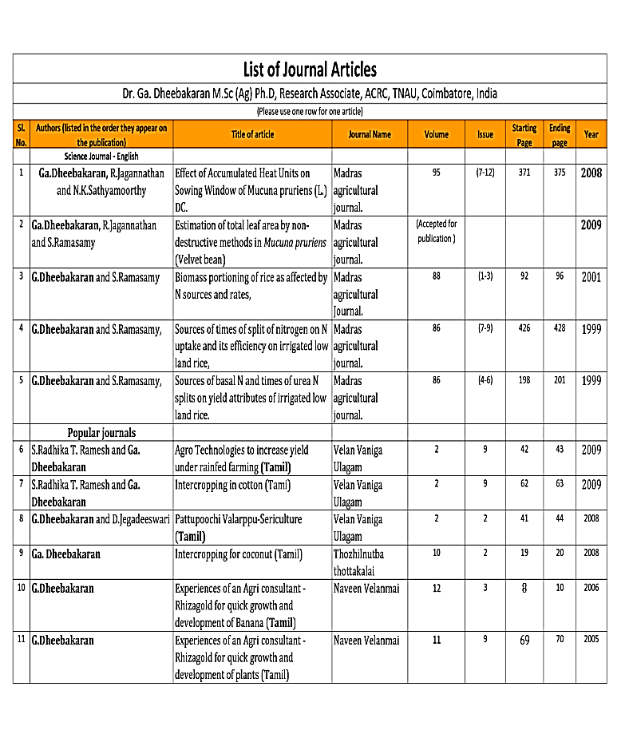
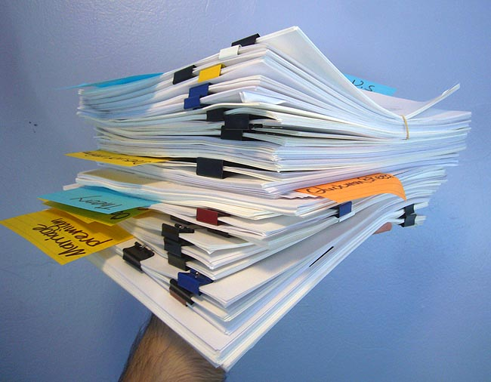
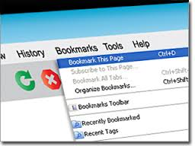
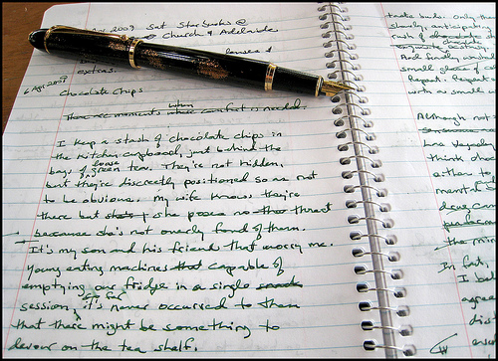
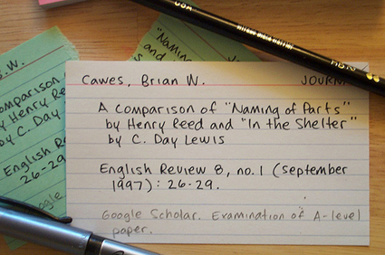
How do you keep track of your research?

Slide 3
Why Use Citation Management Software?
save references all in ONE place
organized and searchable database
maintain consistent & accurate records
share references
create & format in-text citations & bibliographies in a variety of styles

Slide 4
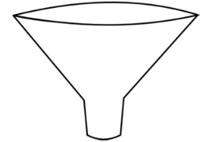
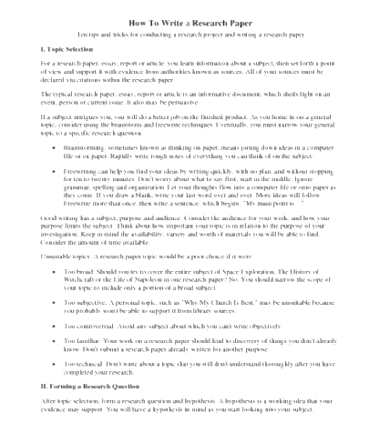
article & book info from Google Scholar
article info from databases like Web of Science ProQuest, etc.
info & data from websites & other sources
book info from library catalogs
add references
Your document:
research paper
dissertation
conference paper
organize collections
your citation
database
save notes & pdfs
insert citations & create bibliographies
share references

Slide 5
Free Citation Management Softwares
Download
Zotero Desktop
Zotero Web Importer
Zotero Microsoft Word Integration
Download
Mendeley Desktop
Mendeley Web Importer
Mendeley Microsoft Word Integration

Slide 6
Free Citation Management Softwares
Zotero.org
Mendeley.com

Slide 7
Free Citation Management Software: Both Products
Integrate with Microsoft Word
Have Web Browser Integrations (Firefox & Chrome)
Have Group Sharing Options
Access your library from anywhere (web based library)
Offer over 7,000 citation styles
Drag & Drop PDF files directly into your library
Create an Unlimited Number of Folders

Slide 8
Free Citation Management Software: Differences
Zotero
Mendeley
300MB free storage space
Open Source Software
Works with Google Docs
Has Safari web connector
Can save snapshots of webpages for easy referral
Third-party apps available for mobile devices
2GB free storage space
Owned by Elsevier (may not always be free)
Has Literature Review & Related Items search feature
Research Networking Groups
Take Notes & Highlight within PDFs
Apps available for iPad & for Android Tablets

Slide 9
Library Workshops: Spring 2020
2/25 Citation Management Systems
3/3 Data Visualization
3/10 Scholarly Publishing
3/24 Staying up to Date: Business
3/31 Building your Online Presence and Demonstrating your Research Impact
4/7 Staying up to Date: Humanities
4/14 Staying up to Date: Engineering
4/21 Staying up to Date: The Sciences

Slide 10
Contact Me
Amber Dashnaw
aldashnaw@Clarkson.edu
(315) 268-4454
Office: ERC 1109

