Slide 1
Graduate Workshop: Finding Data & Statistics
Amber Dashnaw
Spring 2020

Slide 2
Difference Between:
Data
Statistics
Raw information
Results of research that was conducted
Displayed in datasets and/or machine readable data files
Used to create new information
Reported numbers or percentages
Results of data analysis
Displayed in Tables, charts, and/or graphs
Answers “how much” or “how many”

Slide 3
When to Use:
Data
Statistics
An in-depth analysis
Test a hypothesis
Develop a comprehensive marketing strategy
Strengthen a point
Presentation
Paper

Slide 4
Basic Tips When Searching
Begin:
consider where you might reasonably expect to find the information you are seeking.
An approach that may not work well is searching the open web
Is the information coming from a reliable source?

Slide 5
Types of Data
Cross-Sectional: data that are only collected once
Time Series: study the same variable over time
Longitudinal Studies: surveys that are conducted repeatedly and have the same group of respondents

Slide 6
Finding Data: What do I need to know about my topic?
#1 Who or What?
Population you want to study
#2 When?
Period of time you want to study
#3 Where?
Geography or place you want to study
Pick a topic you can adapt to available information

Slide 7
Finding Data: Ask yourself
Who might collect this data?
(government agency, organization, institution, or group)
Who might publish this data?
(government agency, organization, institution, or group)
Is it likely that the data will be made readily available?

Slide 8
Strategy for Finding Data: Identify Potential Producers
Government Agencies
Non-Government Organizations
Academic Institutions
Private Sector

Slide 9
Strategy for Finding Data: Search in a Data Archive
Data repositories collect within subject areas
Open Access Data Repositories
Registry of Research Data Repositories
COnnecting REpositories CORE
Open Access Academy Repositories
University of Minnesota Data Archives
Nature Research Recommended Repositories

Slide 10
Strategy for Finding Data: Search in the Literature
Clarkson Library Catalog
Databases List

Slide 11
Strategy for Finding Data: Turn to the Literature
Unfortunately, citation of research data is often incomplete.
Check to see if the data or a related publication are cited and follow it up.
Don't commit this fallacy when you publish,
cite your data.

Slide 12
Strategy for Finding Data: Statistics Lead to Data
If your find a source that contains a statistic:
where did their data come from?

Slide 13
Strategy for Finding Data: Access to Data Sets
Government Agencies
University Repositories
Topical Data Archives
Contact the Data Producer Directly
Government Document section of the Library

Slide 14
Research Using Secondary Analyses of Published Data
Sharing Clinical Research Data: Workshop Summary by Steve Olson
Reworking Qualitative Data by Janet Heaton
Analyzing Quantitative Data: From Description to Explanation by Norman Blaikie
Using Secondary Data in Educational and Social Research by Emma Smith

Slide 15
Evaluating Data
Is the data appropriate?
Does it come from an authoritative source?
Does it cover your where, when, who, and/or what requirements?
Are you willing to compromise your topic or manipulate the data to meet your needs?

Slide 16
Analyze Data
The process of cleaning, transforming, and modeling data to discover useful information for decision-making

Slide 17
Analyze Data
Codebook: describes the content, structure, and layout of the data collection.

Slide 18
Analyze Data
Princeton University: Data Analysis Guide
University of Michigan: Find & Analyze Data
Harvard University: Research Technology Guide

Slide 19
Cite Data
A dataset citation includes all of the same components as any other citation:
author
title
year of publication
publisher (for data, this is often the archive where it is housed),
edition or version
access information (a URL, DOI or other persistent identifier)

Slide 20
Finding Statistics: What do I need to know about my topic?
No matter the subject statistics are limited by Time Frame and Geography
Time Frame: Single point in time? Changes over time? Historical Information?
Geography: Political boundaries (nations, states, counties, cities) or statistical boundaries (metropolitan areas, block groups, etc.)
Define your topic to adapt to available information

Slide 21
Finding Statistics: Time Frame
Current statistics will likely be unavailable

Slide 22
Strategy for Finding Statistics: Identify Potential Producers
Government Agencies
Non-Government Organizations
Academic Institutions
Private Sector

Slide 23
Strategy for Finding Statistics: Statistical Websites
Bureau of Justice Statistics
Bureau of Labor Statistics
Bureau of Transportation Statistics
Centers for Disease Control and Prevention: FastStats
ChildStats.gov
Data.gov
Data and Statistics about the United States
Department of Homeland Security: Data
FedStats
Global Health Observatory
Integrated Postsecondary Education Data System (IPEDS)
International Statistical Agencies
National Center for Charitable Statistics
National Center for Education Statistics (NCES)
National Center for Health Statistics
Organization for Economic Co-operation and Development
Statistics on Child and Family Well-Being
U.S. Census Bureau
U.S. Energy Information Administration
U.S. Statistical Abstract
UNESCO Institute for Statistics
UNSD Statistical Databases
World Bank Open Data

Slide 24
Strategy for Finding Statistics: Search in the Literature
Clarkson Library Catalog
Databases List
Statista
https://www.youtube.com/watch?v=aKtjemx4LdA

Slide 25
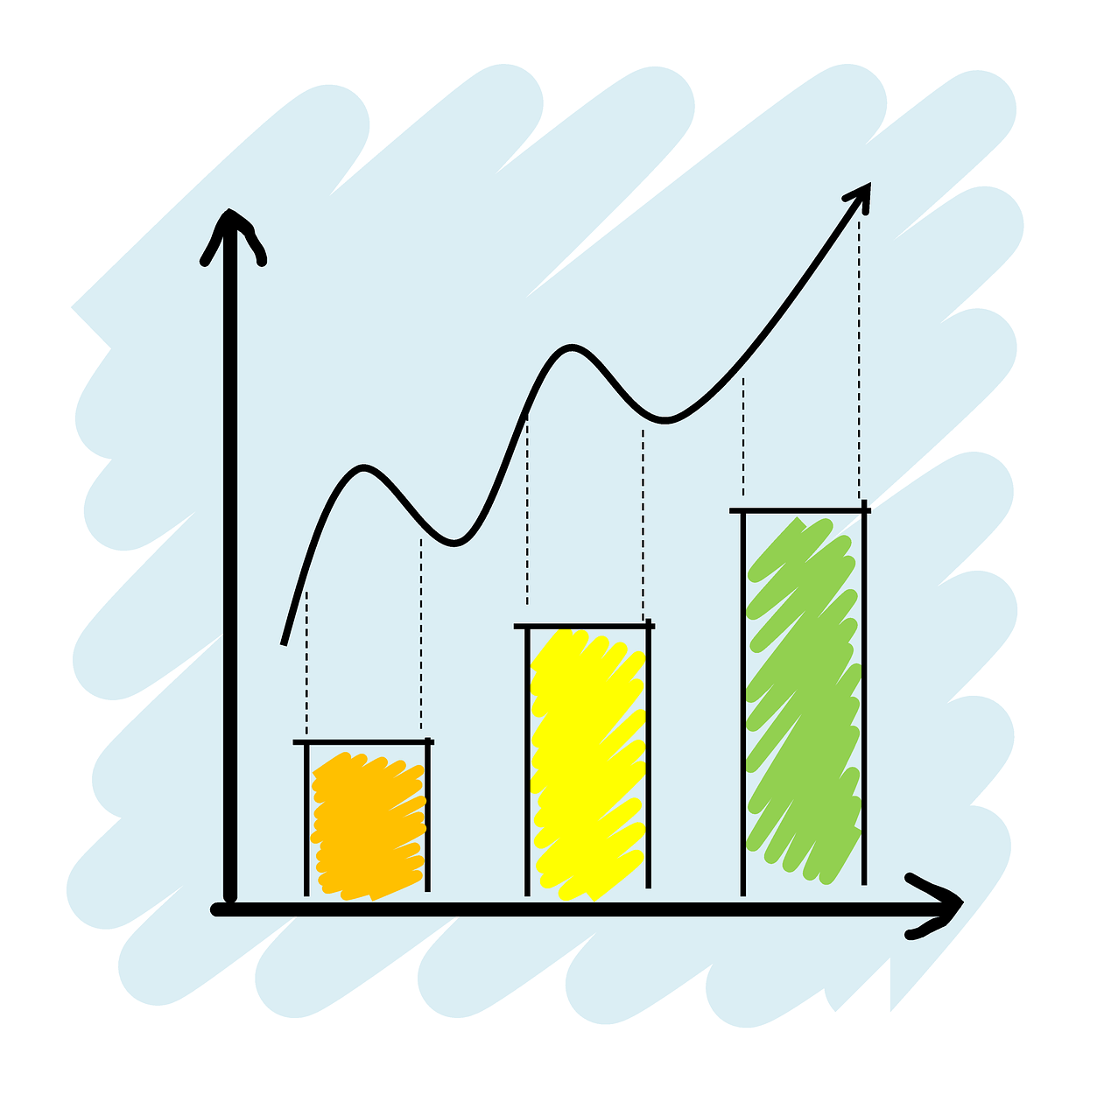
Evaluating Statistics Don’t take statistics at face value
Consider the source and method used to create the statistics
How current are they?
Who is the author?
Who is the intended audience?
Can the data be cross-checked?
Can the statistics be verified?
Be a critical information consumer!

Slide 26
Cite your Statistics
From a website:
Like any other website (same for books, journals, databases, etc.)

Slide 27
Questions?
Amber Dashnaw
aldashnaw@clarkson.edu
(315) 268-4454
Office: ERC 1109

