Slide 1
Graduate Workshop: Dissertation Literature Review Workshop
Amber Dashnaw
Fall 2020

Slide 2
This Workshop:
Will discuss the LITERATURE REVIEW portion of your dissertation ONLY
IS NOT a comprehensive guide to preparing and/or submitting your dissertation
Clarkson University Completion Requirements
Contact: graduate@clarkson.edu

Slide 3
What is a Literature Review?
Provides critical assessment of the sources you have read surrounding your subject area
Identifies the “gap” in that literature that your research will attempt to address

Slide 4
Dissertation Literature Review
IS NOT a summary of important sources
IS NOT a research paper
IS a critical engagement with the sources

Slide 5
Purpose of a Literature Review
What information already exists?
Demonstrate relationships between previous studies and theories
Identify gaps in previous research
Find other people working in the field
Identify major works
Identify main methodologies & research techniques
Identify main ideas, conclusions, and theories and establish similarities and differences
Provide the context for your own research

Slide 6
What is the “Gap”?
The missing piece and/or pieces in the research literature that have not been explored or have been underexplored.

Slide 7
Why do I need one?
Identifies that you have an understanding of your research area
Justifies the need for your contributions to the area
Helps to persuade the person reading that your arguments are worthwhile

Slide 8
Identifying your Topic

Slide 9
Identifying your Topic
Dissertation Research Question:
How can company X’s online customer interactions be improved in order to increase customer loyalty?
Literature Review Research Question:
What is the relationship between customer loyalty and customer satisfaction?

Slide 10
Identifying Keywords
Topic:
What is the relationship between customer loyalty and customer satisfaction?

Slide 11
Identifying Keywords
Topic:
What is the relationship between customer loyalty and customer satisfaction?

Slide 12
Identifying Keywords
Customer
Patron
Client
Satisfaction
Loyalty
Relationship

Slide 13
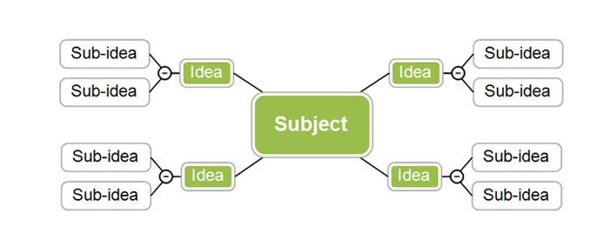
Mind Mapping
A visual note-taking/ brainstorming tool that allows you to see the relationship between concepts surrounding your topic

Slide 14
Develop Effective Searches
Boolean Operators
AND
Combines search terms
loyalty AND customer
OR
Searches for resources with either term
customer AND (loyalty OR satisfaction)
NOT
Eliminates search terms if needed
customer AND (loyalty OR satisfaction) NOT stand-up comedy

Slide 15
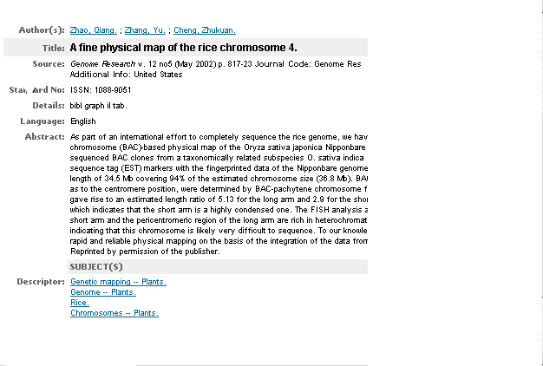
Database Fields
Records are comprised of fields containing specific pieces of bibliographic information
Common Fields Include:
Author
Title
Journal Title
Abstract
Publisher
Date/year of publication
Subject
Don’t select a field? Keywords will automatically be searched
Keywords: all words in the record

Slide 16
Keyword vs. Subject Heading
Initial Search Strategy
Must identify synonymous terms
More likely to have irrelevant results
Controlled vocabulary
Standardized words or phrases used to categorize literature
Relevant results much more likely
Subject headings inconsistent across databases

Slide 17
How to Find Subject Headings
Look to see if the database has an online thesaurus to browse for subjects that match your topic
Start with a keyword search, using words/phrases that describe your topic.
Browse the results; choose 2 or 3 that are relevant.
Look at the Subject or Descriptor field and note the terms used (write them down).
Redo your search using those terms.
Your results will be more precise than your initial keyword search.

Slide 18
Additional Search Tips Most (Not All) Databases have Similar Search Functions
Quotation marks searches the database for those words together as a term; for example, "social identity".
An asterisk (*) searches the database for that word plus any variants of the root word. work* will provide results that include work OR worker OR workplace, OR worksite.
You can also use this for the beginning of the term; *camp will search for camp OR encampment.

Slide 19
Identify Sources

Slide 20
Types of Information Resources to Include
Books
Journal Articles
Government Publications
Conference Papers
Images
Laws & Statutes
Newspaper Articles
Standards
Statistics
Theses & Dissertations

Slide 21
Information Resources
Databases
Government Websites
Reference Materials (dictionaries & encyclopedias)
Conference Papers
Dissertations & Theses
General Internet

Slide 22
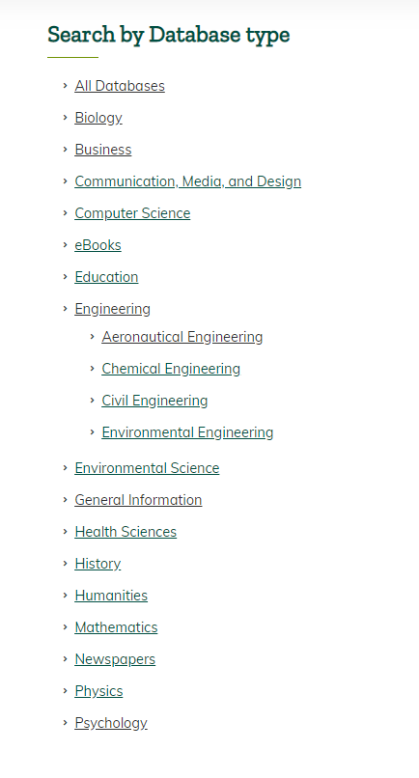
Identify Relevant Disciplinary Databases

Slide 23
Multidisciplinary Databases
Google Scholar
JSTOR
Web of Science
ProQuest Central
EBSCO

Slide 24
Overlap of Sources
Google Scholar searches across resources from all disciplines/subject areas:
journals publisher websites
professional association websites
university websites
Google Books
Web of Science searches citations of high impact journals in the field (not every journal in the field, so Web of Science is less comprehensive in regards to discipline).
A Disciplinary Database searches a defined set of resources, all focused in that field of research, usually this includes:
journals
book chapters
dissertations

Slide 25
Overlap of Sources

Slide 26
Demonstration of Scope Difference
Disciplinary Database
A disciplinary database identifies the citing articles within its scope (the journals it indexes). In this example from PsycINFO this article has been cited 223 times since 2001.
Web of Science
Web of Science found 122 citations to this article in its collection. These citations will be from the other high impact journals that the Web of Science tracks.
Google Scholar
Google Scholar's scope is larger, therefore it can identify that an article has been cited more times across a larger body of literature or types of sources (such as books and reports). Due to the unmediated nature of Google Scholar, some of the "cited by" citations might also be duplicates. Google Scholar reports this article has been cited 344 times since 2001.

Slide 27
Filtering your Results
Look at the number of citations as an indicator of quality
Make your search string more specific
Scan the abstracts
Don’t be afraid to reject sources!

Slide 28
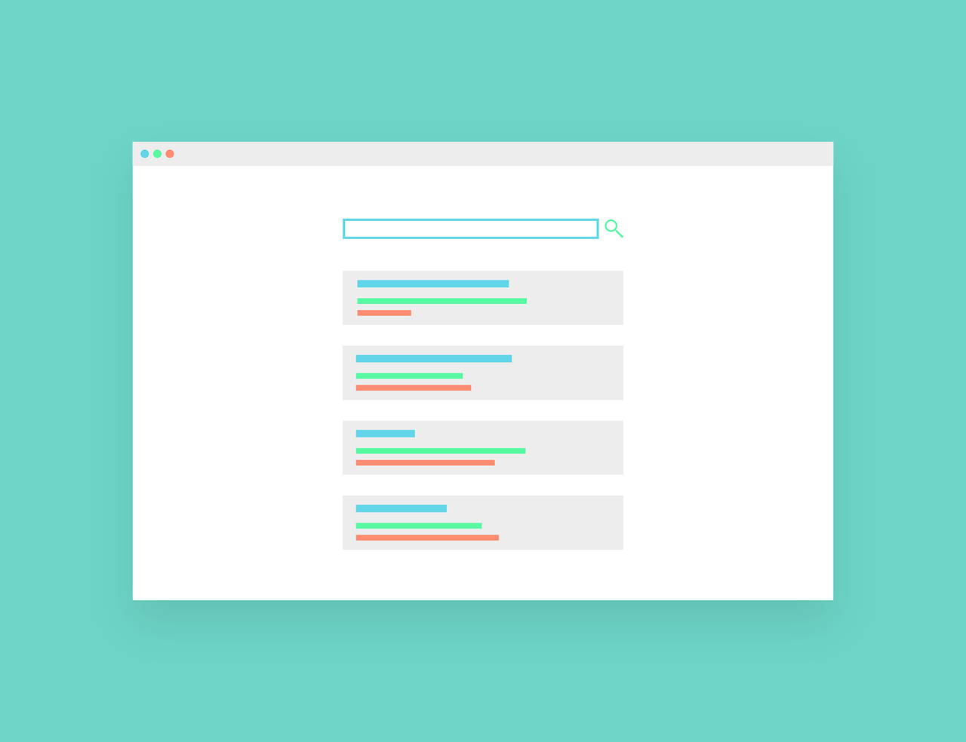
Journal Rankings
What are the top ranking journals in your field? What journals are best for your topic?
Eigenfactor
Google Scholar Metrics
SCImago Journal and Country Rank
Journal Citation Reports
Journal Quality List
Journal Impact Factor

Slide 29
Types of Information Resources: Grey Literature
Materials and research produced by organizations outside of the traditional commercial or academic publishing distribution channels

Slide 30
Types of Information Resources: Grey Literature
Conference Abstracts
Dissertations and Theses
Reports (progress reports, final reports, annual reports, etc.)
Technical Specifications and Standards
Newsletters
Patents
Data
Lecture Presentations and Notes
Etc.

Slide 31
Types of Information Resources: Grey Literature
Resources:
Web of Science
arXiv
IssueLab
Social Science Research Network (SSRN)
USA.gov
Directory of Federal Agencies
Think Tank Directory

Slide 32
Types of Information Resources: Literature Review Articles
add "Literature Review" OR "Review of the Literature" as a title field search in the database.
Or, if available, select the research methodology limit for "literature review".

Slide 33
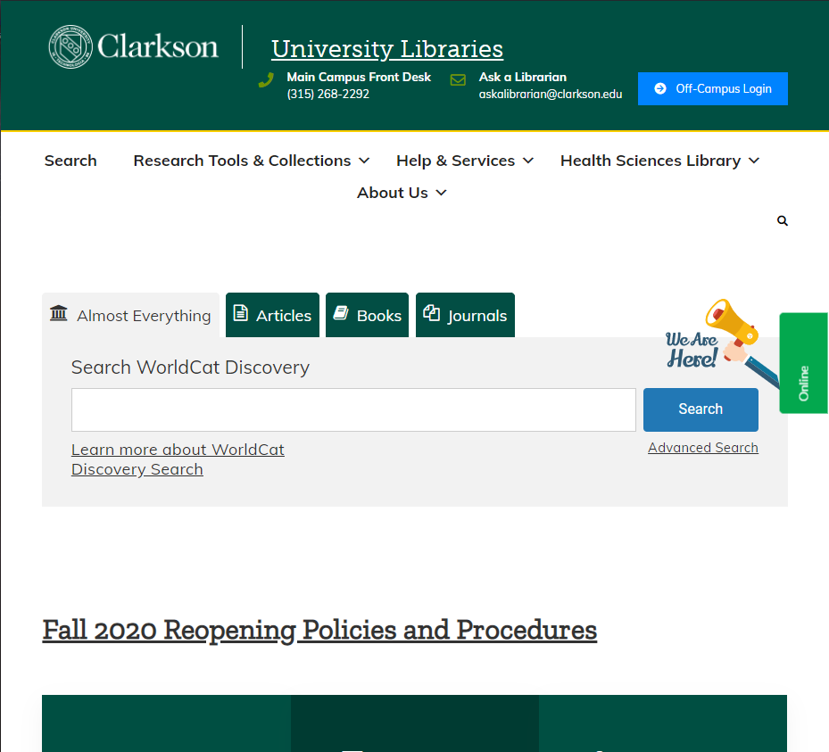
Finding Articles when you Have the Citation

Slide 34
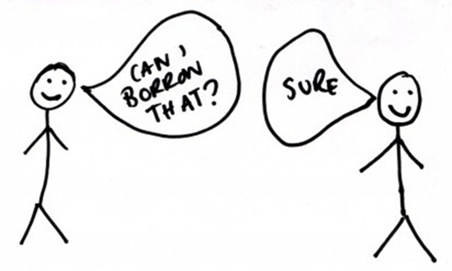
Interlibrary Loan
Can’t find something?
Request items that are not in the Clarkson Library
https://sites.clarkson.edu/library/interlibrary-loan-ill/

Slide 35
Staying Organized

Slide 36
How many Resources to Include?
Needs to be comprehensive
You need to:
Confirm that no one else has conducted your research
Identify as much related research as you can

Slide 37
Set a Timeline!

Slide 38
How do you Know when you Have Enough?
Are you seeing the same articles over and over?
You’re not done if:
You continue to find new influential themes, references, or sources you haven’t seen

Slide 39
You will need References
To demonstrate the breadth of your reading & research
To you help you avoid duplication of effort
To cite published & unpublished works
To help avoid suspicion of plagiarism
Allows your supervisor to check the material you have used

Slide 40
Use Citation Management Software

Slide 41
Reading Sources

Slide 42
First Stage
Go through all your sources to get a sense of their general content and arguments
Determine which sources you want to focus on

Slide 43
Second Stage
Take a more critical in-depth look at your sources
Take notes
Be critical
Ask Questions
What do you think of the methodological approach? The theoretical argument? The hypothesis?
Write those thoughts down

Slide 44
Take Notes On
The Author’s credentials
Types of evidence the Author relies on
The Author’s point of view
The Author’s arguments
The Author’s unique contribution to the scholarly discussion on the topic

Slide 45
Reading a Research Paper: General Tips
NOT like a textbook
Information is dense but structured
May only need specific components of the article
Parts may refer forward or back
Be prepared to read 2-4 times

Slide 46
Parts of a Research Paper
Abstract - Summary
Introduction – Background Information
Literature Review – Previous Research
Methods – How Research was Performed
Results - Findings
Discussion – Interpretation of Findings

Slide 47
Order of Reading
Abstract
Discussion
Introduction
Literature Review
Results
Methods
Notes:
Abstract: Find a connection to your research question
Discussion: Are the results useful? Do you agree with the author’s logic?
Introduction: Do you understand the background information?
Literature Review: Do you need to look up any additional information?
Results: Do you understand the data?
Methods: Do you understand how the experiment was conducted?

Slide 48
Identify Connections
Trends and Patterns
Themes
Debates, conflicts, and contradictions
Pivotal publications
Gaps

Slide 49
What is the “Gap”?
The missing piece and/or pieces in the research literature that have not been explored or have been underexplored.

Slide 50
Identifying the Gap
Important because:
Highlight the originality of your research
Demonstrates your awareness of the literature in your field

Slide 51
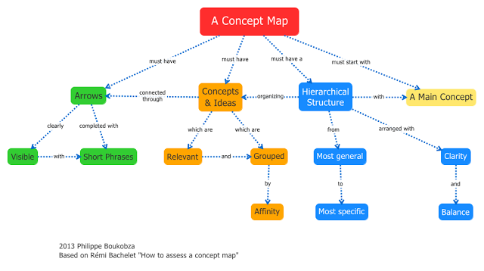
Concept Mapping
Visual organization and representation of concepts of knowledge and relationships among them

Slide 52
When to Stop?
Build an argument, not a library

Slide 53
Writing

Slide 54
General Tips
Identify the broad problem area
Indicate why the topic is important
Distinguish between research & other types of information
Indicate why certain studies are important
Describe the time frame of the topic
If citing a landmark study, identify it as such
If a landmark study was replicated mention the results
Discuss other literature reviews on your topic
Refer the reader to other reviews that discuss details you will not be discussing
Justify comments such as “no studies were found”
If the results of certain previous studies are inconsistent, cite them separately

Slide 55
Structure of your Literature Review
Introduction
Body
Conclusion

Slide 56
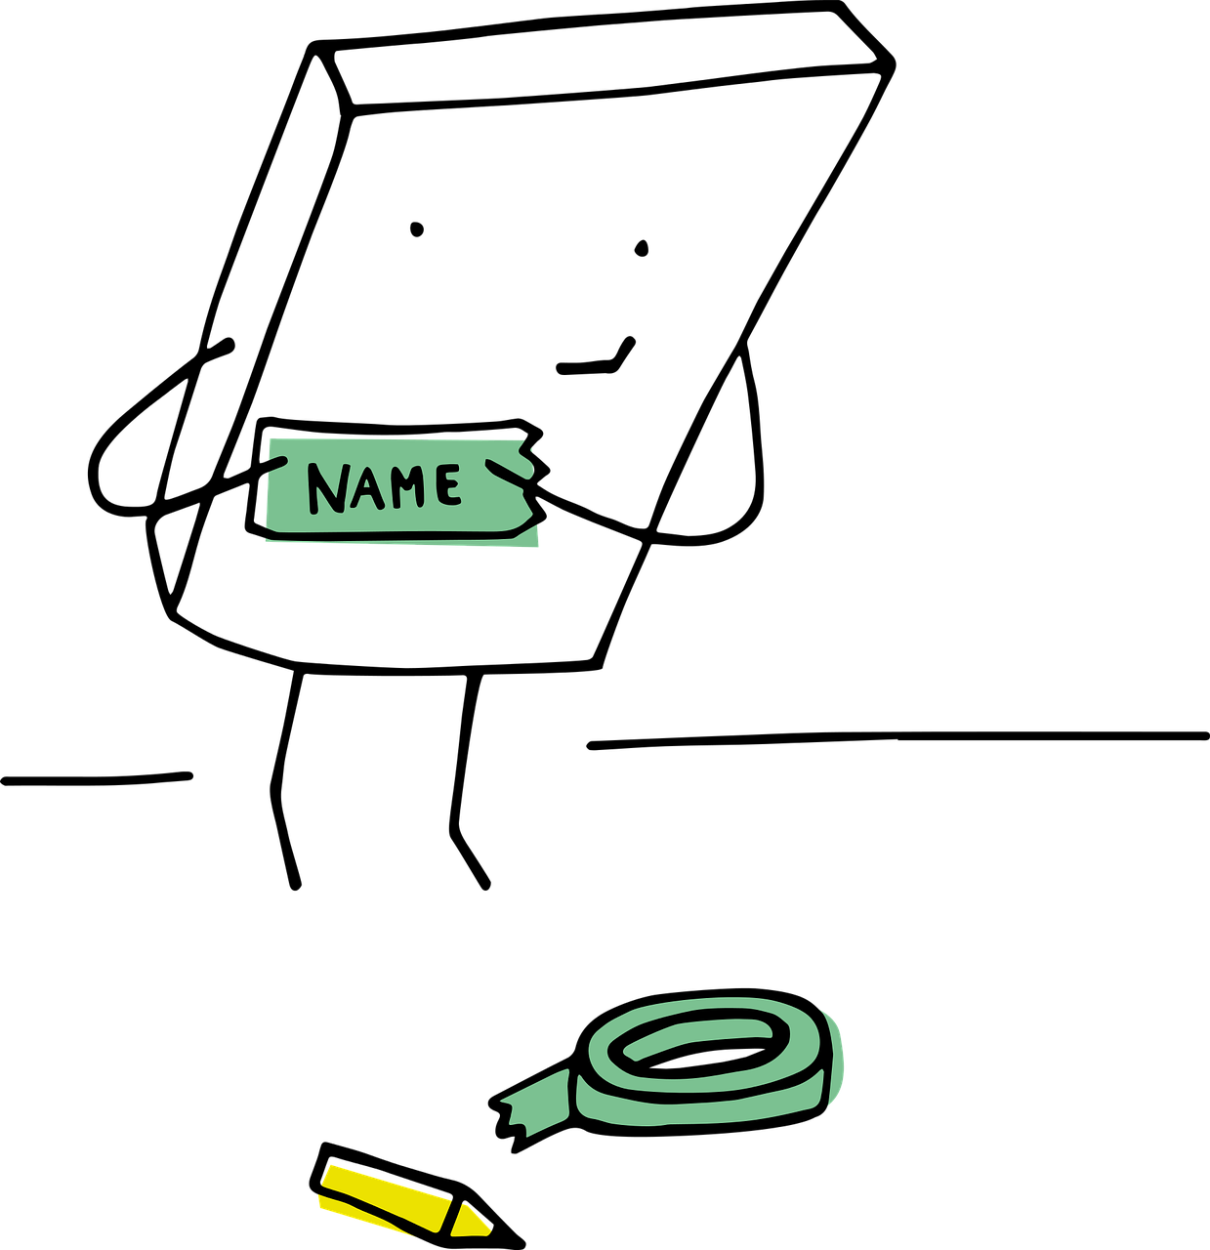
Introduction
Clear, short, & focused
Establishes the significance of your topic
Outline of the trends you identified in the scholarship

Slide 57
Introduction
Dissertation Literature Review
Reiterate your central problem or research question and give a brief summary of the scholarly context. Emphasis of the timeliness of the topic or highlight a gap in the literature.

Slide 58
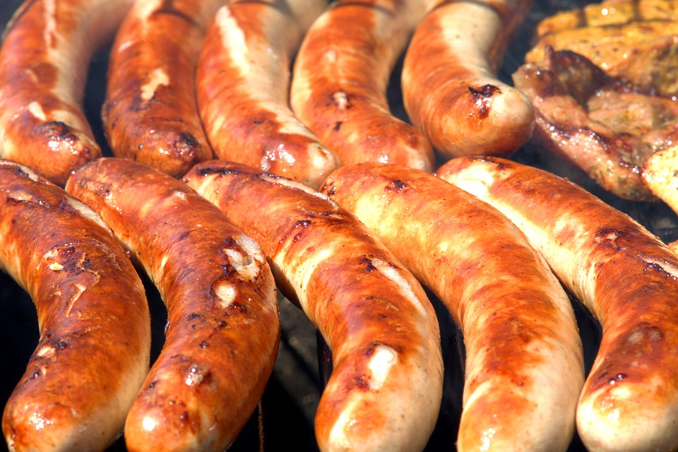
Body
More extensive information about:
Similarities and differences
Patterns and trends
Points of agreement and disagreement

Slide 59
Organization of your Literature Review
Chronological
Trace the development of a topic over time
Thematic
Organize the information into central recurring themes
Methodological
Discuss the comparisons between different methodological approaches to the research
Or a combination of the three

Slide 60
Body
Can be divided into subsections
Summarize and synthesize
Give an overview of main points of each source
Analyze and interpret
Don’t just paraphrase, add your own interpretations
Critically evaluate
Write in well-structured paragraphs

Slide 61
Body
Includes your arguments
Discusses how the literature agrees or disagrees with your arguments
Not too many direct quotes!

Slide 62
Conclusion
Overview of what is known and thought about the topic and what is left to explore
How does your research “fill the gap”?
Recommendations for additional future research?

Slide 63
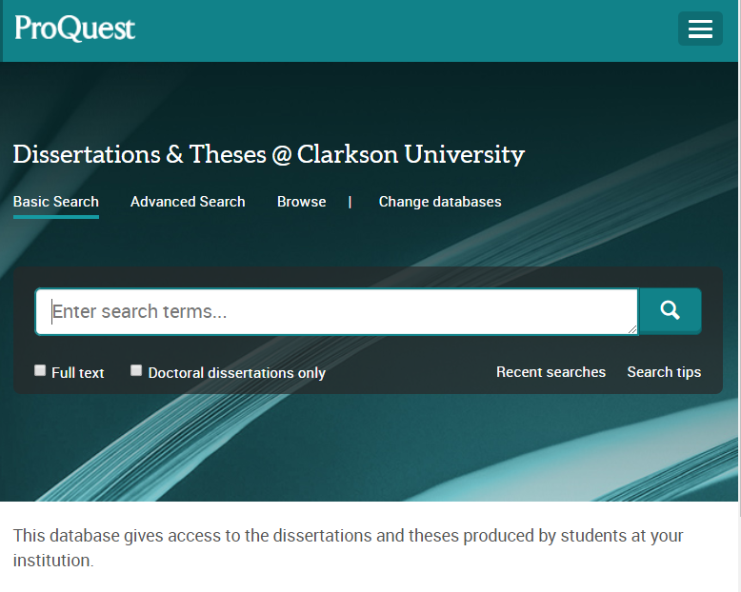
Use Sample Literature Review

Slide 64
Keep it Simple
There may be hundred or thousands of perspectives… Clearly define your focus

Slide 65
Length of a Literature Review
Should be proportional to the entire length of your work:
20%?

Slide 66
Things to Remember
Analyze, analyze, analyze
Use ample evidence
Be very selective
Do not rely on direct quotes
Make your voice heard
Cite your work appropriately

Slide 67
Contact Me
Amber Dashnaw
aldashnaw@clarkson.edu
(315) 268-4454
Ask a Librarian
askalibrarian@clarkson.edu
(315) 268-2292

