Slide 1
Become a Research Guru
Lisa Hoover
Clarkson University Libraries
X3760
lhoover@clarkson.edu

Slide 2
Don’t feel overwhelmed or intimidated
Don’t put it off until the last minute
Do Ask for Help

Slide 4
Sites with pay walls/ subscribed content
Sites with no links (or broken links) to them
New Websites
Sites with Technical Issues
Sites web developers don’t want indexed
The Deep Web

Slide 5
The Library
Print materials & electronic materials
Including free popular eBooks & audiobooks!
Interlibrary loan
Research/reference
Database navigation assistance
Citation & citation management system support

Slide 7
Picking a Topic
What interests you? What/who do you identify with? What do you want to know more about?
What question do you want to answer?

Slide 8
Picking a Topic
Start with a broad topic and consult reference materials like encyclopedias to get a general understanding of the issue
Consider the specific question you want to answer
Think about your search terms
Synonyms
Related concepts

Slide 9
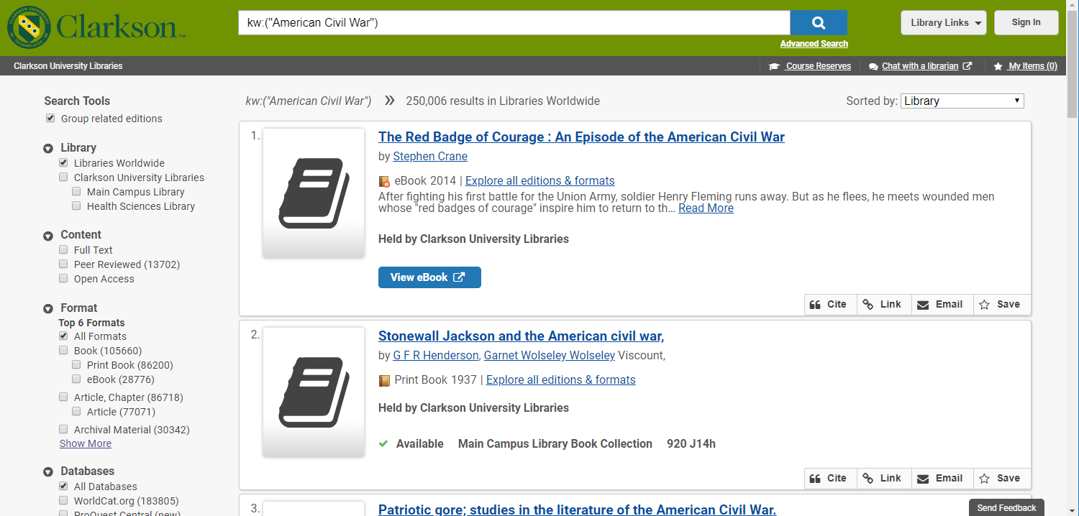
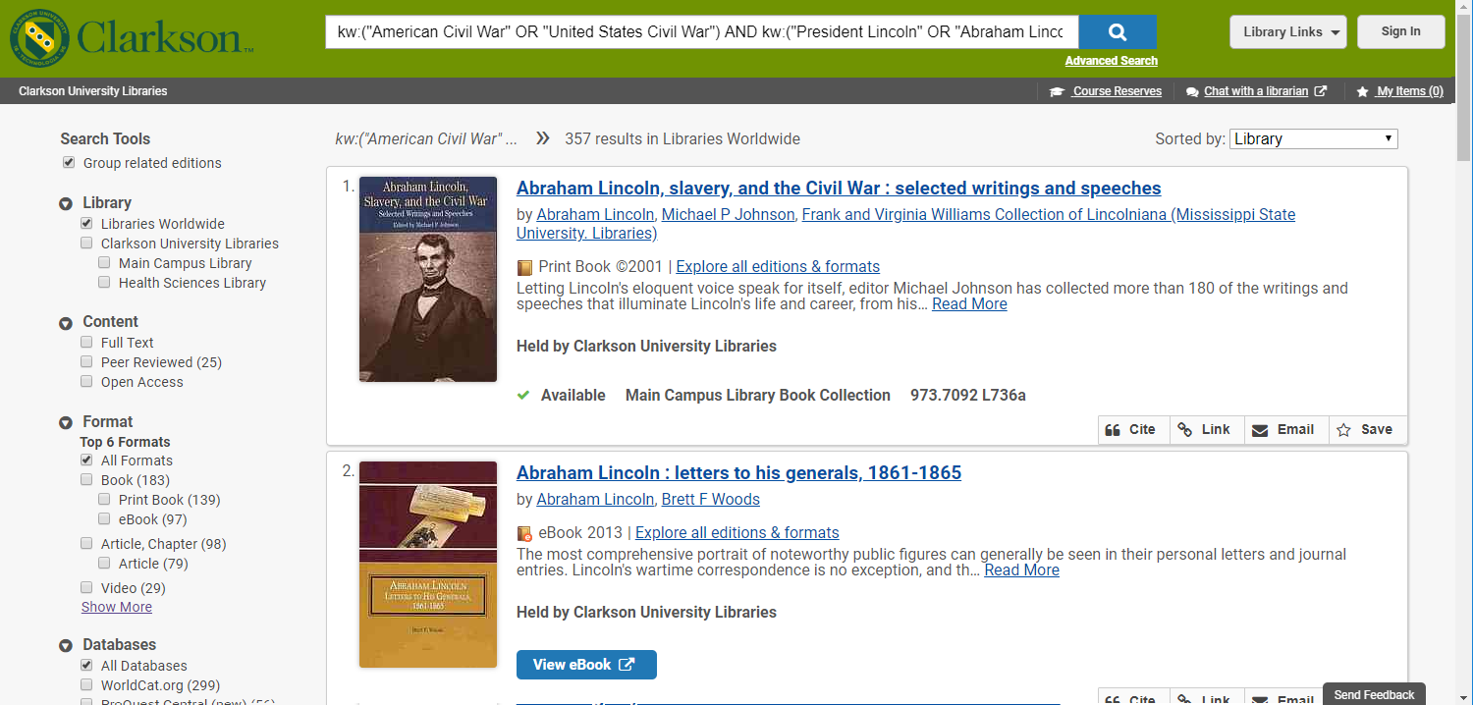
How did President Lincoln’s leadership contribute to the resolution of the Civil War?

Slide 10
Types of Sources
Types of Sources:
Encyclopedias & Reference Materials
Books
Journal Articles
Also…
Primary Sources
Secondary Sources
Also…
Peer Reviewed & Scholarly Sources
Popular Materials
What’s the difference between a journal and a journal article?
What does “scholarly” mean?

Slide 11
Thesis & Final Paper
Specific
Question
Broad Topic

Slide 12
And, if we’re being honest…. Distractions!
Thesis & Final Paper
Third Search Search
Second Search
Specific
Question
First
Search
Broad Topic

Slide 13
Ask for Directions
?

Slide 14
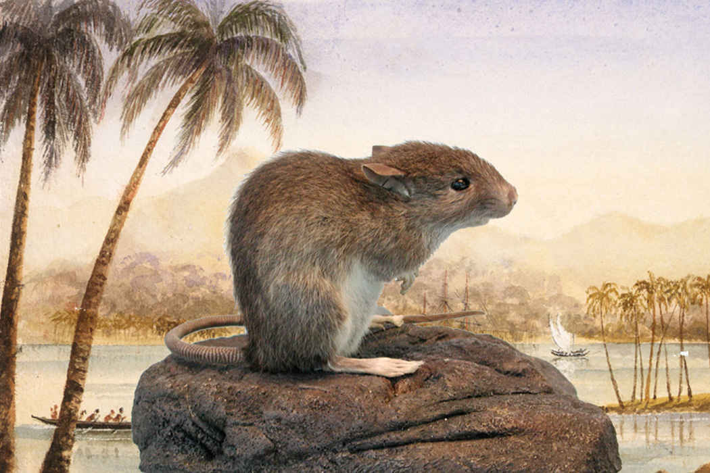
Research Rat Hole
Down the Research Rat Hole
By
Christina Thompson
“And, although I went into this project knowing something about Pacific history, I am by no means an expert in many of these fields, which is why I have spent the last seven or eight years down one research rat hole after another.
A rat hole, according to Urban Dictionary, is a digression, often an unprofitable or distracting one. “Ratholes,” we are told, “usually open up when related but tangential topics are discussed which are explored in much more detail than is required.” Of course, as every researcher knows, it is difficult to determine at the outset which will be the tangential topics and which the essential. Which of many fascinating digressions will prove ultimately to have been a distraction and which will turn out to be the key to some fundamental understanding, the perfect illustration of an essential idea, a critical bridge from one part of the story to another? How to know which unlikely byway will lead to some valuable tidbit and which will dump you out unceremoniously in a dark and profitless dead end?”
The Polynesian rat (Rattus exulans)
via Wikimedia Commons/Flickr/ITHAKA

Slide 15
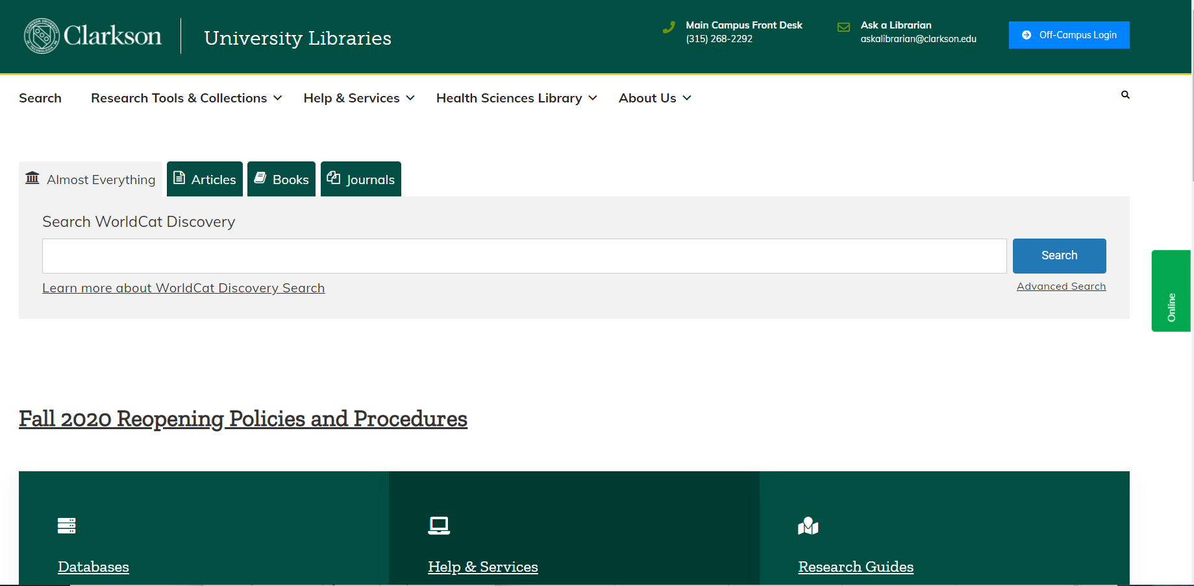
Clarkson.edu/library

Slide 16
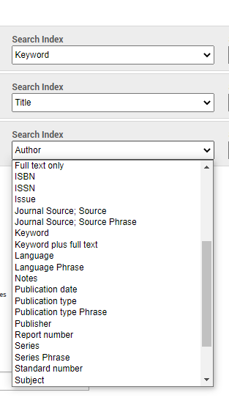
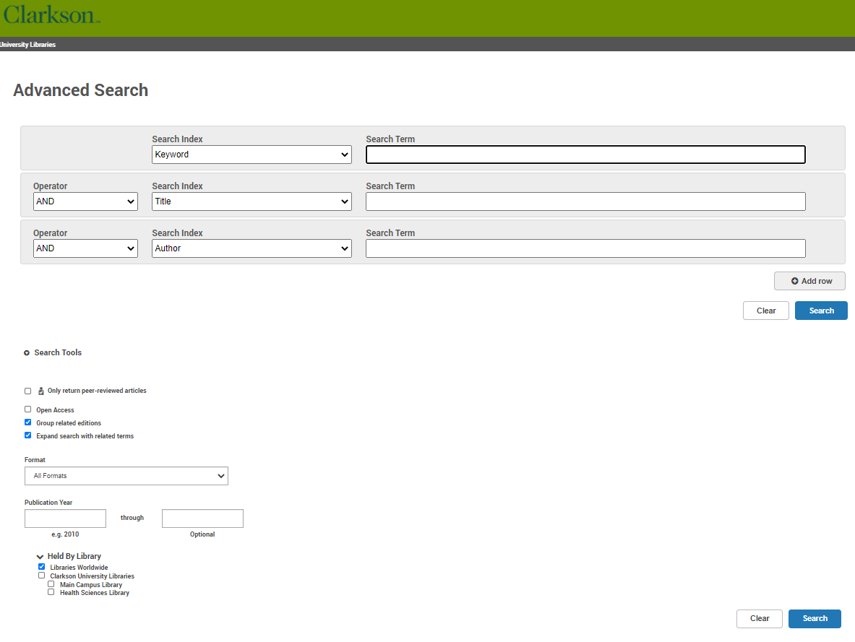
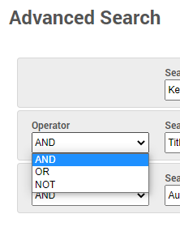
Searching
AND = BOTH
OR = EITHER
NOT = DO NOT INCLUDE

Slide 17
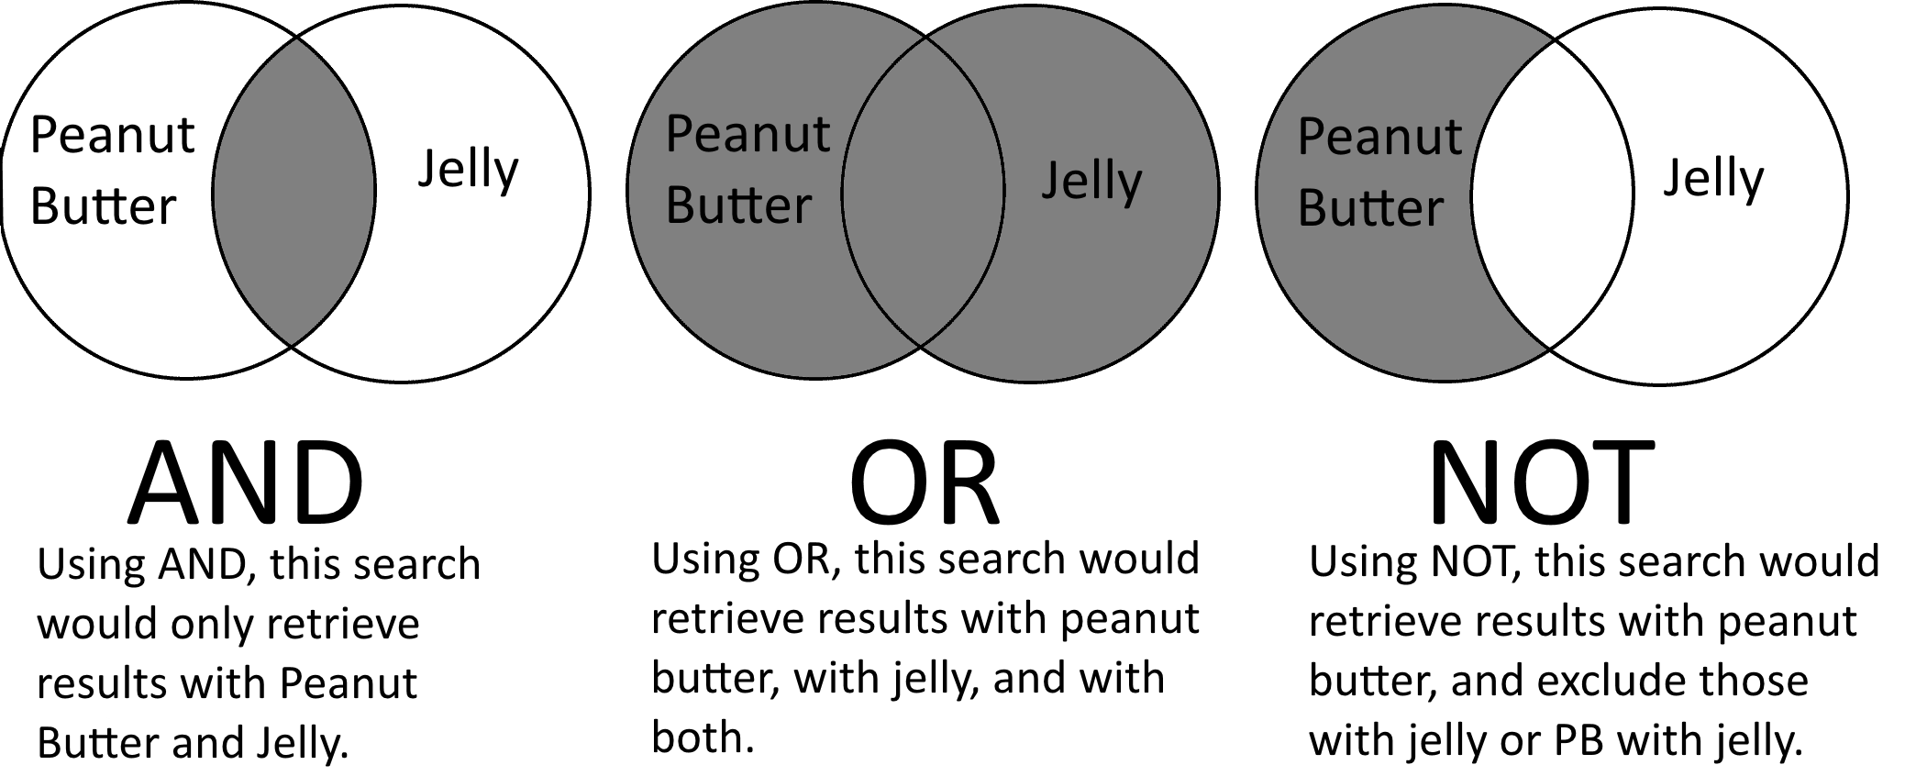
Operators
From Slippery Rock University

Slide 18
Searching the Library - Example
“” – search as a phrase
* - lead, leader, leaders, leading, leadership

Slide 19
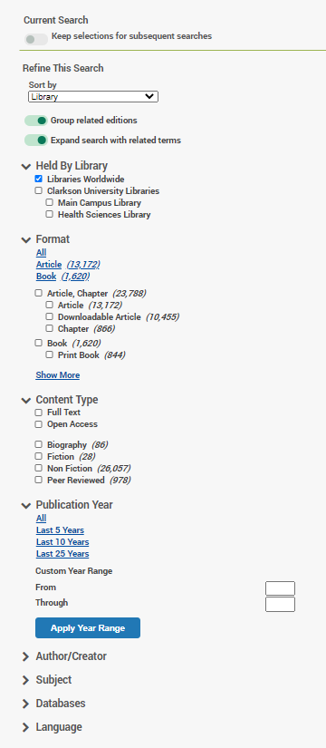
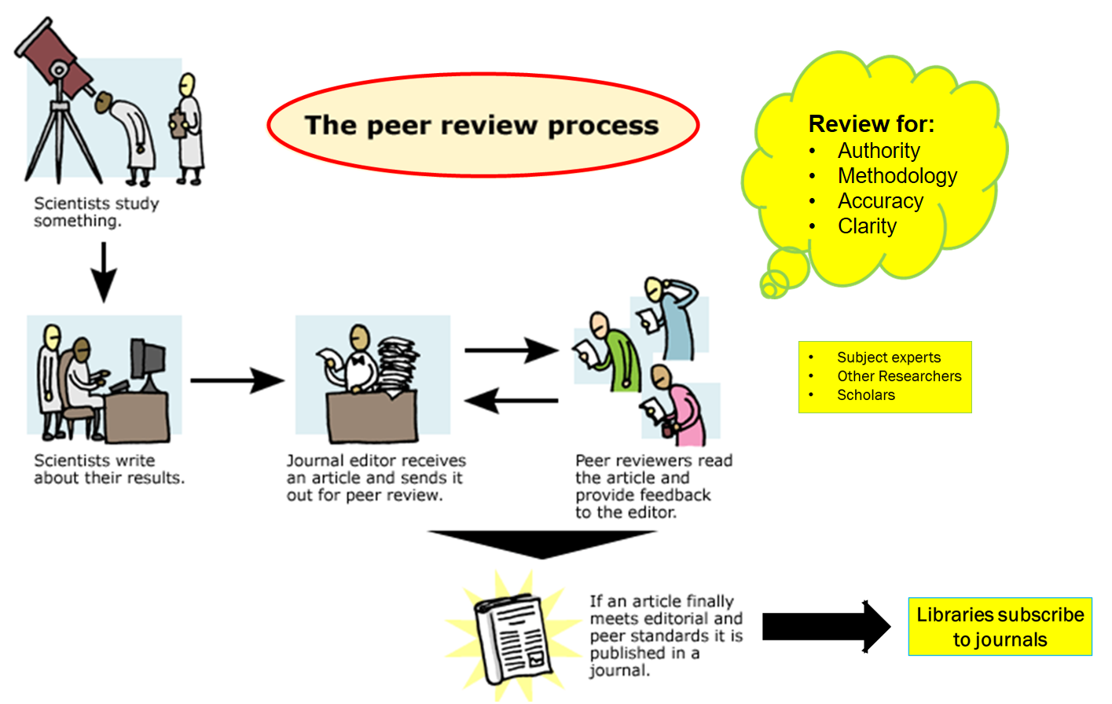

Slide 20
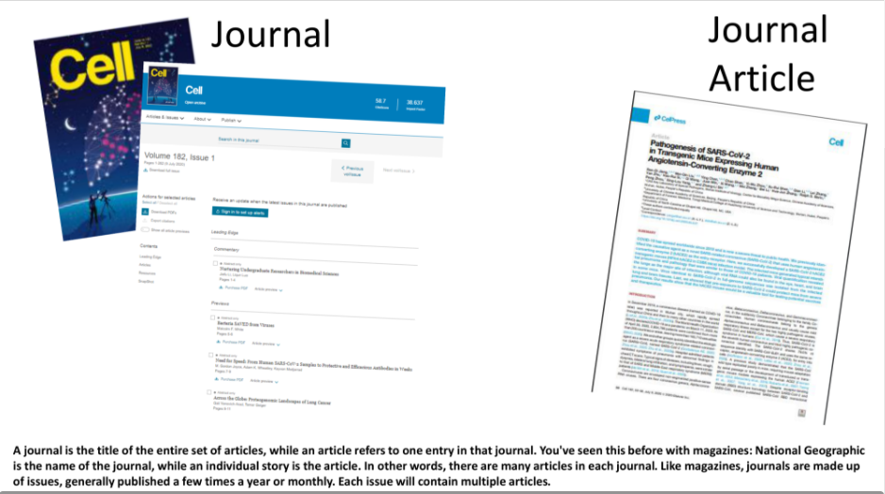

Slide 21
Journal v. Journal Article
Fleming, T. (1987, Nov 06). The civil war and American destiny. National Review (Pre-1988), 39, 48. Retrieved from http://ezproxy.clarkson.edu/login?url=https://www-proquest-com.ezproxy.clarkson.edu/docview/200526180?accountid=37646

Slide 22
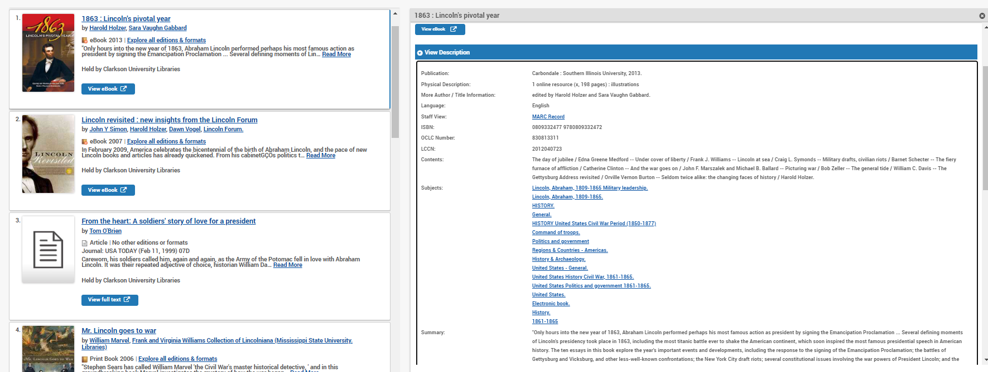
Results!

Slide 23
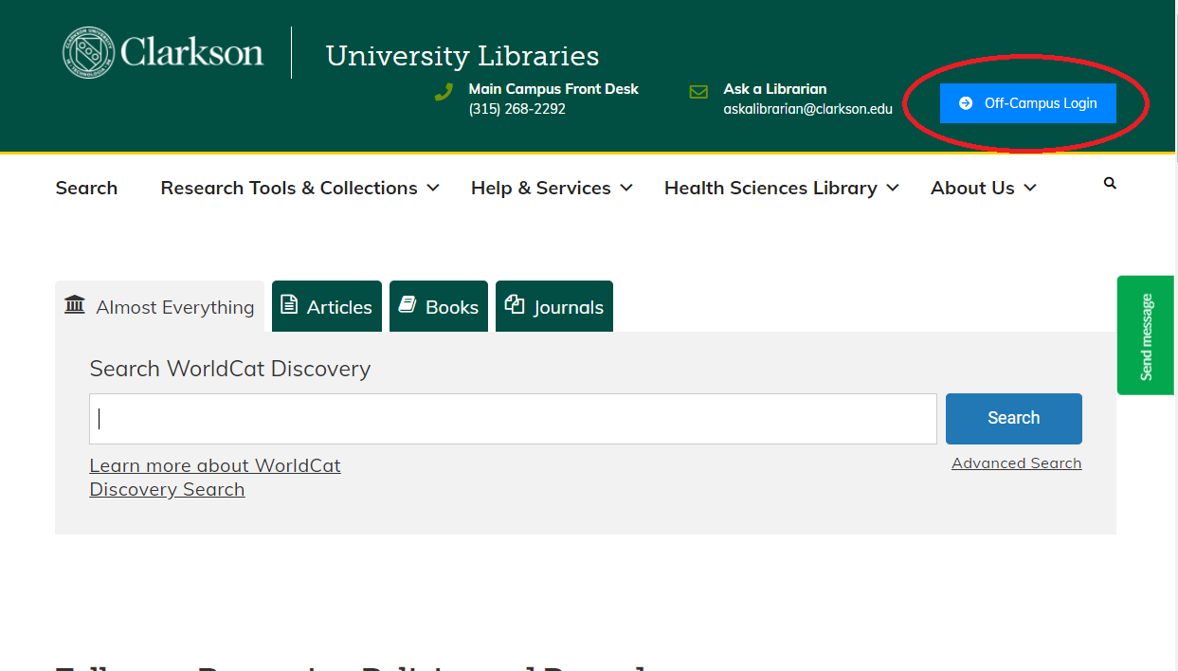
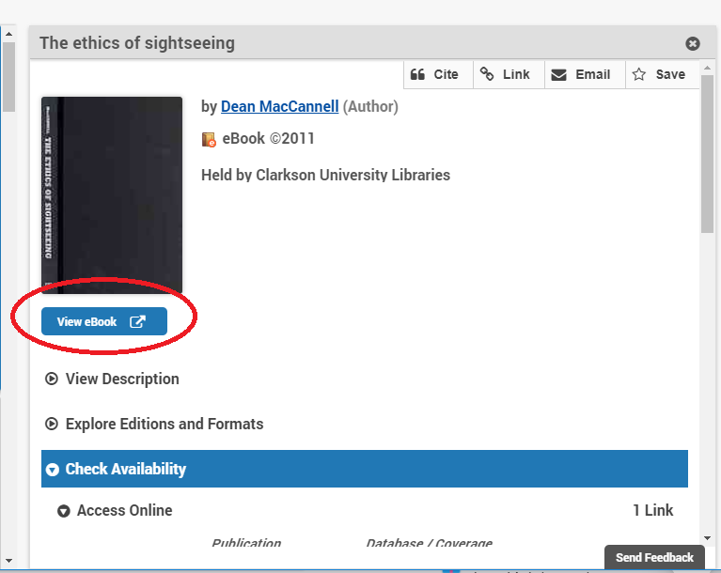
Access

Slide 24
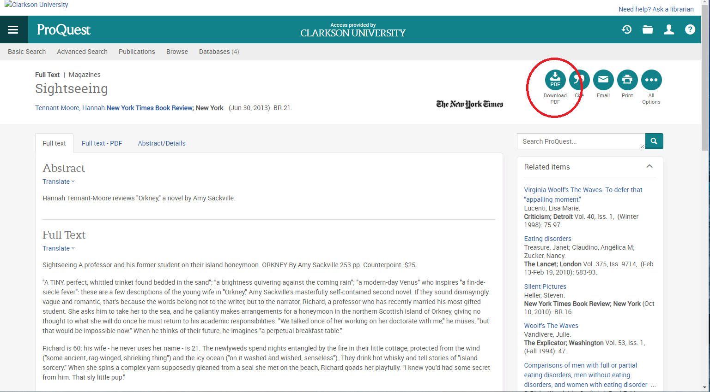
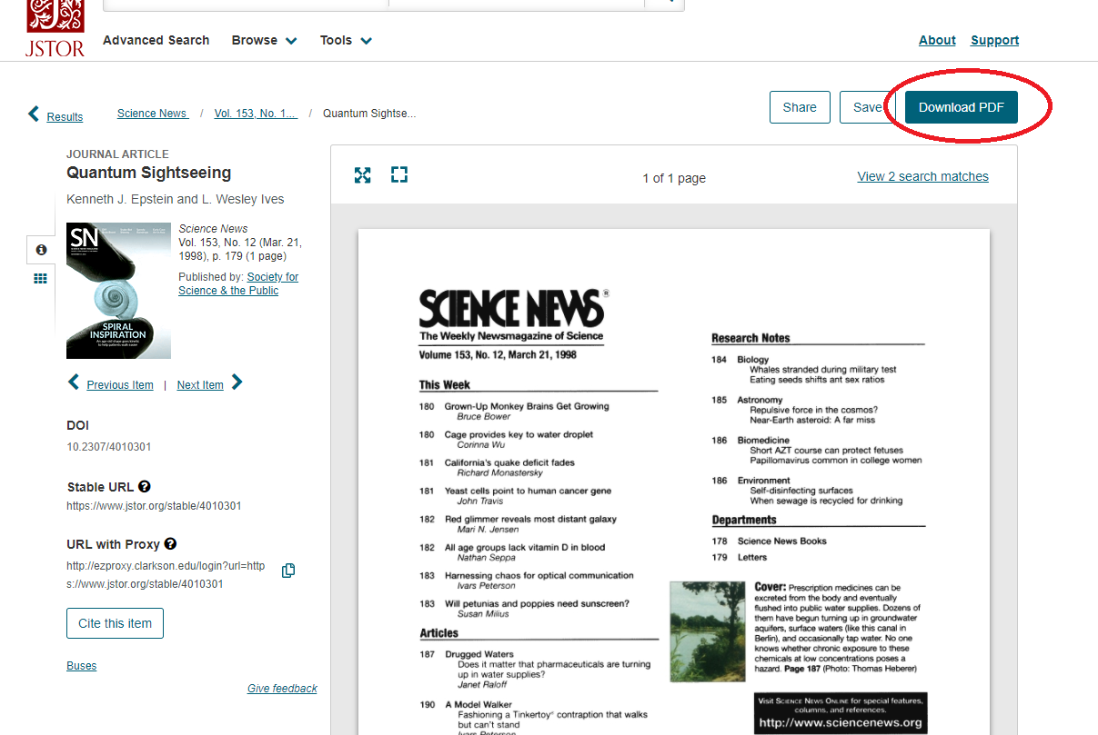
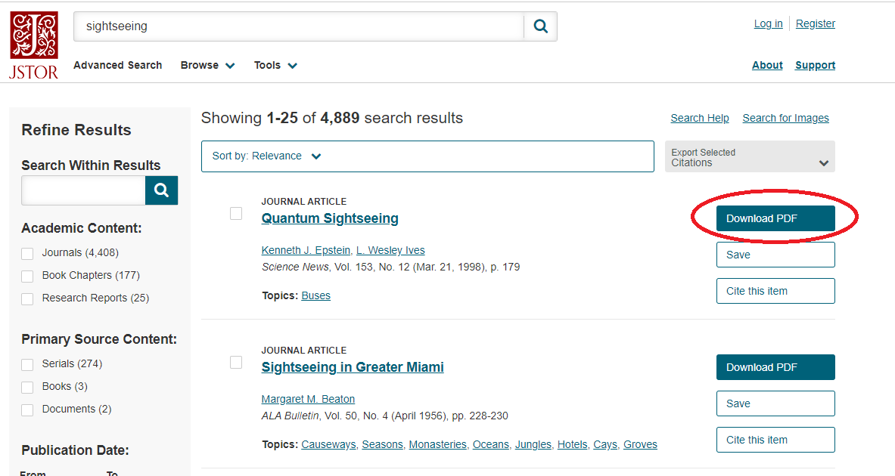
Access

Slide 25
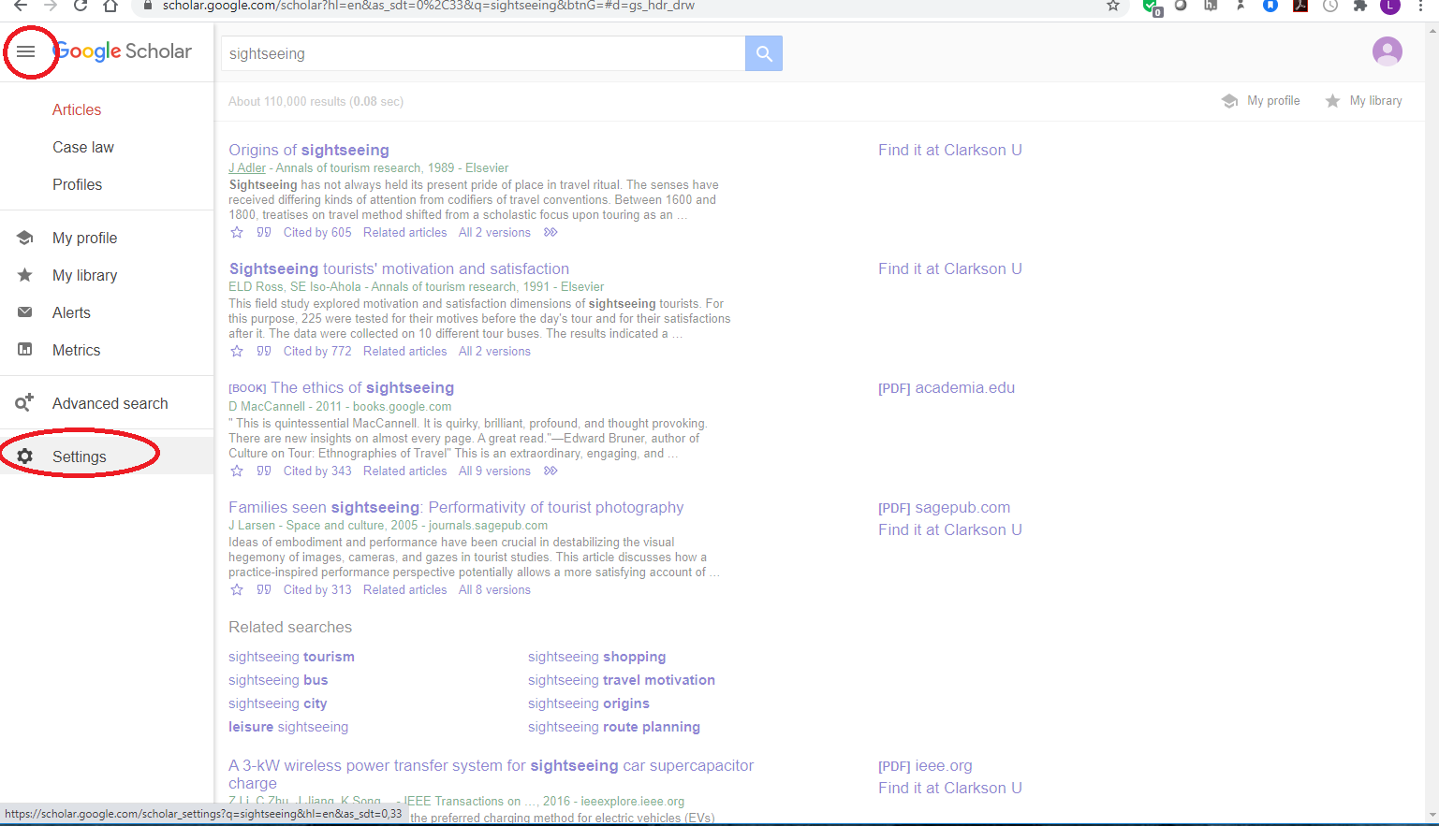
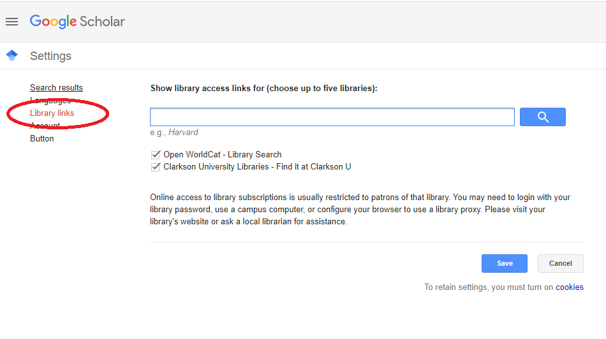
Google Scholar
Clarkson University Libraries

Slide 26
Google Scholar

Slide 27
Tracking a Citation
You may able to just search for the title on the library homepage
HINT: Don’t forget the quotes!
If not, track the citation…

Slide 28
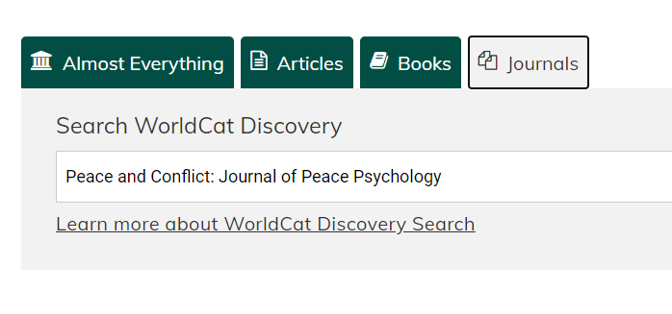
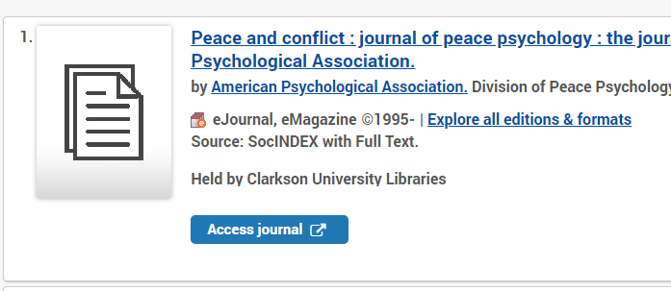
Tracking a Citation
Lieberfeld, D. (2009). Lincoln, Mandela, and qualities of reconciliation-oriented leadership. Peace and Conflict: Journal of Peace Psychology, 15(1), 27–47. https://doi-org.ezproxy.clarkson.edu/10.1080/10781910802589857

Slide 29
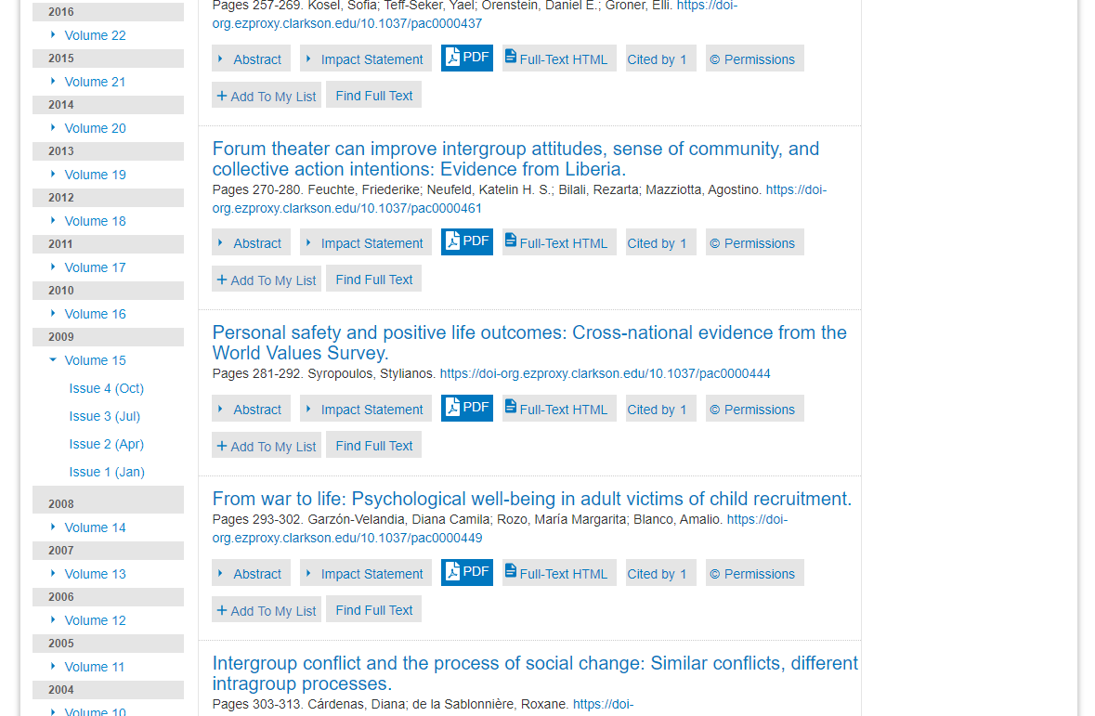
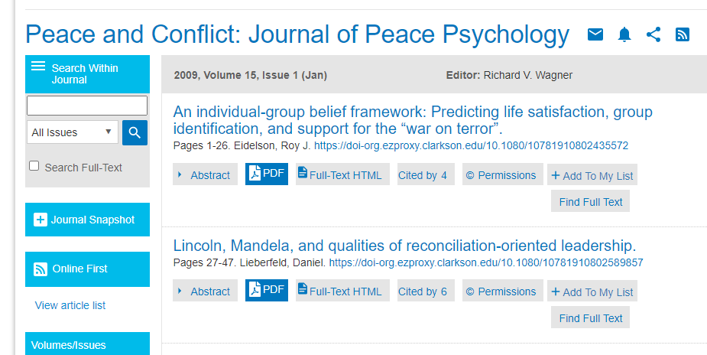
Tracking a Citation
Lieberfeld, D. (2009). Lincoln, Mandela, and qualities of reconciliation-oriented leadership. Peace and Conflict: Journal of Peace Psychology, 15(1), 27–47. https://doi-org.ezproxy.clarkson.edu/10.1080/10781910802589857

Slide 30
Zotero
Workshop: Thurs, Oct. 8 at 5pm by Zoom
Zotero is a free tool to help you collect, organize, cite and share your research.
It helps you save your citation information and track your sources
It allows you to organize your sources
It allows you to create in-text and reference list citations

Slide 31
Your
Librarian

Slide 32
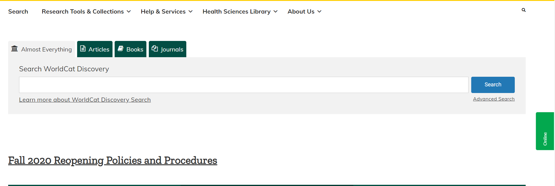
Get Help
Customized one-on-one help!
Lisa Hoover – lhoover@Clarkson.edu
Research Help – askalibrarian@Clarkson.edu
Chat with us!
Check Research Guides or Ask a Librarian

