Slide 1
The Art of persuasion: Make your sources work for you
Clarkson University Libraries
ERC 1110
X3760
lhoover@Clarkson.edu calendly.com/lisahoover

Slide 2
Attendance? Recording?

Slide 3
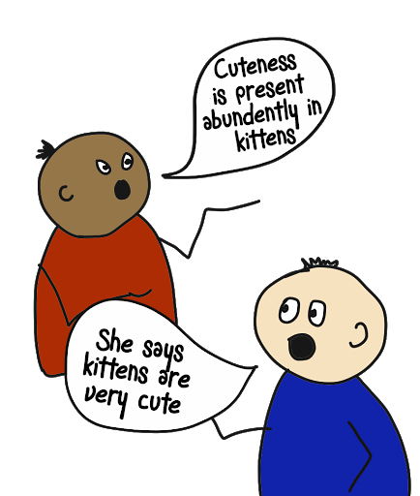
Paraphrasing
Paraphrasing is not just changing a word or two, or even all the words (or their order)
Try taking notes at the end of a section, or with the book/article closed – you’ll be more likely to use your own words
Just be careful you don’t warp or misrepresent the author’s original idea/argument
When you paraphrase, you still need to cite your source! Cite any reference to an author or his or her ideas/arguments
From No Frills Study Skills

Slide 4
!
This really cool study showed…..
Hmm, that’ interesting. I thought ….
Scholarly Article
You
Scholarly Article

Slide 5
How to use a source
Introduce the source
Introduce your ideas
Draw a conclusion

Slide 6
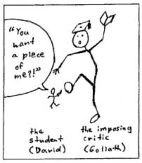
How Do I Use My Sources?
Mark Gaipa’s 8 Strategies
1. Picking a Fight
“Knock down” a scholar’s argument and (ideally) replace it with your own supported by evidence.
Bob Smith argues (citation) ……. However, more recent evidence indicates…. (citation)

Slide 7
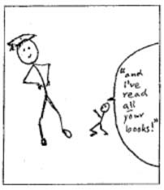
How Do I Use My Sources?
Mark Gaipa’s 8 Strategies
2. Ass Kissing
AKA “Riding a Scholar’s Cottails”
Agree with a scholar to gain evidence and authority and/or defend a scholar from an attack by another scholar, this resolving a larger controversy.
While Susie Adams argues …. (citation), other scholars in the field, such as Amy Jones refute this …. (citation). However, a closer look at the literature shows….. (citation[s]).

Slide 8
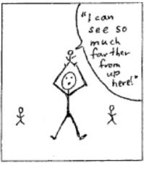
How Do I Use My Sources?
Mark Gaipa’s 8 Strategies
3. Piggybacking
AKA “Standing on the shoulders of a giant”
Agree with a scholar, but then complete or extent the scholar’s work, usually by borrowing an idea or concept and developing it through application to a new subject or new part o the conversation.
Laura Young made a ground breaking discovery in 2015 when she observed that….. (citation). With further research (citation[s]), we can expand on her observation by…..

Slide 9
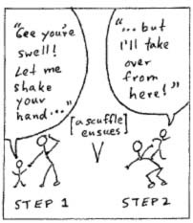
How Do I Use My Sources?
Mark Gaipa’s 8 Strategies
4. Leapfrogging
AKA “biting the hand that feeds you”
Agree with a scholar, but then complete or extent the scholar’s work, then identify and solve a problem in the scholar’s work (an oversight, an inconsistency, or contradiction).
Lee Marshall argues persuasively that….. (citation). However, this overlooks the fact that …..(citation or your own observiation/idea)

Slide 10
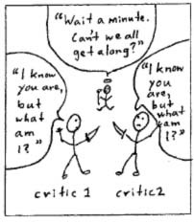
How Do I Use My Sources?
Mark Gaipa’s 8 Strategies
5. Playing Peacemaker
Identify a conflict or dispute between two or more scholars, then resolve it using a new or more encompassing perspective.
Sue Yee argues that the dinosaur extinction was caused by ….. (citation), while other scholars argue that it was caused by…. (citation[s]). However, new evidence (citation) indicates that both may have occurred simultaneously, indicating that……

Slide 11
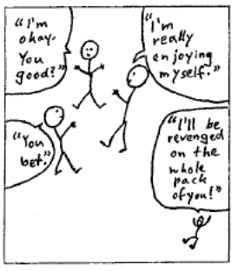
How Do I Use My Sources?
Mark Gaipa’s 8 Strategies
6. Taking on the Establishment
AKA “acting paranoid”
Pick a fight with everyone in a critical conversation; show how the status quo is wrong, a critical consensus is unfounded, or a dispute is based on a faulty assumption
It is widely assumed that ….. (citations[s]). However, I believe this over looks important evidence, such as ….. (citation or evidence)

Slide 12
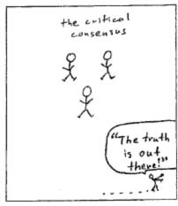
How Do I Use My Sources?
Mark Gaipa’s 8 Strategies
7. Dropping Out
AKA “finding room on the margins”
Focus on an issue in the margins of the critical conversation, illuminating that issue and (ideally) redefining the conversation
So much scholarship in this area has focused on ….. (citation[s]). However, I believe this may overlook ….. (citation[s] or evidence)

Slide 13
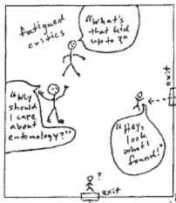
How Do I Use My Sources?
Mark Gaipa’s 8 Strategies
8. Crossbreeding
Inject really new material into the conversation or produce a new argument or perspective – use another discipline or bring in new evidence or framework
Traditionally this problem has been approached purely as a problem of engineering. (citation[s]) However, if we reconsider the problem through a historical lens, we see that non-engineering related problems may contribute, and therefore new solutions may be needed…. (citations or evidence and argument)

Slide 14
Other workshops
Who wrote that? Being wary on the web - Tues, Nov. 2 at 5pm via Zoom
Is it shareworthy? Becoming a more sophisticated social media user - Tues, Nov. 16 at 5pm via Zoom

Slide 15
Contact me
Lisa Hoover
Clarkson University Libraries
ERC 1110
X3760
lhoover@Clarkson.edu calendly.com/lisahoover

