Slide 1
Graduate Workshop: Building Your Online Presence & Demonstrating Your Research Impact
Amber Dashnaw
Public Service Librarian for Graduate Education
Spring 2020

Slide 2
Building your Online Presence

Slide 3
Why do I need an Online Presence?
Manage your online persona
Diffusion of works
Collaboration
Information Management
Measurement of Impact

Slide 4
Common Components of an Online Persona
Name
Photo
Professional Experience
Capabilities
Ideas
Citations of Published Articles
Number of Citations and Downloads of Articles

Slide 5
Digital Footprint
Digital Shadow
The content you create
The content created about you

Slide 6
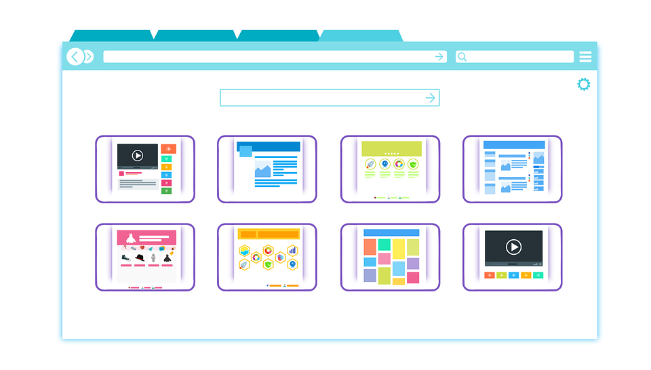
Consider:
What do you want your digital footprint to look like?
What kind of online presence do you want?
What do you have time to manage effectively?

Slide 7
Know What is Out There!
Control your footprint/Minimize your shadow
Regular Google searches
How many results come up?
How many are relevant?
Publications? Online profiles? Facebook photos?
If the results are not you, would that be obvious to someone looking for you?
What would you like to appear?
Set up a Google alert for your name
google.com/alerts#

Slide 8
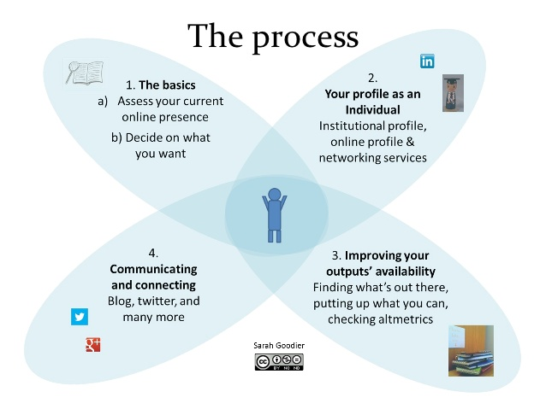

Slide 9
Consider Creating: A Personal Website
A place to host all your scholarship
Consistent web presence
Search Engine Optimization of your content
Tracking capabilities

Slide 10
Consider Creating: Persistent Digital Identifiers
Unique to you (no personal information is encoded)
You choose when and where to use it
Interoperable (across publications, institutions, databases, etc.)
ORCHID

Slide 11
Proprietary Profile Systems
Publons (Previously ResearcherID): Web of Science
ScopusID: Elsevier
PIVOT: ProQuest

Slide 12
Open Profile Systems
Google Scholar
Scienceopen.com
Discovery Platform-claim your profile using your ORCHID ID
EuropePMC
Life-sciences repository- claim your profile using your ORCHID ID

Slide 13
Researcher Social Networking Sites
ResearchGate
Academia.edu
Mendeley
Linkedin
MyScienceWork
SSRN- Social Science Research Network

Slide 14
Copyright Considerations
Can you upload your published works?
SHERPA/RoMEO: http://www.sherpa.ac.uk/romeo/index.php

Slide 15
Improving the Availability of your Scholarship

Slide 16
Institutional Repositories
An archive for collecting, preserving, and disseminating digital copies of the intellectual output of an institution
Typically contains:
Research Publications (pre-prints and/or post-prints)
Lecture Videos
Performance Recordings
Syllabi
Thesis & Dissertations

Slide 17
Grant Funding Agency Repositories

Slide 18
Disciplinary Repositories
An online archive containing works associated with a specific discipline (i.e. Central or Subject Repositories)
List of Open Access Disciplinary Repositories: http://oad.simmons.edu/oadwiki/Disciplinary_repositories

Slide 19
Data Repositories
A digital archive for the storage, preservation, and accessibility of datasets.
Dryad

Slide 20
Free Digital Repositories
figshare
Zenodo
https://figshare.com/
Free up to 1GB of private storage, unlimited public space
Assigns DOIs to uploaded documents
Accepts any file format
All fields of research
https://zenodo.org/
Free up to 50GB per record
Assigns DOIs or uses provided DOIs
Accepts any file format
All fields of research

Slide 21
Social Media
Network with Colleagues
Engage with Influencers
Publish in an active journal
Twitter

Slide 22
Demonstrating your Research Impact
Bibliometrics: Use of statistical methods to analyze scholarly outputs (books, articles, and other publications).

Slide 23
Research Impact
“Research impact is the demonstrable contribution that research makes to the economy, society, culture, national security, public policy or services, health, the environment, or quality of life, beyond contributions to academia”.
-Australian Research Council

Slide 25
Excellence Statements
Grants and Fellowship Applications
Awards and Prizes
Pitch to Industry
Promotions
Online Profiles

Slide 26
Publishing Strategy
Metrics can be useful even if you haven’t published!
Select a prominent researcher in your field and analyze their metrics
This will tell you:
Where they are publishing
Who is citing them
What articles are receiving the most citations

Slide 27
General Metrics Information
No standard for metrics
Metrics will differ across databases
What is considered a “good” metric will vary across scientific disciplines

Slide 28
Complete the Picture

Slide 30
Journal Metrics
Measure of a particular journal’s impact within a field
Google Scholar Metrics
https://scholar.google.com/citations?view_op=top_venues&hl=en
Impact Factor
Web of Science (InCites Journal Citation Reports)
Provided by Clarkson University
Measurement is calculated by determining the frequency with which the average article from a journal title was cited within a particular year (based on the most recent two years)
Only supplied for journals indexed in Web of Science
CiteScore
Scopus (Elsevier)
Measurement is calculated by determining the average number of citations received in a calendar year by all items published in that journal in the preceding three years

Slide 31
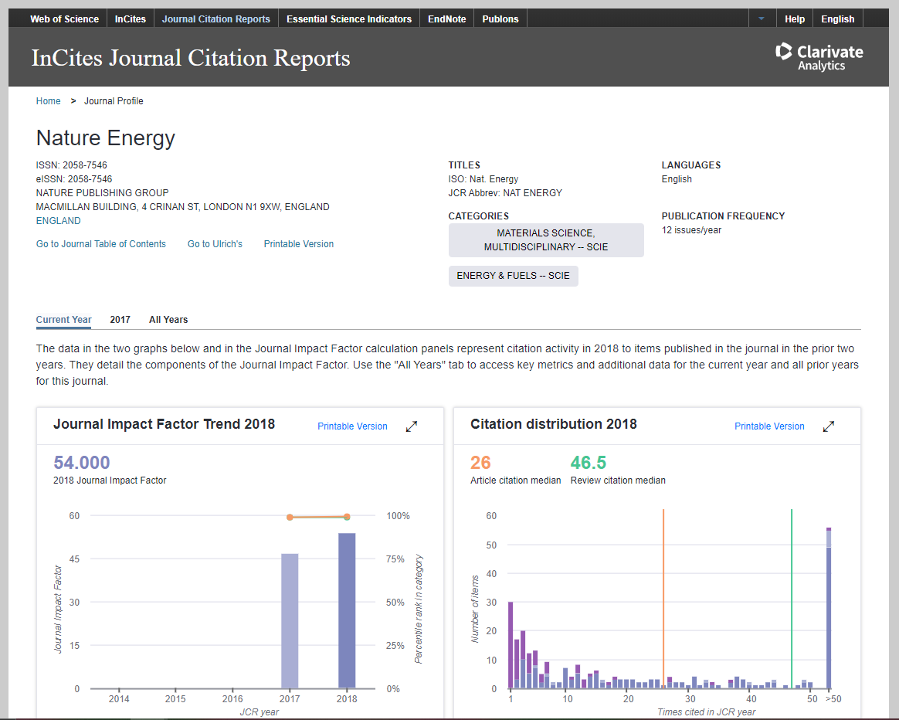
Journal Citation Reports Web of Science

Slide 32
Author Metrics
Total number of publications
Total number of overall citations
Percentage of papers cited
Average number of citations per paper

Slide 33
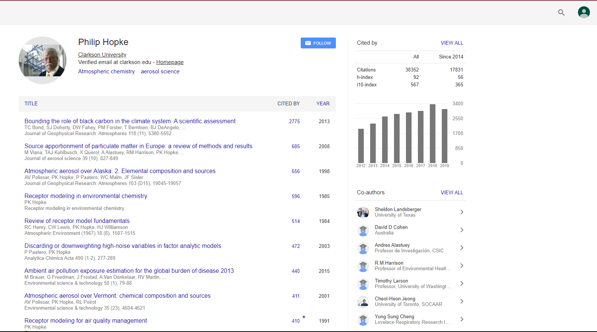
h-Index Metric assigned at the researcher level
Sources which can calculate:
Scopus
Web of Science
Google Scholar

Slide 34
Article Level Metrics
Time Cited
The times cited count is an important measure of impact, but, by itself, it doesn’t indicate how a paper is performing against it’s peers
By whom?
Where?
Why?
When?
What field?

Slide 35
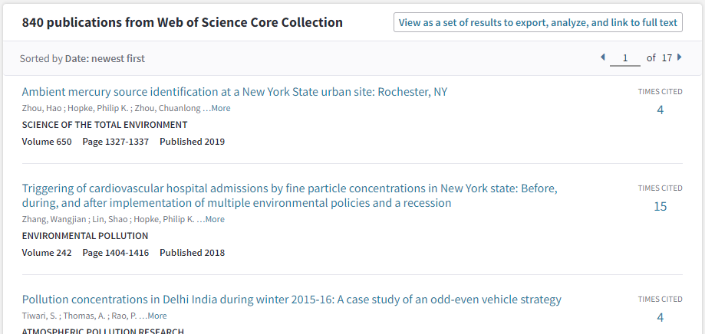
Times Cited
Web of Science
Google Scholar
Scopus

Slide 36
Additional Bibliometric Tools
EigenFactor.org
SCImago Journal & Country Rank
Harzing.com

Slide 37
Bibliometric Limitations
Citation patterns differ across disciplines are hard to compare
Large number of citations do not always indicate quality
Early Career Researchers can be at a disadvantage
Citations can take a long time to accrue

Slide 38
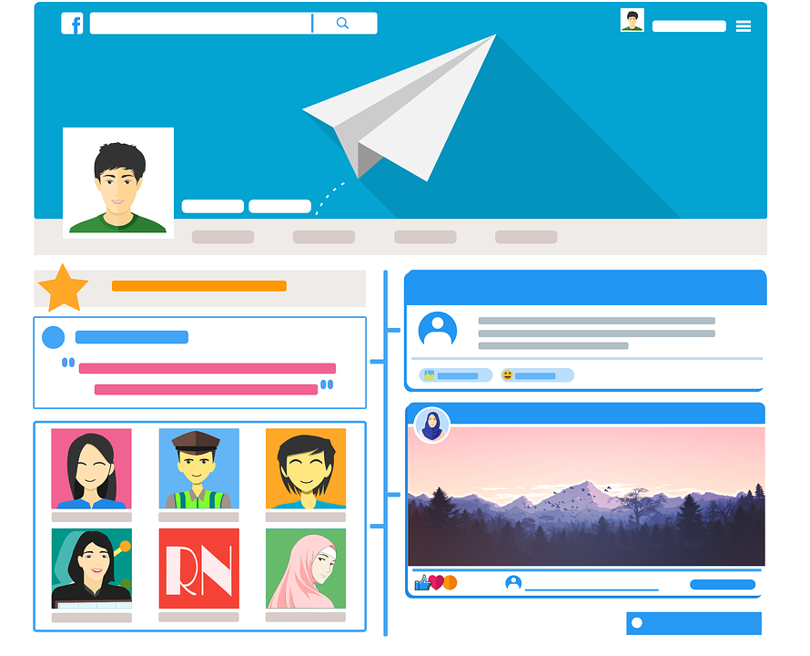
Online Presence & Output
Researchers becoming more engaged with social media
Looking for alternative ways to share and promote their research – Open Access options
Increase in the types of research output across disciplines, not only journals articles & books.

Slide 39
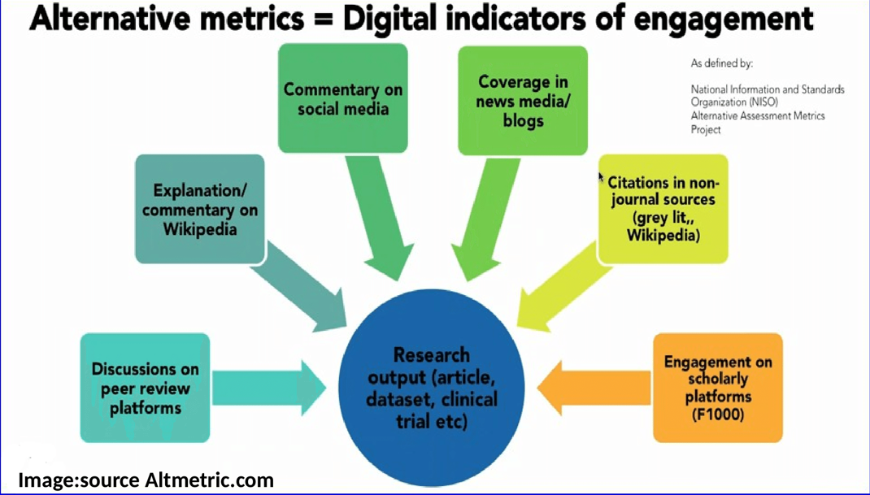

Slide 40
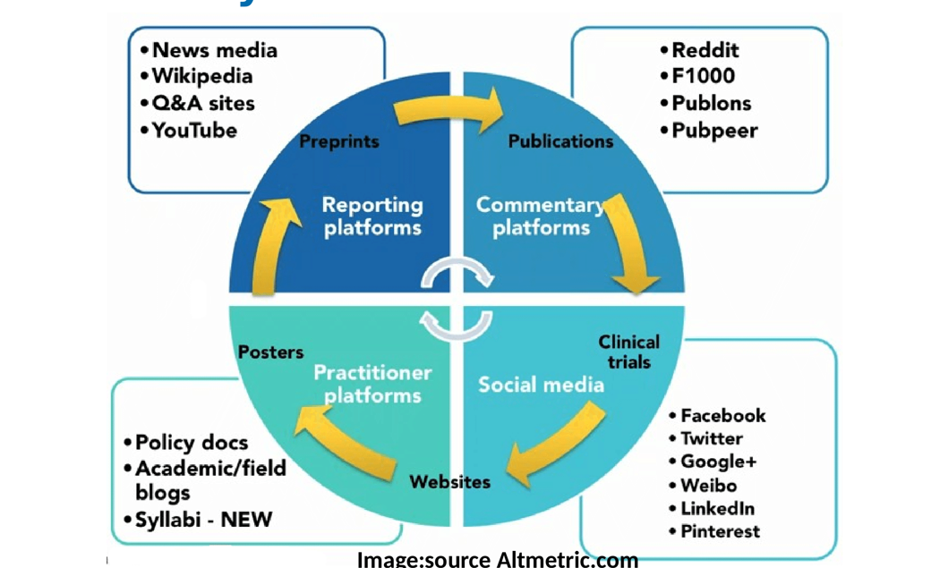

Slide 41
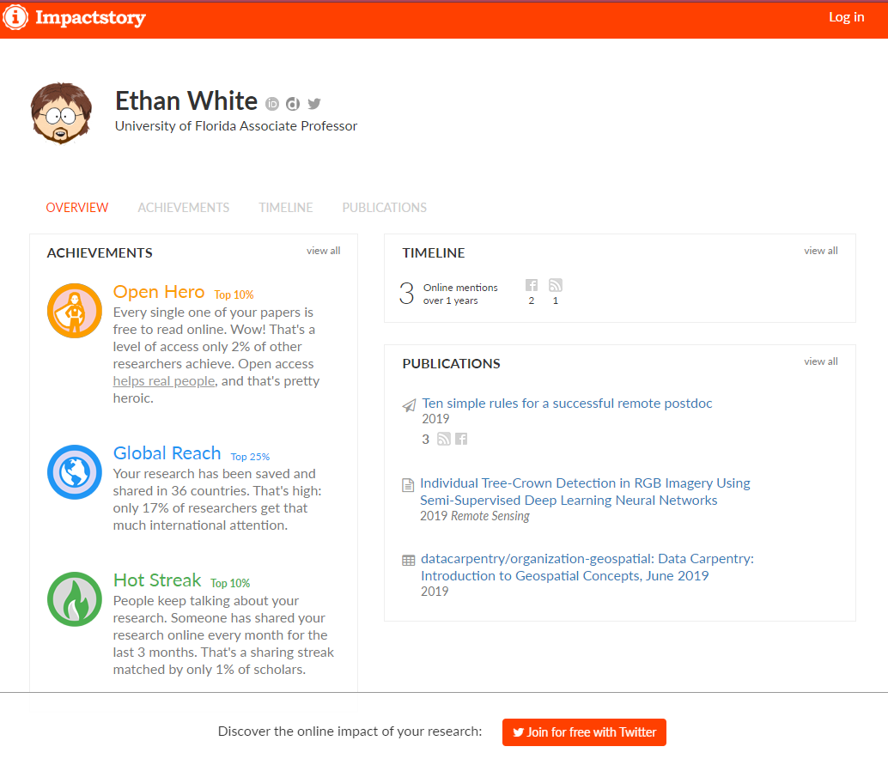
Altmetrics: Alternative Scholarly Impact Metrics
Measure of the volume and nature of attention that research receives online
Altmetric.com
Impactstory
Commercial Product
Measures the impact of data, software, presentations, and other scholarly outputs
Open source, web-based tool
Measures the impact of journal articles, blog posts, datasets, and software
Join free via Twitter

Slide 42
Graduate Workshops: Spring 2020
4/7 Staying Up to Date in Humanities Literature
4/14 Staying Up to Date in Engineering Literature
4/21 Staying Up to Date in The Sciences Literature
@ 5pm via Zoom

Slide 43
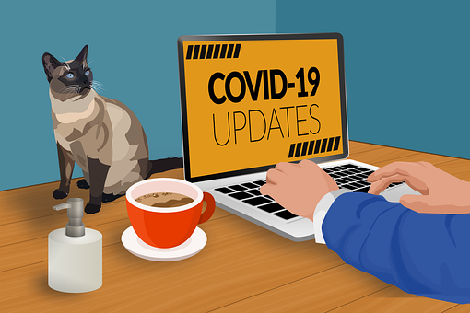
Contact Me!
Amber Dashnaw
aldashnaw@clarkson.edu

