Slide 1
Clarkson University Libraries Workshop Series Data Visualization
Amber Dashnaw
Lisa Hoover

Slide 2
Contact Us
Amber Dashnaw
aldashnaw@clarkson.edu
(315) 268-4454
Office: ERC 1109
Lisa Hoover
lhoover@clarkson.edu
(315) 268-3760
Office: ERC 1110

Slide 3
What is Data Visualization?
Anything that converts data or information into a visual representation (chart, graph, map, table, etc.)
Communicating results very clearly to a general audience
Organizing a view of data that suggests a new hypothesis or next step in the process

Slide 4
Visualization is about: PATTERN DETECTION

Slide 5
Visualization is about: ENGAGMENT

Slide 6
Visualization is about: COMPARISON

Slide 7
Why Visualize Data?
Summaries may miss important trends
Lower barrier of entry into data analysis
Can preserve complexity or present multiple views of a single dataset

Slide 8
Goals
Analysis
Communication
Find a “story”
Try many views & combinations

Slide 9
Scientific Visualization
The visualization of scientific data that have close ties to real-world objects with spatial properties
Ex. Air flow over the wing of an airplane
Ex. 3D images of MRI scans
Goal: Generate an image for something we have spatial information for and combine that with data

Slide 10
Information Visualization
Most statistical charts and graphs
Data sets that don’t have inherent spatial components

Slide 11
Infographic
A way to combine various statistics and visualizations with a narrative.

Slide 12
Stages of Data Visualizing
Acquire: obtain the data
Parse: Provide some structure for the data’s meaning, organize it into categorie
Filter
Mine
Represent
Refine
Interact

Slide 13
Tufte’s 6 Principles of Graphical Integrity
Representation of numbers should match true proportions
Labeling should be clear and detailed
Design should not vary for some ulterior motive, show only data variation
To represent money, well known numbers are best
The number of dimensions represented should be the same at the number of dimensions in the data
Representations should not imply unintended context

Slide 14
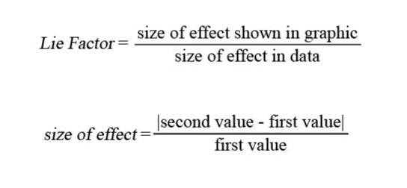
The “Lie Factor”

Slide 15
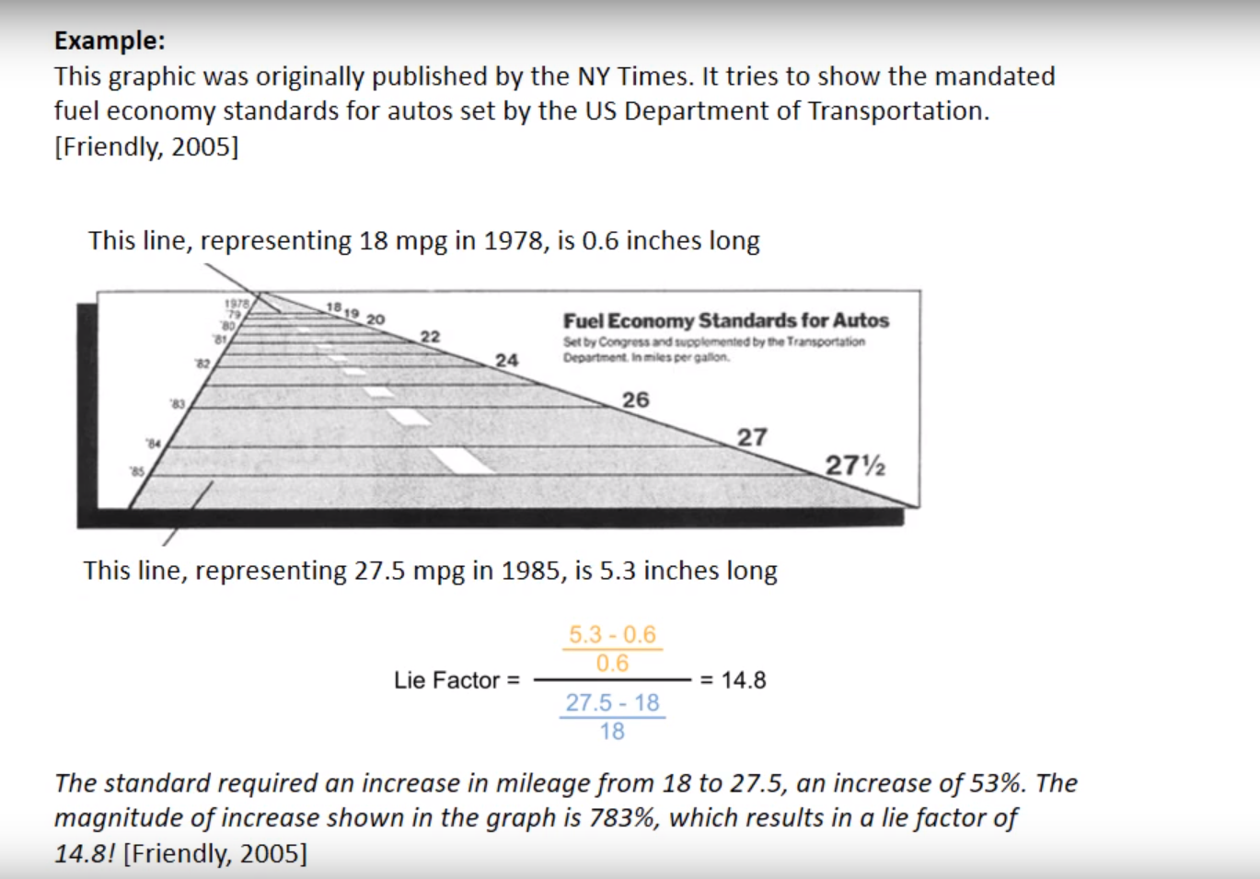

Slide 16
Types of Visualizations

Slide 17
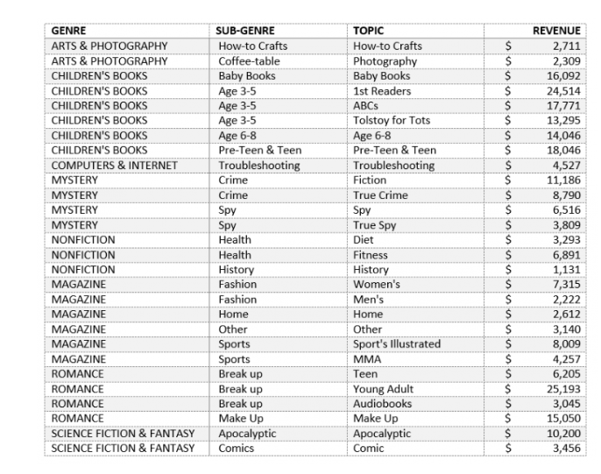
Hierarchical Data
Example:
https://www.microsoft.com/en-us/microsoft-365/blog/2015/08/11/breaking-down-hierarchical-data-with-treemap-and-sunburst-charts/
Notes:
Data where natural groupings exist. Requires some level of order and organizational structure.

Slide 18
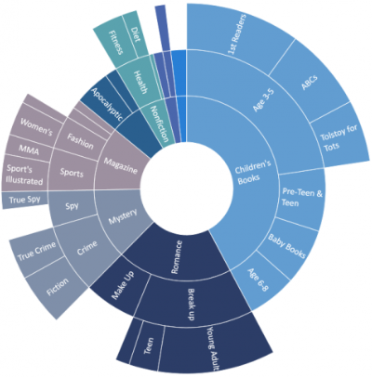
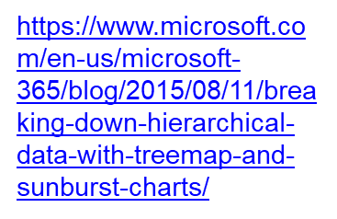
Hierarchical Data
Sunburst
Notes:
Available in Microsoft Excel. Benefit- demonstrates the depth

Slide 19
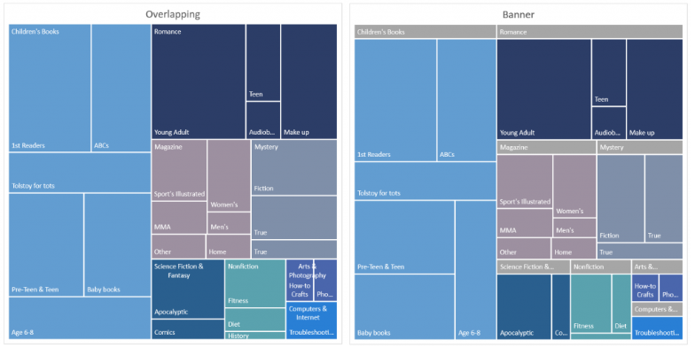
Hierarchical Data
Treemap
Notes:
Available in Microsoft Excel:

Slide 20
Histograms

Slide 21
Bar & Pie Charts

Slide 22
Scatter & Line Plots

Slide 23
Time Series Plots

Slide 24
Relationship Charts

Slide 25
Heat Maps

Slide 26
Maps

Slide 27
Word Clouds

Slide 28
3-D Plots
Benefit from Interactivity

Slide 29
Higher Dimensional Plots

Slide 31
Style and Format
Print Considerations (check in grayscale)
Cultural Considerations
Not too Many! (6-12 at most)

Slide 32
Free Data Visualization Tools
Tableau Public

Slide 33
Free Data Visualization Tools
Google Data Studio

Slide 34
Free Data Visualization Tools
Datawrapper

Slide 35
Free Data Visualization Tools
Chartbuilder

