Slide 1
Graduate Workshop: Advanced Reading Strategies
Amber Dashnaw
Fall 2020

Slide 2
Citation
Critical Reading for Graduate Students: https://sass.queensu.ca/wp-content/uploads/sites/2/2013/09/Critical-reading-for-graduate-students.pdf
This work is licensed under the Creative Commons Attribution-NonCommercial-ShareAlike 4.0 International (CC BY-NC-SA 4.0)

Slide 3
Reader Self-Awareness
Learning Style
Background Knowledge
Attitude
Concentration & Focus

Slide 4
Speed Comprehension Critical Reading Retention & Recall Volume Focus & Concentration Reducing Stress
Reading Components

Slide 5
Speed

Slide 6
Speed Reading Myths
▲ speed = ▼ retention
Skimming isn’t “real” reading
Through work MUST be done slowly
If you don’t immediately understand, read, read again!
Technical documents can’t be read rapidly
You need to remember EVERYTHING!

Slide 7
Reading Speed Test

Slide 8
Reading Speed Test
Time | Result
Under 20 seconds | Very fast
21-30 seconds | Fast
31-45 seconds | Average
46-60 seconds | Slow
61+ seconds | Very slow
Fiction & Non-technical materials
Average: 250-350 words per minute
“Good”: 500-700 words per minute
Some people can read 1000 words per minute or more…

Slide 9
Reading Rate
Determined by:
Reader’s purpose
Difficulty of the material
Internal structure of the information

Slide 10
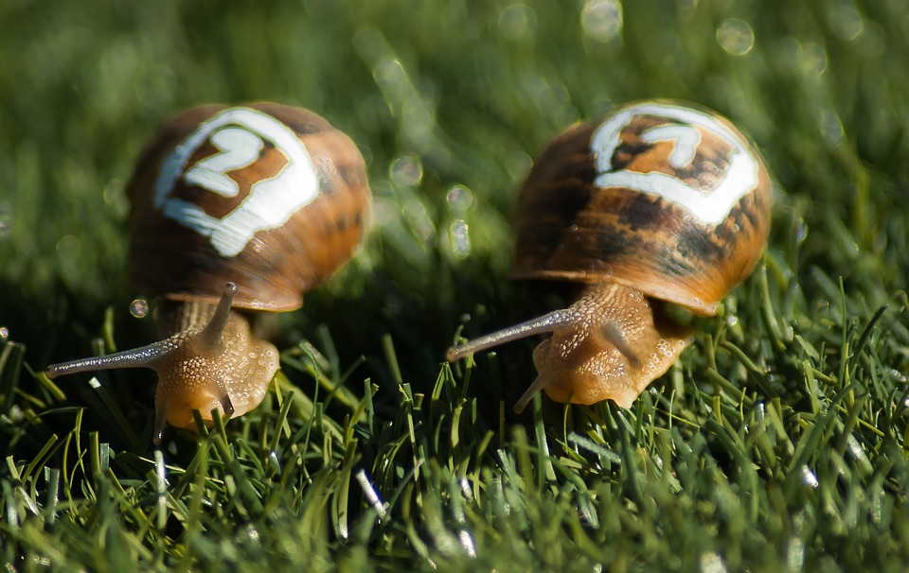
What Slows you Down?
Fixating or Regressing
Not distinguishing important information
Habit
Subvocalization
Fear

Slide 11
Speed Strategies
Skimming
Skimming is reading!
Take mental notes of the outline of the material
Pay attention to what stands out
Quickly survey the headings & keywords

Slide 12
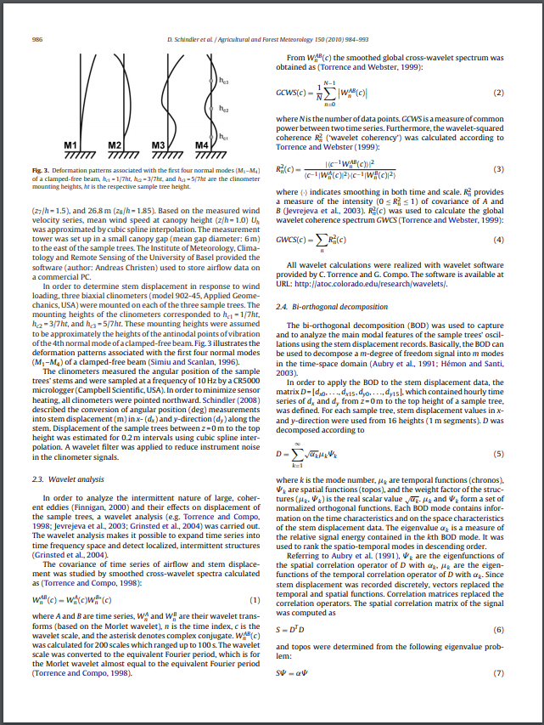
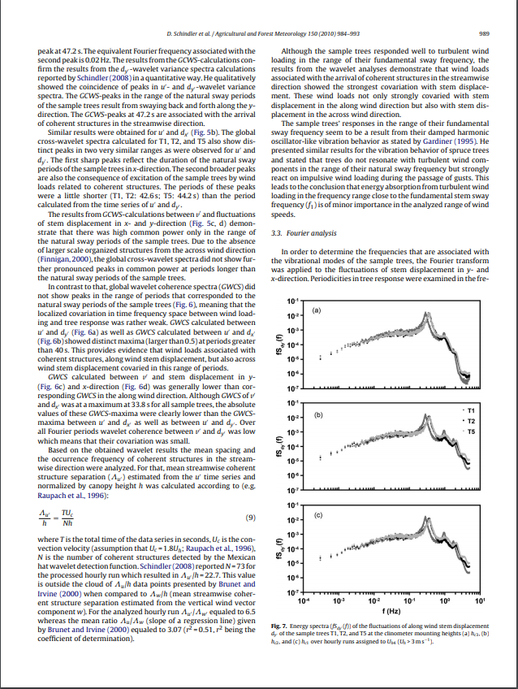
Speed Strategies: Condition your Eyes
Pacer
or Pointer

Slide 13
Speed Strategies: Condition your Eyes
Window Slot
Technique

Slide 14
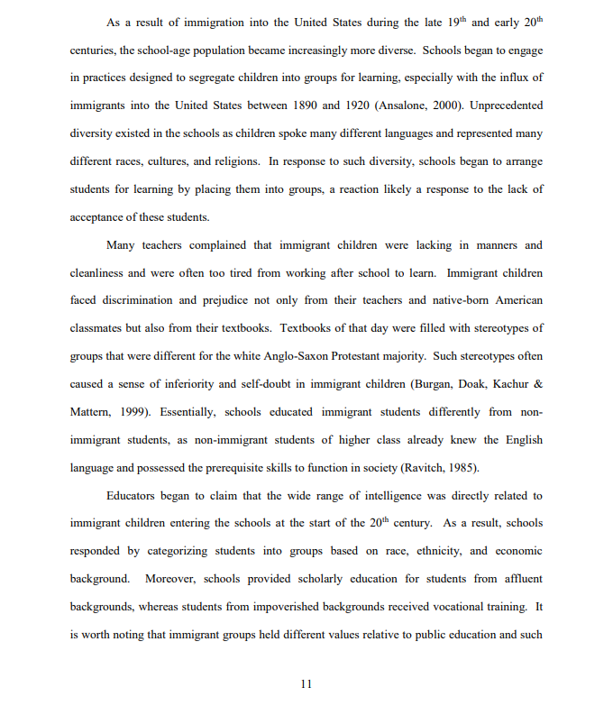
Speed Strategies
Word Chunking
Taking in several words
at a time (usually 3)

Slide 15
Speed Strategies
Use Peripheral
Vision

Slide 16
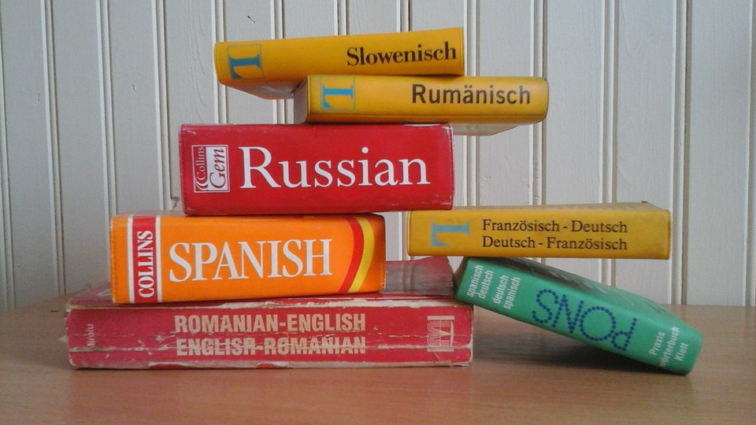
Speed Strategies: Improve your Vocabulary
Read lots & widely
Play word games
& puzzles
Strive to learn a few new academic
& non-academic words per week
Create a personal
dictionary

Slide 17
Shift Gears: Skip material unsuitable to your purpose
Decrease Speed When:
Increase Speed When:
You find an unfamiliar word or concept
Detailed, technical material
Material for which you have little background knowledge
Material which you need to recall in great detail
Simple material you’re familiar with
Unnecessary examples
Detailed explanations
Broad, generalized ideas

Slide 18
Digital Resources
Spritz
ZapReader
Spreeder
Beeline Reader
Rewordify.com
Text Compactor

Slide 19
Comprehension

Slide 20
Good Comprehension is:
Being able to select and understand what you need
Retaining & recalling that information
Linking new information to existing information

Slide 21
Factors that Affect Comprehension
Level of complexity
Level of interest
Background Knowledge
New vocabulary

Slide 22
Comprehension Strategies
SQ3R (Survey, Question, Read, Recall, Review)
Survey
Get an overview of the paper
What is the paper about?
Read:
Title & Abstract
Conclusion
Introduction
Section Headings
Tables & Graphs
Who wrote the paper and when?
Skim the references- did they include relevant works?

Slide 23
Comprehension Strategies
SQ4R (Survey, Question, Read, React, Recite, Review)
Question
Turn the headings into questions
Ask yourself:
Do their results rely on any assumptions? Are they reasonable?
Examine the methods:
Do the methods measure what they claim? Did they explain what they observed?
Did they have adequate controls? Were the tests carried out in a standard way?
Examine the statistics:
Were appropriate statistical tests applied? Was proper analysis used?
Are the results statistically significant?
Examine the conclusions:
Do they follow logically from the observations? What other explanations are there?
What other conclusions or correlations are not pointed out?

Slide 24
Comprehension Strategies
SQ4R (Survey, Question, Read, Recall, Review)
Read
Take Notes (in your own words)
Highlight major points
Analyze this work through the lens of your own experience
If you disagree or agree with a statement, make a note
Recall
Without looking at your notes or the text visualize the main points
**More time should be spent on recall than on reading**
Review
Look at your notes, how well did you recall?

Slide 25
Critical Reading
Evaluating and judging the accuracy of statements and the soundness of the reasoning that leads to the conclusions

Slide 26
Critical Reading Asks:
Who is the author?
Is the information relevant to the context?
Does the author provide adequate support for their conclusions?
What are the authors underlying assumptions?
Consider:
The underlying assumptions
The argument
The argument evaluations

Slide 27
Critical Reading Strategies
Underlying Assumptions Awareness

Slide 28
Critical Reading Strategies
Identifying the argument
People present arguments to persuade others to accept claims
Claim: A statement representing an idea about the way the world is or should be
Premise: Evidence to support a claim
Conclusion: The claim being defended by the evidence

Slide 29
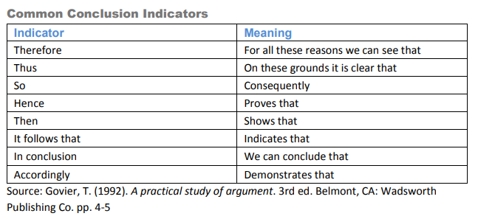
Critical Reading Strategies: Indicator Words

Slide 30
Critical Reading Strategies
Evaluating the Argument
Terms are clearly defined
Writers define key terms for the readers
Information is used fairly
Information presented is correct & current, does not distort facts,
or only represent one side
The argument is logical
On what ‘grounds’ is the information based?

Slide 31
Critical Reading Strategies
Avoiding Logical Fallacies
Hasty Generalization
Missing the Point
Weak Analogy
Appeal to Authority
Straw Man
Red Herring
False Dichotomy
Begging the Question (Circular Reasoning)
Notes:
Hasty generalization Making assumptions about a whole group or range of cases based on a sample that is inadequate (usually because it is atypical or just too small). Stereotypes about people are a common example of the principle underlying hasty generalization.
Missing the point The premises of an argument do support a particular conclusion, but not the conclusion that the arguer actually draws.
Weak analogy Many arguments rely on an analogy between two or more objects, ideas, or situations. If the two things that are being compared aren't really alike in the relevant respects, the analogy is a weak one, and the argument that relies on it commits the fallacy of weak analogy.
Appeal to authority Often we add strength to our arguments by referring to respected sources or authorities and explaining their positions on the issues we're discussing. If, however, we try to get readers to agree with us simply by impressing them with a famous name or by appealing to a supposed authority who really isn't much of an expert, we commit the fallacy of appeal to authority.
Straw man One way of making our own arguments stronger is to anticipate and respond in advance to the arguments that an opponent might make. In this fallacy, the arguer sets up a wimpy version of the opponent's position and tries to score points by knocking it down. But just as being able to knock down a straw man, isn't impressive, defeating a watered-down version of your opponents' argument isn't impressive either.
Red herring Partway through an argument, the arguer raises a side issue that distracts the audience from what's really at stake. Often, the arguer never returns to the original issue.
False dichotomy (either/no) In false dichotomy, the arguer sets up the situation so it looks like there are only two choices. The arguer then eliminates one of the choices, so it seems that we are left with only one option: the one the arguer wanted us to pick in the first place. But often there are really many different options, not just two—and if we thought about them all, we might not be so quick to pick the one the arguer recommends!
Begging the question (e.g. circular reasoning) A complicated fallacy; it comes in several forms and can be hard to detect. An argument that begs the question asks the reader to accept the conclusion without providing real evidence; the argument either relies on a premise that says the same thing as the conclusion (i.e. "being circular" or "circular reasoning"), or simply ignores an important (but questionable) assumption that the argument rests on.

Slide 32
Reading Research Papers
Strict format
Page limitations
Assumed knowledge of audience
Analyze & critique the thesis
Assess the validity & reliability of the findings

Slide 33
Reading Research Papers
Three- Pass Approach
First Pass (5-10 minutes)
Quick Scan
Read title, abstract, and introduction
Read the section headings
Read the conclusion
Glance over the references
Answer the 5 C’s:
Category: What type of paper is this?
Context: What other papers is this related to?
Correctness: Do the assumptions appear to be valid?
Contributions: What are the paper’s main contributions?
Clarity: Is the paper well written?

Slide 34
Reading Research Papers
Three- Pass Approach
Second Pass (<60 minutes)
Read the paper
Ignore the details
Write down the key points
Analyze the figures & diagrams
You can now:
Summarize the main point with supporting evidence

Slide 35
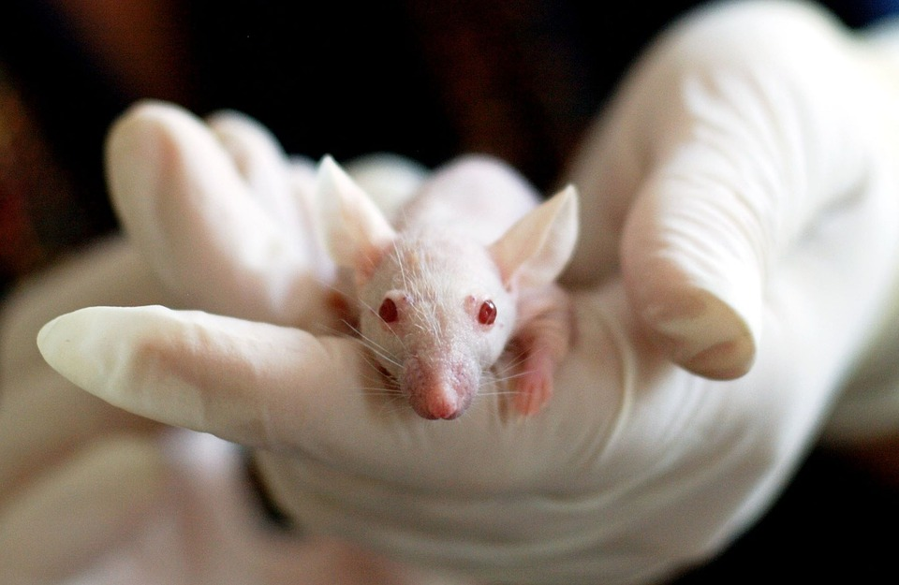
Reading Research Papers
Three- Pass Approach
Third Pass (4-5 hours)
Make the same assumptions as the author
Identify and challenge every assumption
Think about how you would present the idea
Jot down ideas for future work
You can now:
Reconstruct the entire paper from memory and identify it’s strong and weak points
Pinpoint implicit assumptions, missing citations, and potential issues with techniques

Slide 36
Retention
61% of what you read is lost after the first hour and 100% is lost after 24 hours unless you revisit the information!

Slide 37
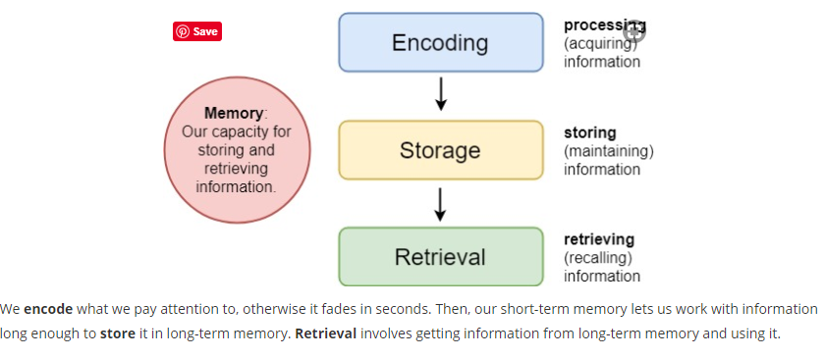
How do we Form Memories?

Slide 38
Retention Strategies
Note Taking
Good Notes:
Summarize the information
Are written in your own words
Organize the information hierarchically by main points, secondary information, and details
Identify relationships & connections between ideas

Slide 39
Retention Strategies
3-step Approach
Read the material & focus on understanding
Take notes on the main ideas (paraphrasing the content)
Highlight the most important information (no more than 20%)

Slide 40
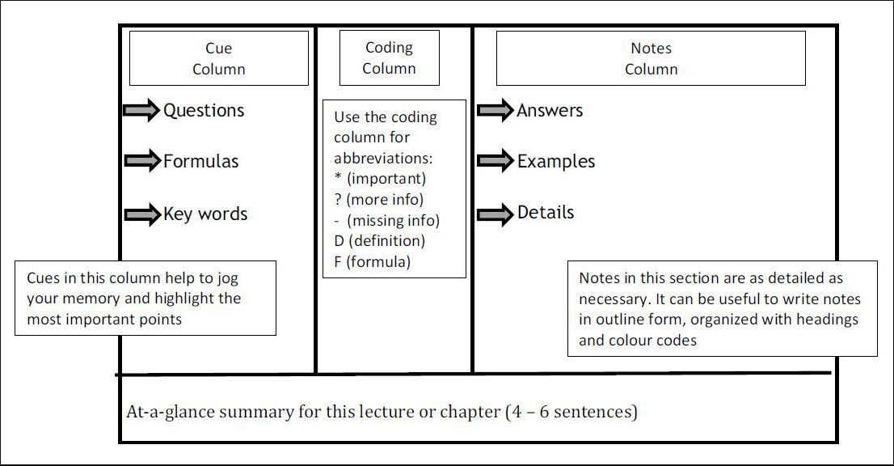
Retention Strategies
Cornell Method

Slide 41
Retention Strategies
Mind Map

Slide 42
Retention Strategies
Highlighting (Use Sparingly)
Use different colors (for the main points, subordinate points, etc.)
Use in conjunction with mind maps
Avoid: using it as a procrastination tool (i.e. identifying what you should learn instead of learning it)

Slide 43
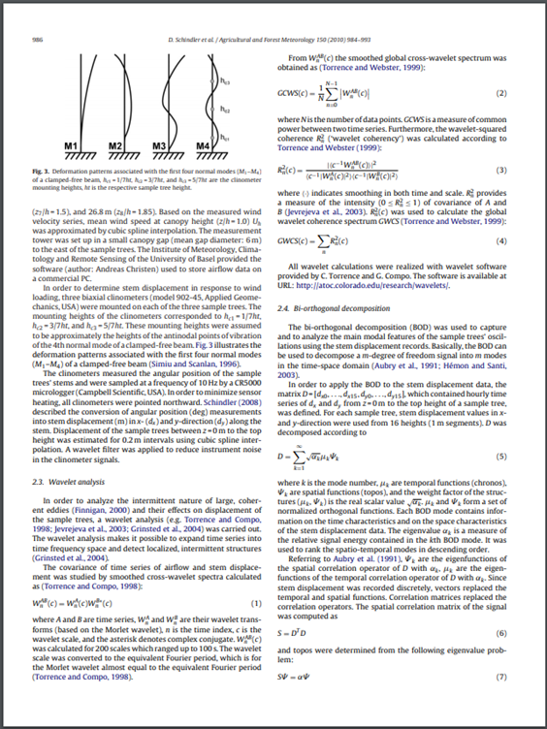
Retention Strategies
Margin Notes
Underlining or circling key words-
then making notes in the margins as you read

Slide 44
Retention Strategies
Reading Out Loud
Helpful for auditory learners

Slide 45
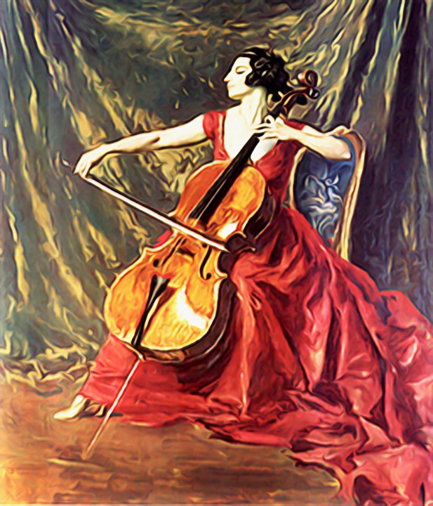
Retention Strategies
Listen to Music!
High-frequency music has a
positive effect on memory

Slide 46
Retention Strategies
Teach Someone Else
Forces you to organize, synthesize,
and explain the information
Develop your own analogies to make
concepts more memorable

Slide 47
Volume

Slide 48
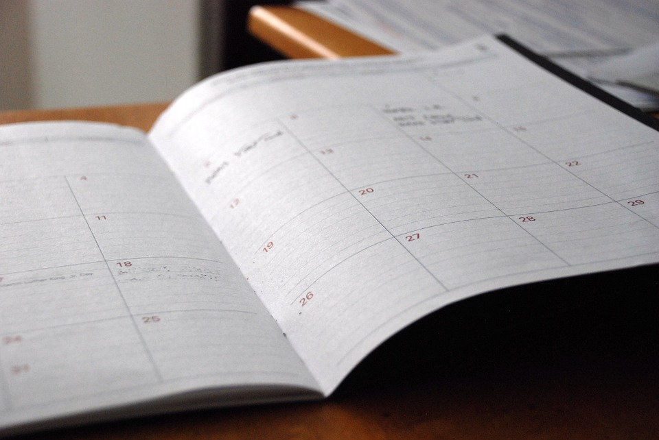
How to Deal?
Schedule a block of time everyday that you will dedicate to reading
Reduce the amount to just the essential things and then read them in a manner appropriate for the type
Purpose: begin your reading with a purpose in mind. (i.e. for an assignment, to get an overview, in-depth understanding, etc.)

Slide 49
Focus & Concentration

Slide 50
Focus & Concentration Strategies
Minimize distractions
Know your concentration span (50-10-50)
Don’t try to read when you’re tired
Tactile learners: Do something while you read
Play with playdough
Draw pictures
Read while standing
Bounce a tennis ball
Twist a rubber band
Tension & relaxation technique

Slide 51
Focus & Concentration
The ‘Off-Track’ Problem
Good: Exploring & curiosity lead you to new information and ideas
Bad: Continually not achieving your goal can be frustrating & unproductive

Slide 52
Focus & Concentration The ‘Off-Track’ Problem
Worry Behavior
Goal-Setting Behavior
Worries, anxieties, or fear that you don’t know enough about your topic area drives your behavior
Worrying that you should know everything about your field
Behaviors are based on real needs & goals
Set small, attainable, and time-specific goals (today I will read one paper or this week I will create a reading schedule)

Slide 53
Focus & Concentration Strategies
The ‘Off-Track’ Problem
Write the new idea on a separate piece of paper (for later investigation)
Create an “Interesting Ideas” file
Organize your time
Self Check-in, use a timer to bring you back to your task/goal
Be nice to yourself!

Slide 54
Reducing Stress

Slide 55
Reducing Stress
Common Stressors
Common Reactions
Lack of time and/or resources
Financial worries
Unclear academic expectations
Homesickness, loneliness, loss
Language barriers, cultural adjustment, and isolation
Loss of focus and concentration
Irritability
Physical tension and/or illness
Avoidance/Procrastination
Exhaustion/Lethargy
Low self-confidence or self-esteem
Sadness
Feelings of being overwhelmed
Changes in eating, sleeping, and exercise
Social withdrawal

Slide 56
Reducing Stress Strategies
Adopt a helpful mindset
Take Stock
Identify your source of stress
Determine what is in your control and what is not
For stressors you control:
What do I need to handle this problem? (information, time, help, a skill, etc.)
Where can I get what I need? (library, professor, classmate, etc.)
When will I take care of this?
Reflect on what you have done previously to help cope in similar situations
Change your mindset
Remember that how we perceive situations is an important factor
Ask yourself “what is the worst that can happen? Is it likely?”
Keep things in perspective
Determine the most important thing to do right now and start with that
Believe in your ability to figure things out and do your best under the circumstances

Slide 57
Reducing Stress Strategies
Prioritize & Plan
Make a to-do list as complete as possible
Break large tasks into small, specific ones
Prioritize each item on the list
Estimate how much time each item will take
Make a schedule for the week blocking off times for items on the list (also including time for relaxation and sleep)
Reduce, postpone, or eliminate your optional responsibilities

Slide 58
Resources at Clarkson
Student Health & Counseling Services (SHAC)
(315) 268-6633
Writing Center
(315) 268-4439 or wcenter@clarkson.edu
Tutoring Center
(315) 268-4394
Diversity & Inclusion Office
(315) 268-4208

Slide 59
Fall 2020 Graduate Workshops Remotely via Zoom
10/08 Dissertation Literature Review Bootcamp

Slide 60
Contact Us
Amber Dashnaw Public Services Librarian for Graduate Education
aldashnaw@clarkson.edu
(315) 268-4454
Ask a Librarian
askalibrarian@clarkson.edu
(315) 268-2292

