Slide 1
Infodemic Avoiding COVID Misinformation
Lisa Hoover
X3760
lhoover@clarkson.edu
ERC 1110

Slide 2
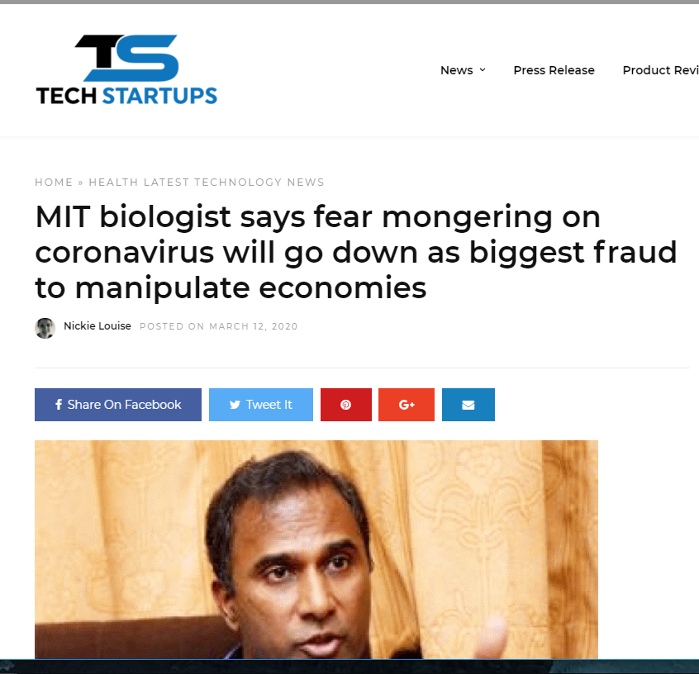
The MIT Biologist
Does he actually work for MIT?
Check the directory – no match
Googled his name + MIT – found that he has degrees from MIT, but doesn’t work for them
Does he have expertise in this area?
Has been working for tech companies, not bio companies
Was lecturer at MIT in early 2000s
Most recent is a tech company
PhD in biological engineering (systems biology) from MIT
Google searches show MIT has distanced themselves from him, professors have made disparaging comments
Is he an expert? Is he reliable?
Story

Slide 3
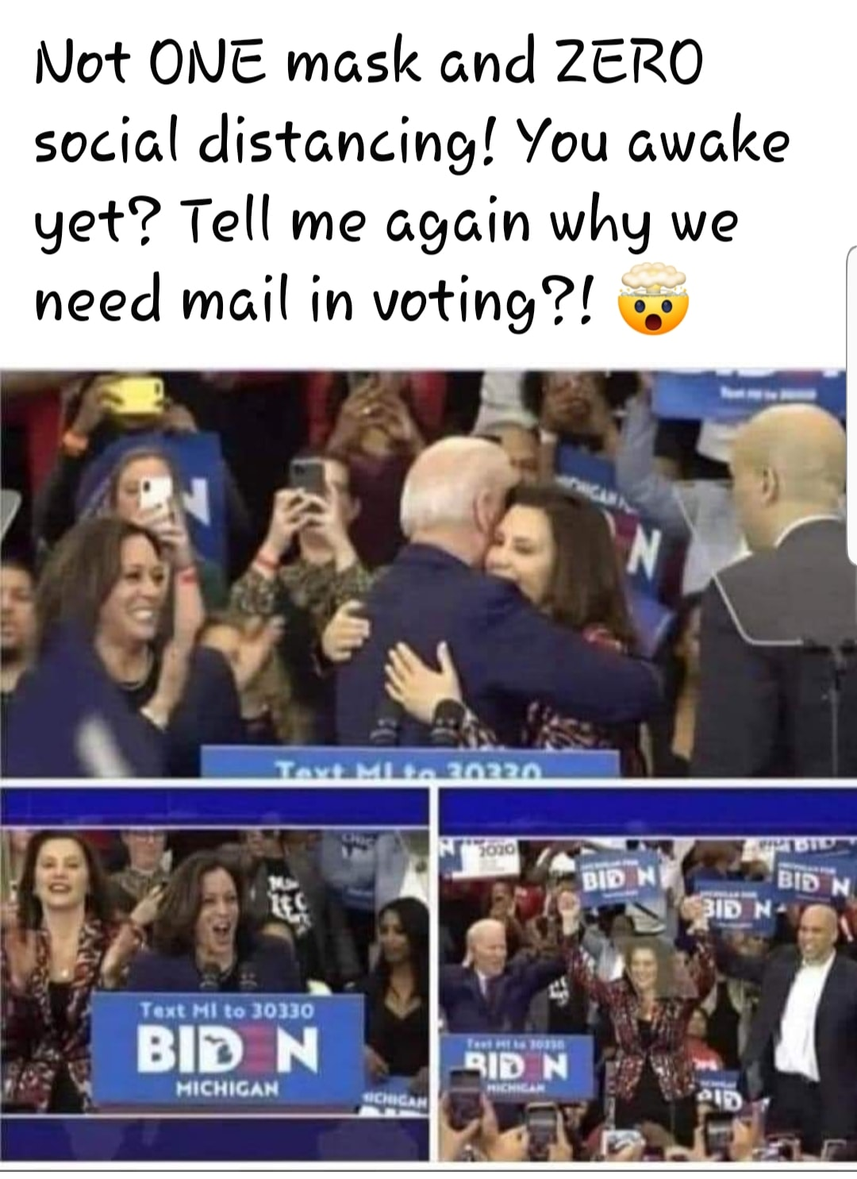
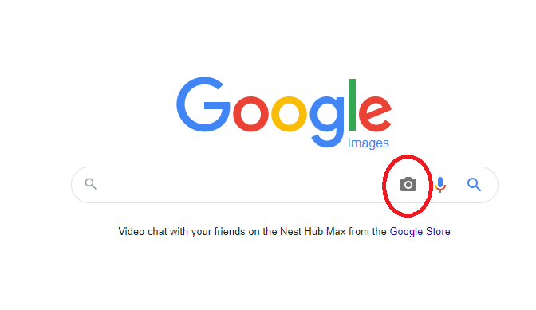
Social Distancing – or Not?
Facebook actually flagged this one for me
CheckYourFact.com says the images are from a rally in March – before CDC advised masks
How would you fact check this photo?
Google Reverse Image Search – see where the photo is from
Is this meme correct? Wrong? Misleading?

Slide 4
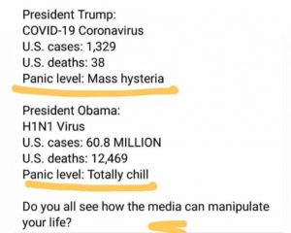
COVID v. H1N1
Also flagged by social media
Good analysis by Hoax Alert
H1N1 data is for a 1 year period (according to Hoax Alert), COVID data for just a couple weeks at this point (I grabbed this meme in March)
Look at fatality rates – CDC estimate for H1N1 2009-2018 (.00075%) & CDC estimate for COVID Feb. 1, 2020 – Aug. 26, 2020 (.02837%)
Was the media “chill” about H1N1?
Is this meme correct? Wrong? Misleading?

Slide 5
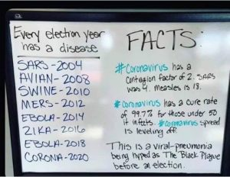
COVID & the Election?
Also flagged by social media
Good analysis by HealthFeedback
Are the years right? HealthFeedback says (citing WHO):
SARS - 2002-2003
Avian Flu – no outbreak in 2008
Swine Flu – 2009-2010
MERS – Most cases 2014
Ebola – 2014 & 2018
Zika – 2016
Contagion factor is not a scientific term; scientists discuss a reproduction number
Reproduction number for COVID not known at this point
Is the 99.7% survival rate accurate?
At the time CDC was estimating .25% to 3% fatality rate; rate now appears to be .02837% per the CDC’s numbers
Is this meme correct? Wrong? Misleading?

Slide 6
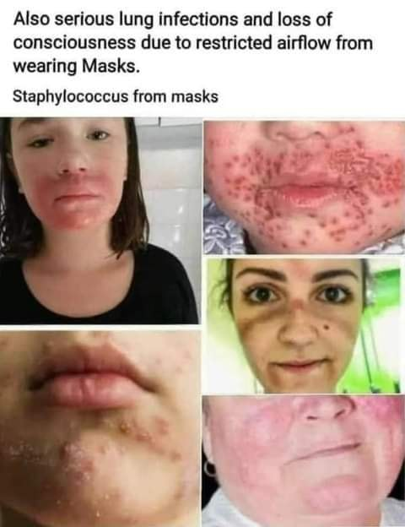
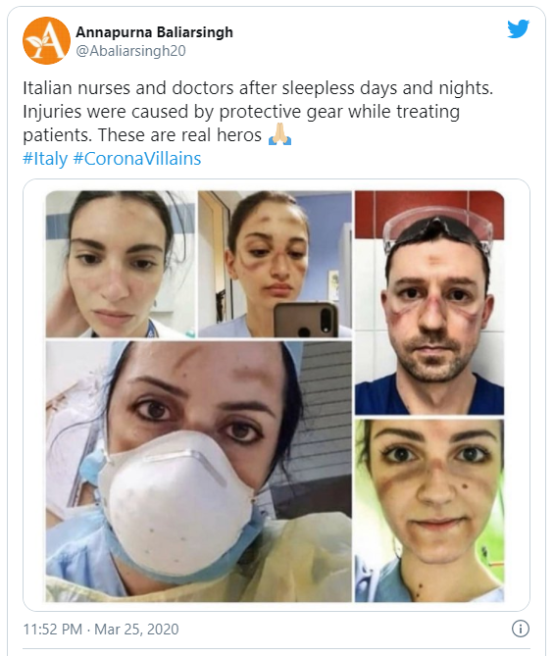
Masks & Infections
Google Reverse Images search
What does the scholarly literature say?
What do the experts say?
Good AP story analyzing:
Bottom right – rosacea
Bottom left – chickenpox
Top left – rash but no infection, probably not from a mask
“Rarely seen an increase in infection from masks” – possible if there is a break in the skin
Playing on emotions?
Is this meme correct? Wrong? Misleading?

Slide 7
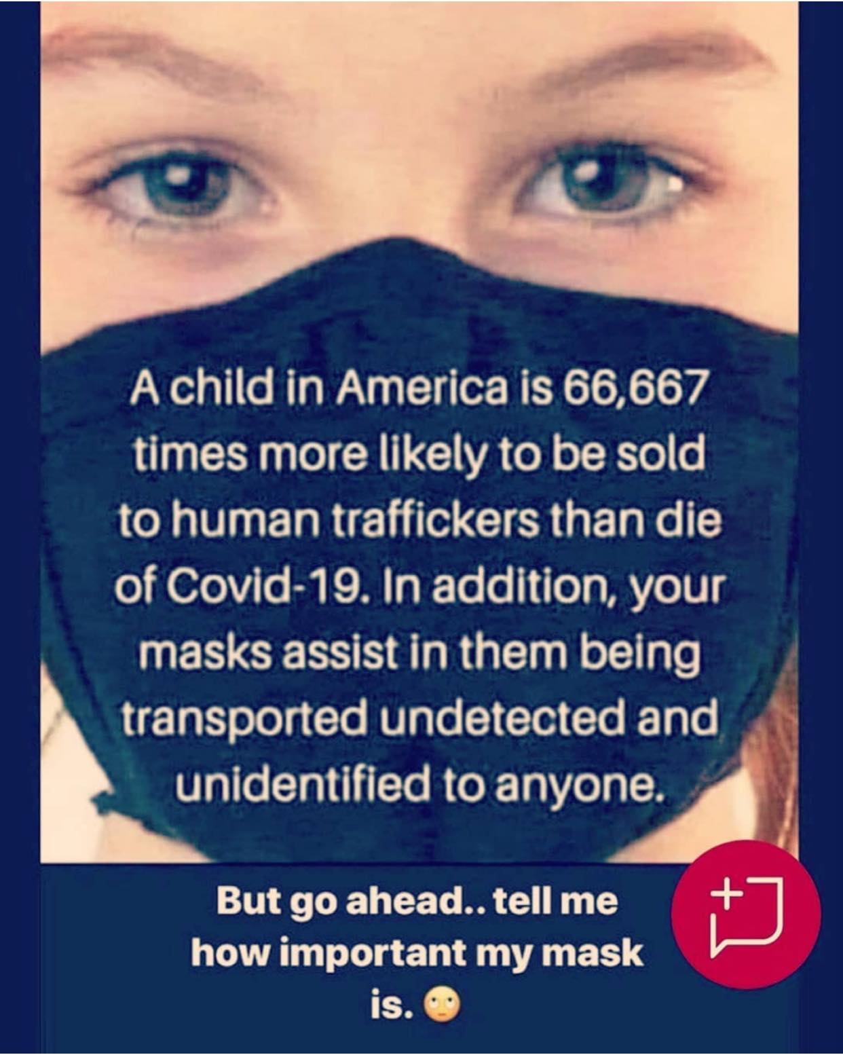
COVID v. Trafficking
March 1 – July 25, 576 cases of COVID in kids reported to CDC – hospitalization rate per 100,000 population is 8 per 100,000 (.00008%)
.00008 x 66,667 would be 5.3%
Of the 23,500 runaways reported in 2018, “1 in 7 were likely victims of child sex trafficking” according to UNICEF
1/7 = 14% of runaways
3,290 child victims
US population of minors is 74 million in 2020, according to childstats.gov
.00004% of kids are victims
Even if this were true.... Does it mean we shouldn’t worry about COVID?
Playing on emotions?
Is this meme correct? Wrong? Misleading?

Slide 8
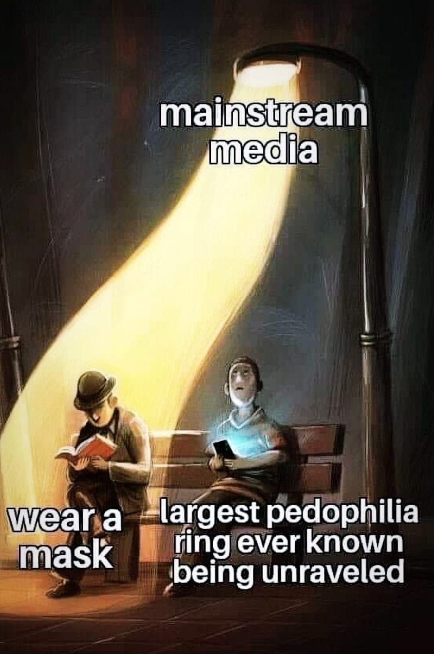
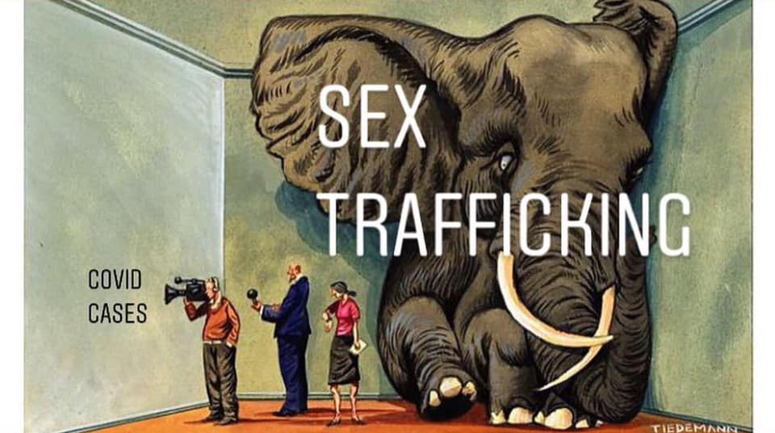
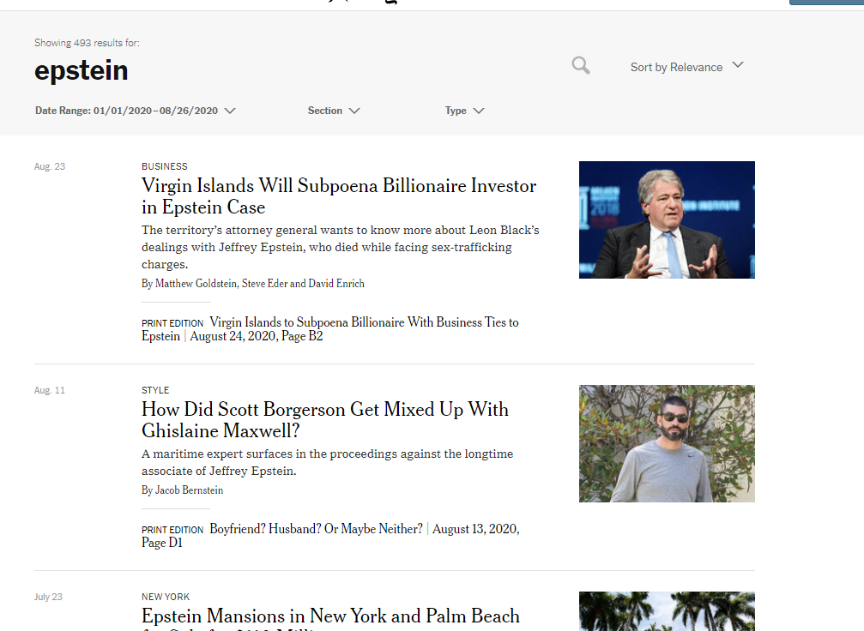
COVID v. Trafficking
Was his ring the “largest ever known?”
Epstein
2002 – 2005
“Dozens” of girls according to Time
Two dozen lawsuits (The Cut)
Accounts range from “a few dozen to over 100” (The Cut)
Sex Trafficking Data
Estimated at 1 million kids worldwide (The Conversation)
DOJ reported arrest 8/24 of man accused of trafficking “hundreds” of Thai “women”
1/3 of trafficking victims are kids, according to UNICEF
NBC reports arrest of 184 people; ring suspected to include up to 70,000 members; 230 victims in 30 countries
Did the media ignore it?
Check Google News – how many stories on it by mainstream media?
Check the mainstream media outlets and search for Epstein
Is this meme correct? Wrong? Misleading?

Slide 9
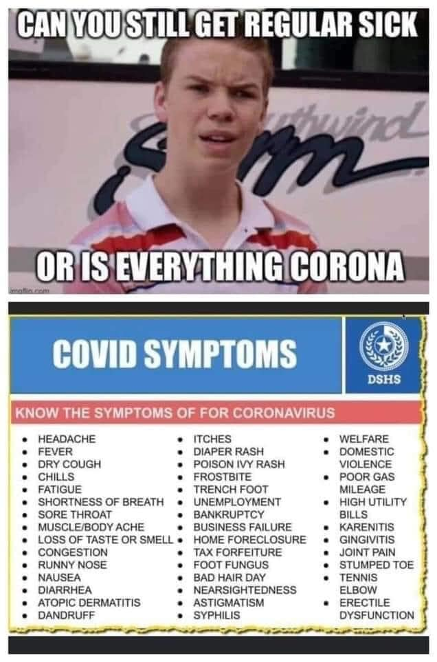
Joke symptoms?
Looks like probably originally intended as a joke... Is it still a joke?
Reverse Google images gives no indication it comes from a real source
Logo looks like a rip off from Texas Health & Human Services
Is it ethical to use an agency logo in a joke?

Slide 10
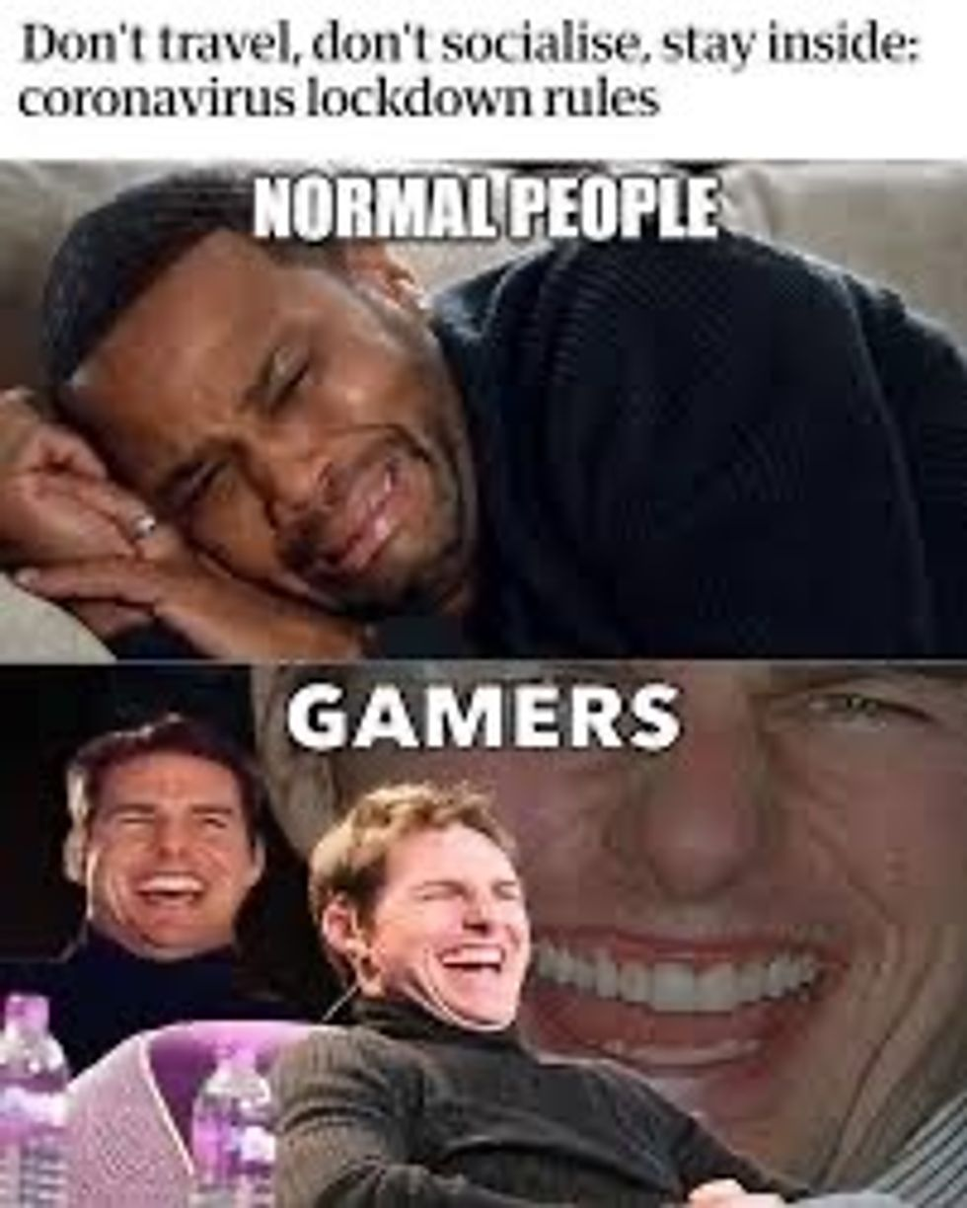
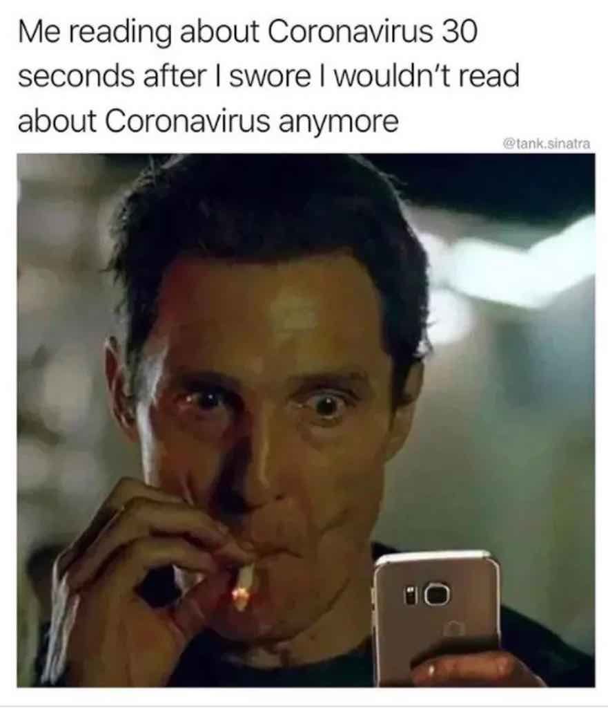
What is an ethical joke?

Slide 11
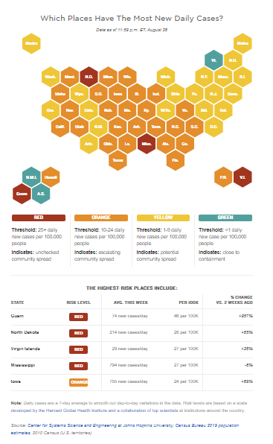
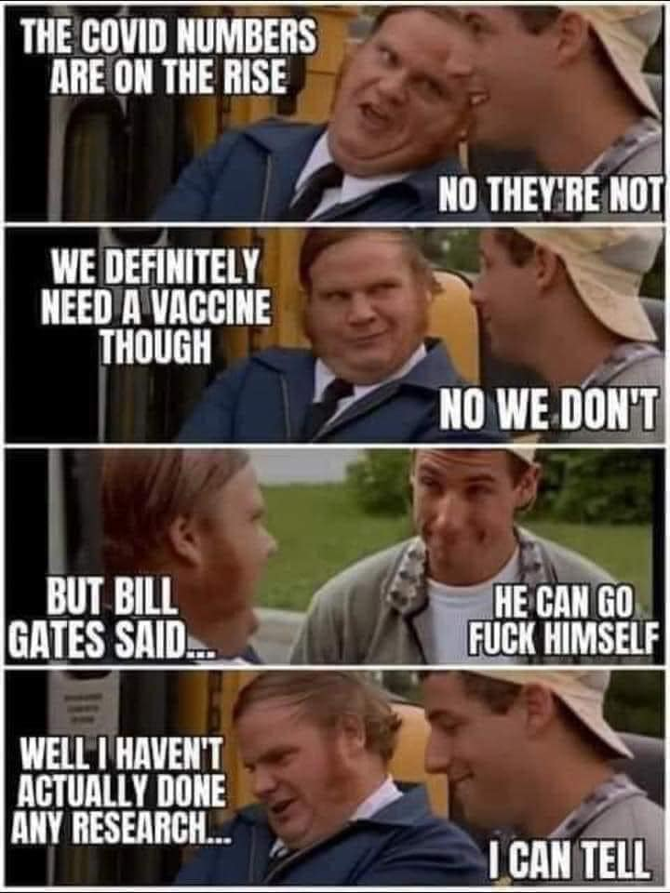
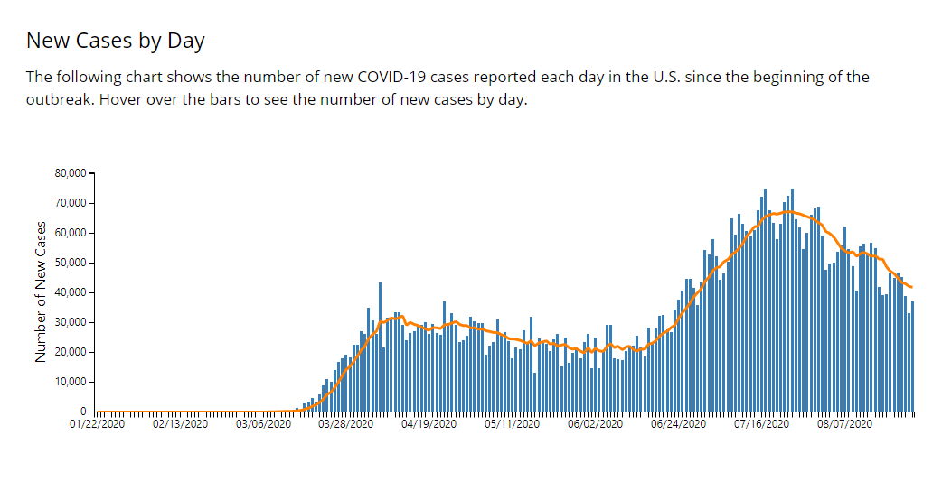
Increases? Vaccine?
True it is not as high overall in the US as it was previously (CDC)
Is increasing in some states (NPR)
Whether we “need” a vaccine is a really complicated question!
Is this meme correct? Wrong? Misleading?

Slide 12
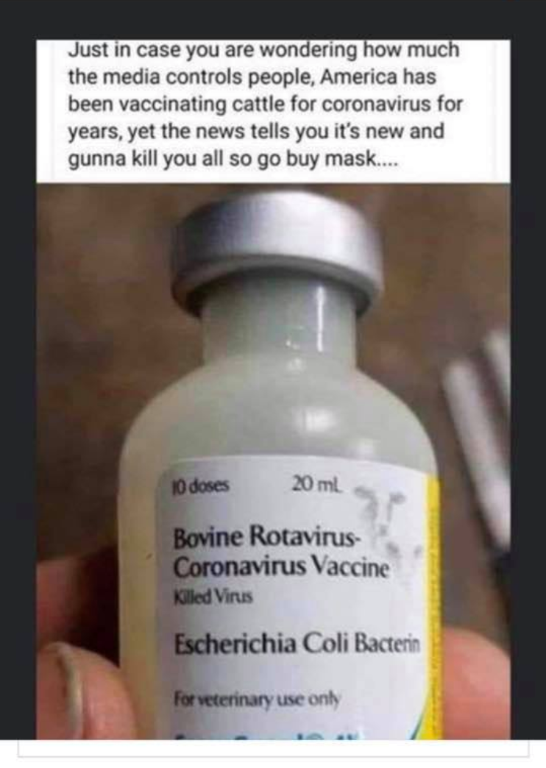
Cow Vaccine
Good Retuers analysis here
Not for human use
Bovine Corona is not the same strain as COVID-19
Coronaviruses aren’t new – COVID-19 is new
Multiple strains – just like the flu
Is this meme correct? Wrong? Misleading?

Slide 13
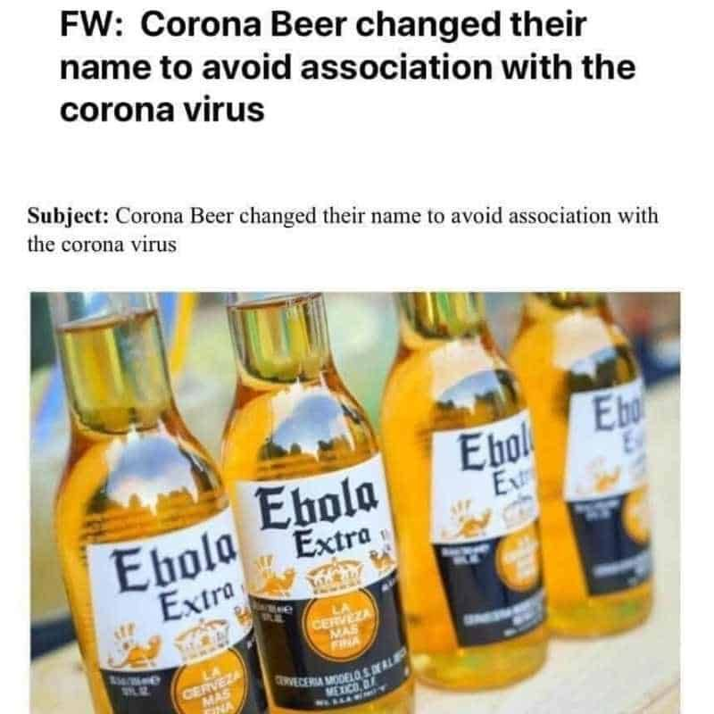
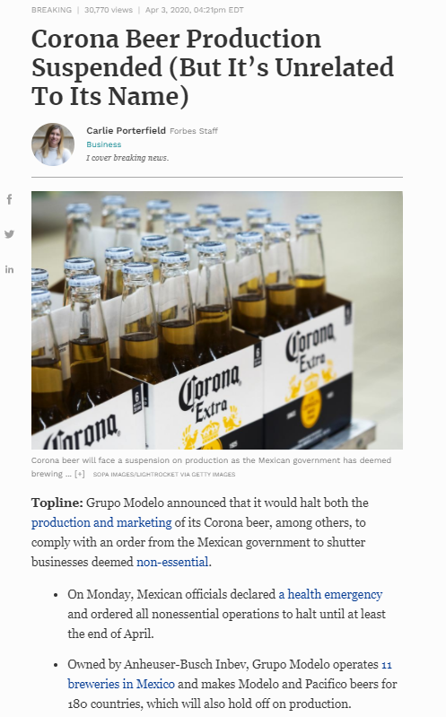
Corona Beer
Often a Google search is all you need
Is this meme correct? Wrong? Misleading?

Slide 14
Take Aways
Ask questions
Think critically
Is it over simplifying?
Is the information easily verifiable as true/false?
Are real people cited? Are those people qualified? Are they reliable?
Where did the image actually come from?
Is it appropriate to compare two sets of data?
Is it misleading?

Slide 15
Lisa Hoover
X3760
lhoover@clarkson.edu
ERC 1110

Slide 16
