Slide 1
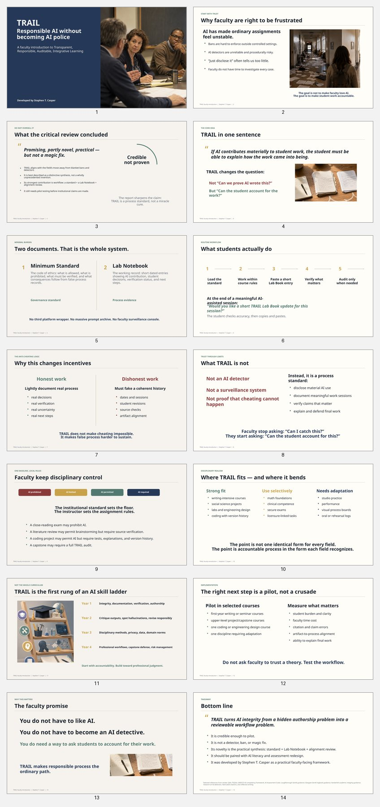

TRAIL for Students
A positive, practical way to learn with AI
and protect your own work.
Reflection Notebook • Lab Notebook • Journaling
Project management • Verification • AI literacy
A learning and Ai-Literacy tool.
TRAIL for Students • Stephen T. Casper
Cite: Casper, S. T. (2026). TRAIL: Transparent, Responsible, Auditable, Integrative Learning [PowerPoint presentations]. Clarkson University.
Notes:
This presentation introduces TRAIL as a positive tool for students. It is not police work, and it is not about assuming students are doing something wrong. It is a way to learn with AI responsibly, protect your own work, and build habits that will matter in college, graduate school, and professional life.

Slide 2

Why TRAIL exists
A simple response to a messy moment
AI is already part of school and work.
Most problems come from unclear rules and invisible process.
This is a way students can use AI without losing ownership of their work.
Faculty need something better than guessing, panicking, or policing.
TRAIL gives you a clear routine: use AI, reflect, verify, and move forward with confidence.
TRAIL for Students • Stephen T. Casper
Notes:
AI is already part of school and work, but the rules are often unclear. That creates problems for everyone. Students may not know what is allowed, and faculty may not know how work was produced. TRAIL gives you a clear routine: use AI when permitted, reflect on the process, verify important claims, and move forward with confidence.

Slide 3
TRAIL in one minute
Two documents. One simple workflow.
1. The Standard
The rules for responsible AI use
2. The Lab/Reflection Notebook
A short record of meaningful work sessions
Load the course rules 9 (.txt/.md)
Do meaningful work
Paste a short update in the notebook
Check important claims
Submit with confidence
Think of it as project management 101 for the AI era.
TRAIL for Students • Stephen T. Casper
Notes:
TRAIL has two documents. The first is the Standard, which explains the rules for responsible AI use in the course or assignment. The second is the Reflection Notebook, or Lab Notebook, which records short notes about meaningful AI-assisted work sessions. The workflow is simple: load the rules, do the work, paste a short update, check important claims, and submit with confidence.

Slide 4
Why students may actually like TRAIL
It helps you, not just your instructor
It keeps a record of your own thinking, revisions, and decisions.
It helps you show what you did and what AI only suggested.
It gives you evidence if a question ever comes up about your work.
It makes it easier to explain your project in class, in office hours, or in interviews.
It often makes later revision faster because you can see where you left off.
TRAIL is a safeguard: conscientious record keeping protects your learning and your integrity.
Big idea:
serious work leaves traces.
TRAIL for Students • Stephen T. Casper
Notes:
TRAIL is not just for instructors. It helps you keep track of your own thinking, revisions, and decisions. It helps you show the difference between what AI suggested and what you actually did. It also gives you evidence if anyone has questions about your work. The big idea is simple: serious work leaves traces.

Slide 5

Your Reflection Notebook
Lab Notebook, journaling, process log — whatever term makes sense to you
You make a short entry after a meaningful AI-assisted session.
You do not need to record every tiny prompt or keystroke.
The goal is to capture the essentials: what you worked on, what AI did, what you decided, what you checked, and what comes next.
That is enough to help you remember, revise, and explain your work.
Short, honest, and useful beats long and performative.
TRAIL for Students • Stephen T. Casper
Notes:
You can call this a Reflection Notebook, Lab Notebook, journal, process log, or project notebook. The name matters less than the habit. You do not need to record every tiny prompt. You only need to capture the essentials: what you worked on, what AI helped with, what you decided, what still needs checking, and what comes next.

Slide 6
Core skills you are building - automatically
This is bigger than one assignment
Documentation
Keep a usable record of your work.
Verification
Check claims, citations, sources, data, and code.
Project management
Track tasks, decisions, and next steps.
Leadership
Own the process and explain your choices.
Compliance
Learn to work within rules and standards.
Professional habits
Build routines employers and grad schools value.
TRAIL for Students • Stephen T. Casper
Notes:
TRAIL helps build skills that go beyond one assignment. Documentation means keeping a usable record of your work. Verification means checking claims, citations, sources, data, and code. Project management means tracking tasks and next steps. Leadership means taking ownership of decisions. Compliance and professional habits matter because many future workplaces will expect people to document, test, and explain AI-assisted work.

Slide 7

TRAIL is the floor of AI literacy
It teaches the first habits students need
Notice when AI is helping and when it is risky.
Separate AI assistance from your own responsibility.
Check what matters instead of trusting outputs blindly.
Record decisions so you can explain your work later.
Build habits that later support advanced AI use in your major or career.
Year 1 starts here: integrity, documentation, verification, and judgment.
TRAIL for Students • Stephen T. Casper
Notes:
TRAIL is the starting point of real AI literacy. Before students can use advanced AI tools well, they need to know when AI is helping, when it is risky, what must be verified, and what remains their own responsibility. Year 1 starts with integrity, documentation, verification, and judgment. Those habits make later AI use safer and more powerful.

Slide 8
Why this helps with debugging and troubleshooting
Especially useful for coding, agents, subagents, repos, and multi-step work
Write down the problem you were trying to solve.
Note what the AI agent or tool actually did.
Record what you tested, what failed, and what changed.
Track repo errors, broken assumptions, and fixes that worked.
If an instructor flags an issue, you can revisit the process instead of guessing.
Faster debugging
Cleaner handoffs
Better revision
TRAIL for Students • Stephen T. Casper
Notes:
TRAIL is especially useful for coding, agents, subagents, repo work, and other multi-step projects. If something breaks, the notebook helps you remember what problem you were trying to solve, what the AI tool did, what you tested, what failed, and what changed. That makes debugging faster, handoffs cleaner, and revision easier.

Slide 9
How TRAIL safeguards you
Conscientious record keeping can protect your work and improve it
If something is flagged, you can show your process instead of just defending the final result.
A good notebook helps you revisit weak spots, fix mistakes, and improve the work.
TRAIL reduces the risk of accidental integrity problems caused by bad citations, unchecked claims, or overreliance on AI.
If you forgot to document earlier work, be honest: use a retrospective note instead of inventing a fake record.
TRAIL is about accountability with support — not suspicion by default.
It helps you protect both your grade and your learning.
TRAIL for Students • Stephen T. Casper
Notes:
TRAIL protects you by giving you a record of your own learning. If something is flagged, you can show the process rather than simply defend the final product. It also helps you catch problems before submission: bad citations, unchecked claims, overreliance on AI, or gaps in reasoning. If you forgot to document earlier work, the honest answer is a retrospective note, not a fake record.

Slide 10
What a short lab entry will look like – the Ai writes it for you
Simple enough to copy, paste, and use
## Lab Book Entry — YYYY-MM-DD
**Project:** Research paper on public health
**System used:** ChatGPT
**Session focus:** Outline and source-checking
Today I worked on the outline for my paper and checked whether my main claims had enough support. The AI helped me brainstorm headings and identify where my evidence was thin. I rejected two suggested claims because they were too broad. I still need to verify two citations and one statistic before drafting the final section.
**Next step:** Verify the remaining sources and draft section three.
Ask yourself:
What happened?
What did AI do?
What did I decide?
What still needs checking?
What comes next?
TRAIL for Students • Stephen T. Casper
Notes:
This is the basic model. The entry is short, plain, and useful. It identifies the project, system used, session focus, what happened, what AI helped with, what the student decided, what still needs checking, and the next step. The goal is not to write a second paper about your paper. The goal is to leave enough of a trail that you can return to your work and explain it.

Slide 11
When TRAIL is most useful
Best for work that unfolds over time
Papers, projects, coding, lab work, presentations, and research assignments.
Multi-step assignments where AI is allowed, likely, or useful.
Group projects where you need a record of roles, decisions, and revisions.
Moments when you want to protect yourself by showing how the work developed.
Not every tiny use of AI needs an entry. Focus on meaningful sessions and real decisions for big assignments.
The goal is useful documentation, not busywork.
TRAIL for Students • Stephen T. Casper
Notes:
TRAIL is most useful for work that unfolds over time: papers, projects, coding, lab work, presentations, research assignments, and group projects. Not every tiny use of AI needs an entry. The focus is on meaningful sessions and real decisions. The goal is useful documentation, not busywork.

Slide 12
TRAIL helps you work smarter.
It supports learning, reflection, and better revision.
It builds project management, verification, and compliance skills.
It helps you debug complex work and revisit flagged problems.
It safeguards you through honest documentation of your own learning.
It gives you the first habits of real AI literacy.
Bottom line:
TRAIL is a positive habit system for the AI era.
TRAIL for Students • Developed by Stephen T. Casper
Notes:
TRAIL helps you work smarter because it supports reflection, revision, project management, verification, and self-protection. It gives you a way to debug complicated work, revisit flagged problems, and show how your learning developed. Most importantly, it teaches the first habits of real AI literacy: document, verify, take responsibility, and keep learning at the center.

