Slide 1
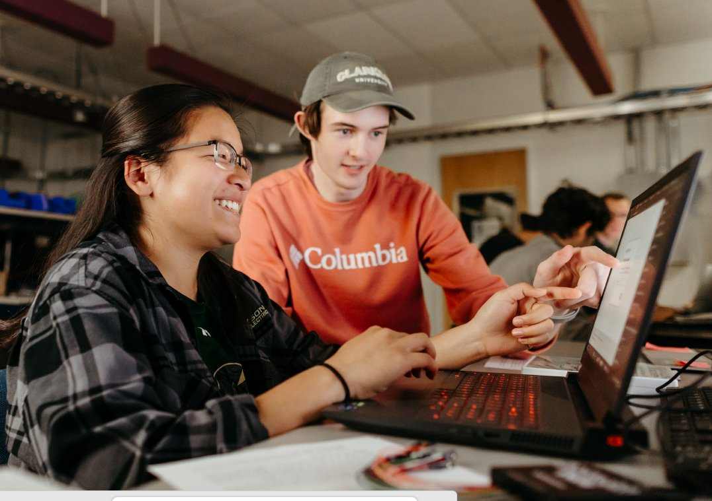
TRAIL
Responsible AI without becoming AI police
A faculty introduction to Transparent, Responsible, Auditable, Integrative Learning
Notes:
Open by acknowledging faculty skepticism. This is not a pitch that everyone should love AI. It is a practical answer to a problem we already have: students are using AI, detection is unreliable, and vague disclosure statements are too thin. TRAIL is a framework for making AI-assisted academic work visible, verifiable, and accountable without turning faculty into AI police.

Slide 2

START WITH TRUST
Why faculty are right to be frustrated
AI has made ordinary assignments feel unstable.
•
Bans are hard to enforce outside controlled settings.
•
AI detectors are unreliable and procedurally risky.
•
“Just disclose it” often tells us too little.
•
Faculty do not have time to investigate every case.
The goal is to make student work accountable.
TRAIL faculty introduction | Stephen T. Casper | 2
Cite: Casper, S. T. (2026). TRAIL: Transparent, Responsible, Auditable, Integrative Learning [PowerPoint presentations]. Clarkson University.
Notes:
Frame the problem sympathetically. Faculty objections are legitimate: AI can generate polished prose, invent citations, weaken learning, and obscure authorship. TRAIL begins by saying faculty are right to worry. But bans, detectors, and vague disclosure do not give us a workable classroom procedure.

Slide 3
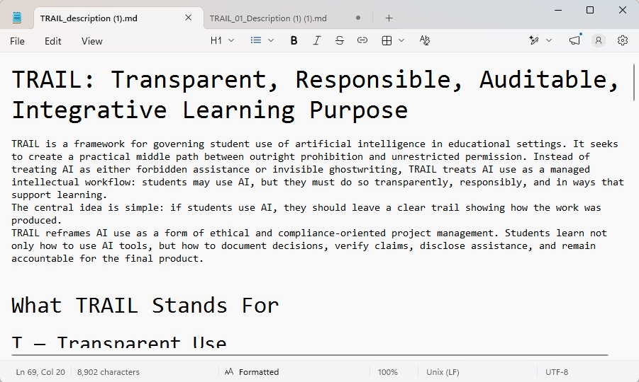
DO NOT OVERSELL IT
What the critical review concluded
“
Promising, partly novel, practical — but not a magic fix.
Credible
not proven
•
TRAIL aligns with the field’s move away from blanket bans and detectors.
•
It is best described as a distinctive synthesis, not a wholly unprecedented invention.
•
Its strongest contribution is workflow: a standard + a Lab Notebook + alignment review.
The report sharpens the claim:
TRAIL is a process standard, not a miracle cure.
•
It still needs pilot testing before institutional claims are made.
TRAIL faculty introduction | Stephen T. Casper | 3
Cite: Casper, S. T. (2026). TRAIL: Transparent, Responsible, Auditable, Integrative Learning [PowerPoint presentations]. Clarkson University.
Notes:
We should not pretend TRAIL solves everything. The review says TRAIL is credible and worth piloting, but not proved. That makes the project stronger, not weaker: the claim is disciplined. TRAIL should be tested, refined, and studied.

Slide 4

THE CORE IDEA
TRAIL in one sentence
“
If AI contributes materially to student work, the student must be able to explain how the work came into being.
TRAIL changes the question:
From “Can we prove AI wrote this?”
to “Can the student account for the work?”
TRAIL faculty introduction | Stephen T. Casper | 4
Cite: Casper, S. T. (2026). TRAIL: Transparent, Responsible, Auditable, Integrative Learning [PowerPoint presentations]. Clarkson University.
Notes:
This is the core frame. TRAIL is not an AI detector. It asks students to account for their intellectual process: what they used, what they accepted, what they changed, what they checked, and what remains their responsibility.

Slide 5
MINIMAL BURDEN
Two documents. That is the whole system.
1
Minimum Standard
2
Lab Notebook
The code of ethics: what is allowed, what is prohibited, what must be verified, and what consequences follow from false process records.
The working record: short dated entries showing AI contribution, student decisions, verification status, and next steps.
Governance standard
Process evidence
No third platform wrapper that costs $$$. No massive prompt archive. No faculty dystopia surveillance console.
TRAIL faculty introduction | Stephen T. Casper | 5
Cite: Casper, S. T. (2026). TRAIL: Transparent, Responsible, Auditable, Integrative Learning [PowerPoint presentations]. Clarkson University.
Notes:
Emphasize simplicity. Faculty do not need a new technical system. The standard is the rule book. The Lab Notebook is the process record. The two-document architecture matters because it feels normal: a code of ethics and a lab book.

Slide 6
ROUTINE WORKFLOW
What students actually do
1
2
3
4
5
Load the
standard
Work within
course rules
Paste a short
Lab Book entry
Verify what
matters
Audit only
when needed
At the end of a meaningful AI-assisted session:
“Would you like a short TRAIL Lab Book update for this session?”
The student checks accuracy, perhaps answers some questions, then copies and pastes into the lab book.
.txt or .md
TRAIL faculty introduction | Stephen T. Casper | 6
Cite: Casper, S. T. (2026). TRAIL: Transparent, Responsible, Auditable, Integrative Learning [PowerPoint presentations]. Clarkson University.
Notes:
This is meant to reassure faculty. Students are not writing a second paper about their paper. They are making short entries when AI materially affects the work. The notebook stays light, and the final audit is only for major submissions or when the instructor asks.

Slide 7
THE ANTI-CHEATING LOGIC
Why this changes incentives
Honest work
Dishonest work
Lightly document real process
Must fake a coherent history
•
real decisions
•
dates and sessions
•
real verification
•
student revisions
•
real uncertainty
•
source checks
•
real next steps
•
artifact alignment
TRAIL does not make cheating impossible.
It makes false process harder to sustain.
TRAIL faculty introduction | Stephen T. Casper | 7
Cite: Casper, S. T. (2026). TRAIL: Transparent, Responsible, Auditable, Integrative Learning [PowerPoint presentations]. Clarkson University.
Notes:
Do not overclaim. Students can still cheat. But a student trying to cheat has to fabricate not just a product but a process. The key review question becomes artifact-to-process alignment: does the submitted work plausibly match the documented history?

Slide 8
TRUST THROUGH LIMITS
What TRAIL is not
Not an AI detector
Instead, it is a process standard:
Not a surveillance system
•
disclose material AI use
•
document meaningful work sessions
Not proof that cheating cannot happen
•
verify claims that matter
•
explain and defend final work
Faculty stop asking: “Can I catch this?”
They start asking: “Can the student account for this?”
TRAIL faculty introduction | Stephen T. Casper | 8
Cite: Casper, S. T. (2026). TRAIL: Transparent, Responsible, Auditable, Integrative Learning [PowerPoint presentations]. Clarkson University.
Notes:
This slide is for skeptical faculty who fear another enforcement fad. TRAIL is not based on detector scores. It does not assume machine-facing Markdown instructions are enforceable. It creates a better evidentiary and pedagogical workflow.

Slide 9
ONE BASELINE, LOCAL RULES
Faculty keep disciplinary control
AI prohibited
AI limited
AI permitted
AI required
The institutional standard sets the floor.
The instructor sets the assignment rules.
•
A close-reading exam may prohibit AI.
•
A literature review may permit brainstorming but require source verification.
•
A coding project may permit AI but require tests, explanations, and version history.
•
A capstone may require a full TRAIL audit.
TRAIL faculty introduction | Stephen T. Casper | 9
Cite: Casper, S. T. (2026). TRAIL: Transparent, Responsible, Auditable, Integrative Learning [PowerPoint presentations]. Clarkson University.
Notes:
Faculty often fear that AI policy will flatten disciplinary judgment. TRAIL does the opposite. It gives a minimum standard, but course-specific and assignment-specific rules still govern. Faculty decide what is appropriate for the learning goal.

Slide 10
DISCIPLINARY REALISM
Where TRAIL fits — and where it may stretch
Strong fit
Use selectively
Needs adaptation
•
writing-intensive courses
•
math foundations
•
studio practice
•
social science projects
•
clinical competence
•
performance
•
labs and engineering design
•
secure exams
•
visual process boards
•
coding with version history
•
licensure-linked tasks
•
oral or rehearsal logs
The point is accountable process in the form each field recognizes.
TRAIL faculty introduction | Stephen T. Casper | 10
Cite: Casper, S. T. (2026). TRAIL: Transparent, Responsible, Auditable, Integrative Learning [PowerPoint presentations]. Clarkson University.
Notes:
Do not let the conversation get trapped in edge cases. TRAIL is broadly adaptable, but not universal in one exact form. Some contexts need secure assessment; some creative fields need visual or oral process evidence rather than a prose notebook. The principle is portable; the format can adapt.

Slide 11

NOT THE WHOLE CURRICULUM – a start on Ai Literacy.
TRAIL is the first rung of an AI skill ladder
Year 1
Integrity, documentation, verification, authorship
Year 2
Critique outputs, spot hallucinations, revise responsibly
Year 3
Disciplinary methods, privacy, data, domain norms
Year 4
Professional workflows, capstone defense, risk management
Start with accountability. Build toward professional judgment.
TRAIL faculty introduction | Stephen T. Casper | 11
Cite: Casper, S. T. (2026). TRAIL: Transparent, Responsible, Auditable, Integrative Learning [PowerPoint presentations]. Clarkson University.
Notes:
The report strongly supports TRAIL as a first-year foundation. Students need to learn what counts as AI assistance, how to verify, how to disclose, and how to remain responsible. But that is only Year 1. Later years should build toward disciplinary and professional AI fluency.

Slide 12
IMPLEMENTATION
We do not know if this will work
Pilot in selected courses
Measure what matters
•
first-year writing or seminar courses
•
student burden and clarity
•
upper-level project/capstone courses
•
faculty time cost
•
one coding or engineering design course
•
citation and claim errors
•
one discipline requiring adaptation
•
artifact-to-process alignment
•
ability to explain final work
We cannot tell you to trust the theory. We can test the strategy.
TRAIL faculty introduction | Stephen T. Casper | 12
Cite: Casper, S. T. (2026). TRAIL: Transparent, Responsible, Auditable, Integrative Learning [PowerPoint presentations]. Clarkson University.
Notes:
The review recommends a pilot, not a universal mandate. That is politically and pedagogically wise. We need to test whether TRAIL improves AI literacy, reduces unsupported claims, gives faculty usable evidence, and keeps workload reasonable.

Slide 13
WHY THIS MATTERS
The faculty promise
You do not have to like AI.
You do not have to become an AI detective.
You do need a way to ask students to account for their work.
TRAIL makes responsible process the ordinary path.
TRAIL faculty introduction | Stephen T. Casper | 13
Cite: Casper, S. T. (2026). TRAIL: Transparent, Responsible, Auditable, Integrative Learning [PowerPoint presentations]. Clarkson University.
Notes:
This is the emotional close. Faculty do not need to endorse AI culture. They need a humane, scalable way to preserve learning and accountability. TRAIL makes process visible without trying to automate judgment.

Slide 14
TAKEAWAY
Bottom line
“
TRAIL may turn AI integrity from a hidden authorship problem into a reviewable workflow problem.
•
It is credible enough to pilot.
•
It is not a detector, ban, or magic fix.
•
Its novelty is the practical synthesis: standard + Lab Notebook + alignment review.
•
It should be paired with AI literacy and assessment redesign.
TRAIL faculty introduction | Stephen T. Casper | 14
Cite: Casper, S. T. (2026). TRAIL: Transparent, Responsible, Auditable, Integrative Learning [PowerPoint presentations]. Clarkson University.
Notes:
Close with a balanced claim. TRAIL is not everything, but it is a serious starting point. It gives faculty a manageable way to ask students to document, verify, and account for AI-assisted work. It should be piloted and refined as the foundation of a broader AI skill ladder.

